Slide 1
TOBACCO CESSATION:
Behavioral Counseling and Pharmacotherapy
Notes:
This program focuses on equipping the learner with state-of-the-art knowledge and skills for assisting patients with quitting.
Tobacco use is a complex, addictive behavior. As such, helping a patient to quit requires a behavioral intervention, not simply a drug. Research shows that adding pharmacotherapy to a behavioral intervention substantially increases patients’ likelihood of quitting (Fiore et al., 2008).
Clinicians are educators who routinely interact with patients to discuss health-related issues. With the introduction of pharmaceutical products to aid cessation, clinicians’ potential role for helping patients to quit using tobacco has expanded. It is our job, as educators, to make sure that students in the health professions are equipped for this role.
Fiore MC, Jaén CR, Baker TB, et al. (2008). Treating Tobacco Use and Dependence: 2008 Update. Clinical Practice Guideline. Rockville, MD: U.S. Department of Health and Human Services. Public Health Service.

Slide 2
“CIGARETTE SMOKING…
is the chief, single, avoidable cause of death
in our society and the most important public health issue of our time.”
C. Everett Koop, M.D., former U.S. Surgeon General
All forms of tobacco are harmful.
Notes:
As the former U.S. Surgeon General C. Everett Koop noted in 1982, “Cigarette smoking is the chief, single, avoidable cause of death in our society and the most important public health issue of our time” (USDHHS, 1982). The first Surgeon General’s report on smoking was published in 1964—since this time, 29 Surgeon General’s reports have summarized the conclusive evidence from biologic, epidemiologic, behavioral, and pharmacologic studies that tobacco use is detrimental to health (USDHHS, 2010).
It is well established that smoking harms nearly every organ in the body, causing a wide range of diseases and reducing quality of life and life expectancy (USDHHS, 2004; USDHHS 2010). Approximately 100 million persons died due to tobacco use in the 20th century—which is just a fraction of the number that we anticipate losing during the 21st century. Currently, 5.4 million deaths occur annually worldwide due to tobacco (WHO, 2008). If urgent action is not taken, by 2030 we will witness more than 8 million deaths annually and more than 80% of those deaths will be in developing countries (WHO, 2008). If current trends continue, one billion persons worldwide will die during the 21st century (WHO, 2008).
While users of non-cigarette forms of tobacco (e.g., cigars, smokeless tobacco, pipes) often believe these products are safe (or safer), it’s important for clinicians to convey to their patients that all forms of tobacco are harmful. As the death toll continues to rise, public health advocates continue to work toward identifying effective ways to (1) prevent the onset of tobacco use and (2) help patients to cease use of all tobacco products.
Health care professionals can have an important public health impact by helping to counter tobacco use. However, research studies consistently demonstrate that students in the health professions receive insufficient training for providing comprehensive tobacco cessation counseling.
U.S. Department of Health and Human Services (USDHHS). (1982). The Health Consequences of Smoking: Cancer. A Report of the Surgeon General (DHHS Publication No. PHS 82-50179). Rockville, MD: Public Health Service, Office on Smoking and Health.
U.S. Department of Health and Human Services (USDHHS). (2004). The Health Consequences of Smoking: A Report of the Surgeon General. Atlanta, GA: U.S. Department of Health and Human Services, Centers for Disease Control and Prevention, National Center for Chronic Disease Prevention and Health Promotion, Office on Smoking and Health.
U.S. Department of Health and Human Services (USDHHS). (2010). How Tobacco Causes Disease: The Biology and Behavioral Basis for Smoking-Attributable Disease: A Report of the Surgeon General. Atlanta, GA: U.S. Department of Health and Human Services, Centers for Disease Control and Prevention, National Center for Chronic Disease Prevention and Health Promotion, Office on Smoking and Health.
WHO Report on the Global Tobacco Epidemic, 2008. (2008). The MPOWER package. Geneva, World Health Organization.

Slide 3

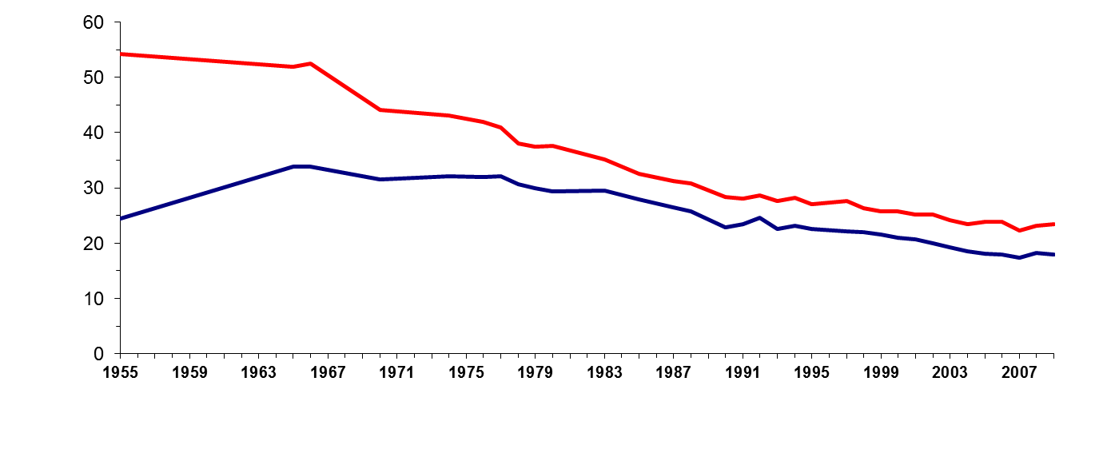
TRENDS in ADULT SMOKING, by SEX—U.S., 1955–2009
Trends in cigarette current smoking among persons aged 18 or older
20.6% of adults are current smokers
Male
Percent
Female
23.5%
17.9%
Year
70% want to quit
Graph provided by the Centers for Disease Control and Prevention. 1955 Current Population Survey; 1965–2005 NHIS. Estimates since 1992 include some-day smoking.
Notes:
This graph demonstrates trends in smoking among adults in the U.S. between 1955 and 2009 (CDC, 1999; CDC, 2010). Since 1990, the smoking prevalence among men and women has experienced only a slight decline, compared to previous decades, highlighting a need for enhanced tobacco control efforts. In 2009, results of the National Health Interview Survey (NHIS) indicated that approximately 46.6 million adults (20.6% of the U.S. adult population) were current smokers¹ (CDC, 2010); of these, 78.1% smoke every day and 21.9% smoke some days (CDC, 2010). More men (23.5%) than women (17.9%) were current smokers.
An estimated 70% of all smokers want to quit completely (CDC, 2002), and in 2008, 45.3% of current smokers reported that they stopped smoking for more than 1 day during the past 12 months because they were trying to quit (CDC, 2009). In 2008, an estimated 48.1 million adults were former smokers,² representing 51.1% of persons who had ever smoked (CDC, 2009).
♪ Note to instructor(s): Cessation statistics vary depending on factors such as the duration of follow-up, definitions of abstinence, and whether reports of cessation were biologically confirmed. According to the CDC (2002), 4.7% of smokers who had smoked every day or some days during the past year had quit and were able to maintain abstinence for 3–12 months in 2000.
¹Current smokers: persons who reported having smoked 100 or more cigarettes during their lifetime and who smoked every day or some days at the time of the assessment.
²Former smokers: persons who reported having smoked 100 or more cigarettes during their lifetime but currently did not smoke.
Centers for Disease Control and Prevention (CDC). (1999). Achievements in public health, 1900–1999: Tobacco use—United States, 1900–1999. MMWR 48:986–993.
Centers for Disease Control and Prevention (CDC). (2002). Cigarette smoking among adults—United States, 2000. MMWR 51:642–645.
Centers for Disease Control and Prevention (CDC). (2009). Cigarette smoking among adults and trends in smoking cessation—United States, 2008. MMWR 58:1227–1232.
Centers for Disease Control and Prevention (CDC). (2010). Vital signs: Cigarette smoking among adults ages ≥18 years—United States, 2009. MMWR 59:1135–1140.

Slide 4
ANNUAL U.S. DEATHS ATTRIBUTABLE to SMOKING, 2000–2004
Percent of all smoking-attributable deaths
Cardiovascular diseases | 128,497
Lung cancer | 125,522
Respiratory diseases | 103,338
Second-hand smoke | 49,400
Cancers other than lung | 35,326
Other | 1,512
29%
28%
23%
11%
8%
<1%
TOTAL: 443,595 deaths annually
Centers for Disease Control and Prevention (CDC). (2008). MMWR 57:1226–1228.
Notes:
4
Cigarette smoking is the primary known preventable cause of premature death in the U.S. (USDHHS, 2006), with nearly one of every five deaths being smoking related (Danaei et al., 2009).
Cigarette smoking is the primary known preventable cause of premature death in the U.S. Each year, nearly half a million Americans die from cigarette smoking; one of every five deaths in the U.S. is smoking related (CDC, 2008). This number surpasses the combined death toll due to alcohol, car accidents, suicides, homicides, HIV disease, and illicit drug use.
Average number of years of life lost because of smoking, for male and female smokers (CDC, 2002): males, 13.2 years; females,14.5 years
A total of 443,595 annual deaths due to cigarette smoking are reported by the CDC (2008) as follows:
Cardiovascular disease………… 128,497
Ischemic heart disease, other heart diseases, cerebrovascular diseases, atherosclerosis,
aortic aneurysm, other circulatory diseases
Lung cancer……………………… 125,522
Trachea, lung, bronchus (not including lung cancer due to second-hand smoke exposure)
Respiratory diseases……………. 103,338
Pneumonia, influenza, bronchitis, emphysema, chronic airway obstruction
Second-hand smoke…………….... 49,400
Cancers other than lung………….. 35,326
Lip, oral cavity, pharynx, esophagus, pancreas, larynx, cervix, uterus, urinary bladder, kidney, other urinary
Other…………………………………. 1,512
*Percentages on the slide do not add to 100% due to rounding.
♪ Note to instructor(s): The Surgeon General’s Report, The Health Consequences of Involuntary Exposure to Tobacco Smoke (USDHHS, 2006) indicates that in 2005, second-hand smoke killed more than 3,000 adult nonsmokers due to lung cancer, approximately 46,000 due to coronary heart disease, and 430 newborns due to sudden infant death syndrome. These data vary slightly from the numbers reported on the slide, which derive from a CDC report published in 2008.
Centers for Disease Control and Prevention (CDC). (2002) Annual smoking-attributable mortality, years of potential life lost, and economic costs—United States, 1995–1999. MMWR 51:300–303.
Centers for Disease Control and Prevention (CDC). (2008). Annual smoking-attributable mortality, years of potential life lost, and productivity losses—United States, 2000–2004. MMWR 57:1126–1128.
Danaei G, Ding EL, Mozarrarian D, Taylor B, Rehm J, Murray CJL, Ezzati M. (2009). The preventable causes of death in the United States: comparative risk assessment of dietary, lifestyle, and metabolic risk factors. PLoS Med 6(4): e1000058.
Mokdad AH, Marks JS, Stroup DF, Gerberding JL. (2004). Actual causes of death in the United States, 2000. JAMA 291:1238–1245.
U.S. Department of Health and Human Services (USDHHS). (2006). The Health Consequences of Involuntary Exposure to Tobacco Smoke: A Report of the Surgeon General. U.S. Department of Health and Human Services, Centers for Disease Control and Prevention, Coordinating Center for Health Promotion, National Center for Chronic Disease Prevention and Health Promotion, Office on Smoking and Health.

Slide 5
ANNUAL SMOKING-ATTRIBUTABLE ECONOMIC COSTS
Health-care expenditures
$96.7 billion
Lost productivity costs
$97.6 billion
Total federal-state Medicaid program costs
$30.9 billion
Total Medicare program costs
$18.9 billion
Total economic burden of smoking, per year
$194 billion
Billions of US dollars
Societal costs: $10.28 per pack of cigarettes smoked
Centers for Disease Control and Prevention (CDC). (2008). MMWR 57:1226–1228.
Notes:
The economic costs to society associated with smoking are enormous (Campaign for Tobacco-Free Kids, 2009).
Grand total annual smoking-attributable economic costs in the United States is approximately $194 billion, of which $96.7 billion are due to health care expenditures and $97.6 billion due to lost productivity costs. Overall, federal-state Medicaid programs lost $30.9 billion annually and Medicare loses $18.9 billion annually due to smoking (CDC, 2008). For each pack of cigarettes sold, the societal costs are $10.28—nearly double the average retail cost of a pack of cigarettes ($5.51) (Campaign for Tobacco-Free Kids, 2010).
Strong tobacco control programs can reduce the prevalence of smoking, save lives, and also substantially impact health-care expenditures. In California, the tobacco control program was associated with an estimated $86 billion reduction in total health costs between 1989 and 2004—a strong return on investment (Lightwood et al., 2008).
Campaign for Tobacco-Free Kids. (2009). “Public Health Benefits and Healthcare Cost Savings From the Federal Cigarette Tax Increase.” Retrieved March 3, 2011, from http://tobaccofreekids.org/research/factsheets/pdf/0314.pdf
Campaign for Tobacco-Free Kids. (2010). “State Cigarette Excise Tax Rates & Rankings.” Retrieved March 3, 2011, from http://tobaccofreekids.org/research/factsheets/pdf/0097.pdf.
Centers for Disease Control and Prevention (CDC). (2008). Smoking-attributable mortality, years of potential life lost, and productivity losses—United States, 2000–2004. MMWR 57:1226–1228.
Lightwood JM, Dinno A, Glantz SA. (2008). Effect of the California Tobacco Control Program on personal health care expenditures. PLoS Med 5(8)e178:1214–1222.

Slide 6
2004 REPORT of the
SURGEON GENERAL:
HEALTH CONSEQUENCES OF SMOKING
FOUR MAJOR CONCLUSIONS:
Smoking harms nearly every organ of the body, causing many diseases and reducing the health of smokers in general.
Quitting smoking has immediate as well as long-term benefits, reducing risks for diseases caused by smoking and improving health in general.
Smoking cigarettes with lower machine-measured yields of tar and nicotine provides no clear benefit to health.
The list of diseases caused by smoking has been expanded.
U.S. Department of Health and Human Services (USDHHS). (2004).
The Health Consequences of Smoking: A Report of the Surgeon General.
Notes:
In 2004, the Surgeon General published a comprehensive report detailing the health consequences of smoking. Four major conclusions of the report are as follows:
1. Smoking harms nearly every organ of the body, causing many diseases and reducing the health of smokers in general.
2. Quitting smoking has immediate as well as long-term benefits, reducing risks for diseases caused by smoking and improving health in general.
3. Smoking cigarettes with lower machine-measured yields of tar and nicotine provides no clear benefit to health.
4. The list of diseases (shown on next slide) caused by smoking has been expanded to include abdominal aortic aneurysm, acute myeloid leukemia, cataract, cervical cancer, kidney cancer, pancreatic cancer, pneumonia, periodontitis, and stomach cancer. These are in addition to diseases previously known to be caused by smoking, including bladder, esophageal, laryngeal, lung, oral, and throat cancers, chronic lung diseases, coronary heart and cardiovascular diseases, as well as reproductive effects and sudden infant death syndrome.
Smoking remains the leading cause of preventable death and has negative impacts on people at all stages of life. It harms unborn babies, infants, children, adolescents, adults, and seniors.
U.S. Department of Health and Human Services (USDHHS). (2004). The Health Consequences of Smoking: A Report of the Surgeon General. U.S. Department of Health and Human Services, Centers for Disease Control and Prevention, National Center for Chronic Disease Prevention and Health Promotion, Office on Smoking and Health.

Slide 7
QUITTING: HEALTH BENEFITS
Time Since Quit Date
Circulation improves,
walking becomes easier
Lung function increases up to 30%
Lung cilia regain normal function
Ability to clear lungs of mucus increases
Coughing, fatigue, shortness of breath decrease
2 weeks to
3 months
1 to 9
months
Excess risk of CHD decreases to half that of a continuing smoker
1
year
Risk of stroke is reduced to that of people who have never smoked
Lung cancer death rate drops to half that of a continuing smoker
Risk of cancer of mouth, throat, esophagus, bladder, kidney, pancreas decrease
5
years
10
years
after
15 years
Risk of CHD is similar to that of people who have never smoked
Notes:
The 1990 Surgeon General’s Report on the health benefits of smoking cessation outlines the numerous and substantial health benefits incurred when patients quit smoking (USDHHS, 1990):
Health benefits realized 2 weeks to 3 months after quitting include the following: circulation improves, walking becomes easier, and lung function increases up to 30%.
One to nine months later, lung ciliary function is restored. This improved mucociliary clearance greatly decreases the chance of infection because the lung environment is no longer as conducive to bacterial growth. Consequently, coughing, sinus congestion, fatigue, and shortness of breath decrease. In some patients, coughing might actually increase shortly after quitting. This is because the cilia in pulmonary epithelial cells are functioning “normally” and are more effectively clearing the residual tars and other accumulated components of tobacco smoke.
One year later, excess risk of coronary heart disease (CHD) is decreased to half that of a smoker.
After 5 to 15 years, stroke risk is reduced to a rate similar to that of people who have never smoked.
Ten years after quitting, an individual’s chance of dying of lung cancer is approximately half that of continuing smokers. Additionally, the chance of getting mouth, throat, esophagus, bladder, kidney, or pancreatic cancer is decreased.
Finally, 15 years after quitting, an individual’s risk of CHD is reduced to a rate similar to that of people who have never smoked.
Thus the benefits of quitting are significant. It is never too late to quit to incur many of the benefits of quitting. The next two slides depict some advantages of quitting earlier in life, as opposed to later.
U.S. Department of Health and Human Services (USDHHS). (1990). The Health Benefits of Smoking Cessation. A Report of the Surgeon General (DHHS Publication No. CDC 90-8416). U.S. Department of Health and Human Services, Public Health Service, Centers for Disease Control and Prevention and Health Promotion, Office on Smoking and Health.

Slide 8
TOBACCO DEPENDENCE:
A 2-PART PROBLEM
Tobacco Dependence
Physiological
Behavioral
The addiction to nicotine
The habit of using tobacco
Treatment
Treatment
Medications for cessation
Behavior change program
Treatment should address the physiological and the behavioral aspects of dependence.
Notes:
Tobacco dependence is a chronic condition that requires a two-prong approach for maximal treatment effectiveness (Fiore et al., 2008).
Prolonged tobacco use of tobacco results in tobacco dependence, which is characterized as a physiological dependence (addiction to nicotine) and behavioral habit of using tobacco. Addiction can be treated with FDA-approved medications for smoking cessation, and the behavioral habit can be treated through behavior change programs, such as individualized counseling and group or online cessation programs.
The Clinical Practice Guideline for treating tobacco use and dependence (Fiore et al., 2008), which summarizes more than 8,700 published articles, advocates the combination of behavioral counseling with pharmacotherapy in treating patients who smoke.
♪ Note to instructor(s): Specific methods for treating tobacco use and dependence are covered in detail in the Assisting Patients with Quitting and Aids for Cessation modules.
Fiore MC, Jaén CR, Baker TB, et al. (2008). Treating Tobacco Use and Dependence: 2008 Update. Clinical Practice Guideline. Rockville, MD: U.S. Department of Health and Human Services. Public Health Service.

Slide 9
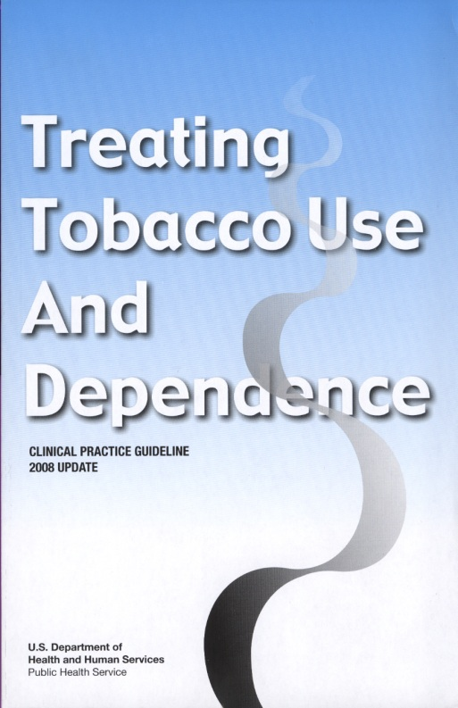
CLINICAL PRACTICE GUIDELINE for TREATING TOBACCO USE and DEPENDENCE
Update released May 2008
Sponsored by the U.S. Department of Health and Human Services, Public Heath Service with:
  Agency for Healthcare Research and Quality
  National Heart, Lung, & Blood Institute
  National Institute on Drug Abuse
  Centers for Disease Control and Prevention
  National Cancer Institute
www.surgeongeneral.gov/tobacco/
HANDOUT
Notes:
In May 2008, the U.S. Public Health Service published an updated Clinical Practice Guideline for treating tobacco use and dependence (Fiore et al., 2008). This guideline, which represents a distillation of more than 8,700 articles from the literature, reaches a consensus on strategies and recommendations designed to assist health care providers in delivering state-of-the-art interventions for tobacco cessation. Ten key recommendations, outlined in the Guideline, are provided by Rx for Change in an ancillary audience handout (see file A11 CPG REC.pdf).
The slides that follow describe feasible, practical, and effective behavioral strategies that clinicians can apply when assisting patients with quitting. These strategies derive from recommendations set forth in the Clinical Practice Guideline. The recommended strategies might not be appropriate in all circumstances, and health care providers should exercise clinical judgment based on individual patient characteristics, available resources, and any new information that becomes available such as that provided by the Food and Drug Administration (FDA) (Fiore et al., 2008).
The complete guideline, along with supportive materials, is available at www.surgeongeneral.gov/tobacco/.
♪ Note to instructor(s): The first Clinical Practice Guideline on the topic of tobacco cessation was published in 1996 (based on approximately 3,000 articles); a second Guideline was published in 2000 (based on more than 6,000 articles). The newest Guideline (May 2008; based on more than 8,700 articles) is an update of the 2006 version, in that new information and recommendations were added, but not all meta-analyses from the 2006 version were re-examined.
Fiore MC, Jaén CR, Baker TB, et al. (2008). Treating Tobacco Use and Dependence: 2008 Update. Clinical Practice Guideline. Rockville, MD: U.S. Department of Health and Human Services. Public Health Service.

Slide 10
EFFECTS of CLINICIAN INTERVENTIONS
With help from a clinician, the odds of quitting approximately doubles.
Compared to patients who receive no assistance from a clinician, patients who receive assistance are 1.7–2.2 times as likely to quit successfully for 5 or more months.
n = 29 studies
2.2
1.7
1.0
1.1
Fiore et al. (2008). Treating Tobacco Use and Dependence: 2008 Update.
Clinical Practice Guideline. Rockville, MD: USDHHS, PHS, May 2008.
Notes:
Decades of research tell us that clinicians can have an important impact on their patients’ likelihood of achieving cessation. A meta-analysis of 29 studies determined that patients who received a tobacco cessation intervention from a nonphysician clinician or a physician clinician were 1.7 and 2.2 times as likely to quit (at 5 or more months postcessation), respectively, compared with patients who did not receive such an intervention (Fiore et al., 2008; p. 88). Self-help materials were only slightly better than no clinician.
Fiore MC, Jaén CR, Baker TB, et al. (2008). Treating Tobacco Use and Dependence: 2008 Update. Clinical Practice Guideline. Rockville, MD: U.S. Department of Health and Human Services. Public Health Service.

Slide 11
WHY SHOULD CLINICIANS ADDRESS TOBACCO?
Tobacco users expect to be encouraged to quit by health professionals.
Screening for tobacco use and providing tobacco cessation counseling are positively associated with patient satisfaction (Barzilai et al., 2001).
Failure to address tobacco use tacitly implies that
quitting is not important.
Barzilai et al. (2001). Prev Med 33:595–599.
Notes:
Tobacco users expect to be encouraged to quit by health professionals. In a study examining whether health habit counseling affects patient satisfaction, Barzilai et al. (2001) determined that of 12 health habits examined (exercise, diet, alcohol history, alcohol counseling, tobacco history, tobacco counseling, passive tobacco exposure, dscontraception and condom use, substance use history, substance use counseling, STD prevention, and counseling about HIV testing or prevention), only tobacco history and tobacco counseling were significantly associated with full satisfaction with the clinician visit.
A clinician who does not address tobacco use during a clinical encounter tacitly implies that quitting is not important.
Barzilai DA, Goodwin MA, Zyzanski SJ, Stange KC. (2001). Does health habit counseling affect patient satisfaction? Prev Med 33:595–599.

Slide 12
The 5 A’s
ASK
ADVISE
ASSESS
ASSIST
ARRANGE
HANDOUT
Fiore et al. (2008). Treating Tobacco Use and Dependence: 2008 Update.
Clinical Practice Guideline. Rockville, MD: USDHHS, PHS, May 2008.
Notes:
The Clinical Practice Guideline (Fiore et al., 2008) delineates five key components for tobacco cessation interventions. These components, referred to as the 5 A’s, offer a practical method for implementing tobacco counseling in clinical practice. The 5 A’s are as follows:
Ask – systematically identify all tobacco users at every visit
Advise – strongly urge all tobacco users to quit
Assess – determine willingness to make a quit attempt
Assist – aid the patient in quitting (provide counseling and medication)
Arrange – ensure follow-up care
♪ Note to instructor(s): The 5 A’s presented in the guideline are a modified form of the National Cancer Institute’s original 5 A’s (Anticipate [tobacco use], Ask, Advise, Assist, and Arrange; Frankowski & Secker-Walker, 1994; Glynn & Manley, 1990).
♪ Note to instructor(s): Throughout this module, ask audience to refer to their Tobacco Cessation Counseling Guidesheet (ancillary handout A1 GUIDE.pdf). The slides in this module are designed to parallel the guidesheet.
Fiore MC, Jaén CR, Baker TB, et al. (2008). Treating Tobacco Use and Dependence: 2008 Update. Clinical Practice Guideline. Rockville, MD: U.S. Department of Health and Human Services. Public Health Service.
Frankowski BL, Secker-Walker RH. (1994). Pediatricians’ Role in Smoking Prevention and Cessation (Smoking and Tobacco Control Monograph No. 5; NIH Publication No. 94-3693). Bethesda, MD: U.S. Department of Health and Human Services, Public Health Service, National Institutes of Health, National Cancer Institute.
Glynn TJ, Manley MW. (1990). How to Help Your Patients Stop Smoking: A National Cancer Institute Manual for Physicians (NIH Publication No. 90-3064). Bethesda, MD: U.S. Department of Health and Human Services, Public Health Service, National Institutes of Health, National Cancer Institute.

Slide 13
The 5 A’s (cont’d)
ASK
Ask about tobacco use
  “Do you ever smoke or use any type of tobacco?”
    “I take time to ask all of my patients about tobacco use—because it’s important.”
  “Condition X often is caused or worsened by smoking. Do you, or does someone in your household smoke?”
  “Medication X often is used for conditions linked with or caused by smoking. Do you, or does someone in your household smoke?”
Notes:
Ask. Tobacco use can induce early onset of disease and exacerbate existing medical conditions, and tobacco smoke has the potential to interact with many medications, altering both drug levels and efficacy. It is appropriate, if not essential, for clinicians to assess and document each patient’s tobacco use status, preferably at each visit. Asking about tobacco use should be considered to be as important as evaluating vital signs during a routine medical screening, and when obtaining a medication history, clinicians should ask about tobacco in the same way that they would ask about any other drug. Clinicians also should consider including a query about tobacco use on the new patient profile form. At a minimum, the form should assess tobacco use status (i.e., current, former, never).
Appropriate language for assessing tobacco use status would be: “Do you ever smoke or use any type of tobacco?” This question will capture not only cigarette smoking but all forms of tobacco use. The query also can be linked to the clinician’s knowledge of a patient’s disease status or medication profile. For example:
“Condition X often is caused or worsened by smoking. Do you, or does someone in your household smoke?”
or
“Medication X often is used for conditions linked with or caused by smoking. Do you, or does someone in your household smoke?”
When clinicians ask about tobacco use, it is important that they take a genuine and sensitive approach, conveying concern for their patients’ well-being. A judgmental tone likely will not result in accurate disclosure of tobacco use. In an effort to promote autonomy with a patient, consider asking for permission to ask questions: “May I ask you a few questions?,” before launching a series of inquiries.

Slide 14
The 5 A’s (cont’d)
ADVISE
tobacco users to quit (clear, strong, personalized)
  “It’s important that you quit as soon as possible, and I can help you.”
  “Cutting down while you are ill is not enough.”
  “Occasional or light smoking is still harmful.”
  “I realize that quitting is difficult. It is the most important thing you can do to protect your health now and in the future. I have training to help my patients quit, and when you are ready, I will work with you to design a specialized treatment plan.”
Notes:
Advise. It is the clinician’s responsibility to assist patients in improving their health. Patients who use tobacco should be strongly advised to quit. At the very least, these patients should be advised to consider quitting. The message should be clear and strong, yet personalized and sensitive. The message must be delivered without judgment—or the clinician will likely waste that “teachable moment” and potentially alienate his or her patient. Tone and manner should convey a concern for the patient’s well-being as well as a commitment to help him or her quit—when the patient is ready.
Consider the following statements (Fiore et al., 2008):
“It’s important that you quit as soon as possible, and I can help you.”
“Cutting down while you are ill is not enough.”
“Occasional or light smoking is still harmful.”
“I realize that quitting is difficult. It is the most important thing you can do to protect your health now and in the future. I have training to help my patients quit, and when you are ready, I will work with you to design a specialized treatment plan.”
The clinician can personalize the message by tying tobacco use to current health or illness; its social and economic costs; the patient’s motivation level and readiness to quit; or the impact of tobacco use on children, others in the household and in their environment, and pets. For example:
“If you continue to smoke, your [disease] will worsen/fail to improve.”
Using a genuine and sensitive approach that acknowledges the difficulty of what is being requested, the clinician is more likely to move the patient forward in the process of preparing to quit.
Fiore MC, Jaén CR, Baker TB, et al. (2008). Treating Tobacco Use and Dependence: 2008 Update. Clinical Practice Guideline. Rockville, MD: U.S. Department of Health and Human Services. Public Health Service.

Slide 15
The 5 A’s (cont’d)
ASSESS
Assess readiness to make a quit attempt
Assist with the quit attempt
  Not ready to quit: provide motivation (the 5 R’s)
  Ready to quit: design a treatment plan
  Recently quit: relapse prevention
ASSIST
Notes:
Assess. After the clinician advises the patient to quit, the next step is to assess the patient’s readiness, or willingness, to try to quit. Is the patient considering quitting in the next month? Or did he or she quit recently?
Assist. The patient’s readiness to try to quit will define the next course of action, which is delivering an intervention tailored to his or her needs. By being a good listener and gathering appropriate information, the clinician can tailor the interventions effectively. A patient who is not ready to quit will receive a very different type of intervention than will one who is ready to quit in the upcoming weeks. For the patient who is not ready to quit, clinicians should apply the 5 R’s (to be discussed later).
If the patient is ready to quit (i.e., in the next 30 days), a treatment plan should be designed. Ideally, this should include including counseling and pharmacotherapy (if appropriate). The clinician could suggest that the patient enroll in a structured tobacco cessation program to increase the likelihood of quitting—this is particularly important for persons who are at high risk of relapse or for patients who are highly dependent, refractory smokers (i.e., having made multiple serious quit attempts). Other patient populations that might be particularly well suited for structured programs include adolescent smokers, pregnant smokers, and patients with coexisting psychiatric conditions.
A patient who recently quit (i.e., in the past 6 months) will need continued support and encouragement, and reminders regarding the need to abstain from all tobacco use—even a puff. A patient who has been off of tobacco for more than 6 months typically is relatively stable but often needs to be reminded to remain vigilant for potential triggers for relapse.

Slide 16
The 5 A’s (cont’d)
Arrange follow-up care
ARRANGE
Number of sessions | Estimated quit rate*
0 to 1 | 12.4%
2 to 3 | 16.3%
4 to 8 | 20.9%
More than 8 | 24.7%
* 5 months (or more) postcessation
Provide assistance throughout the quit attempt.
Fiore et al. (2008). Treating Tobacco Use and Dependence: 2008 Update.
Clinical Practice Guideline. Rockville, MD: USDHHS, PHS, May 2008.
Notes:
Arrange. The clinician should make certain to arrange for follow-up care and patient monitoring. With each contact, it is important to document the counseling session. These records can provide a starting point for subsequent discussions. Follow-up visits can be arranged in several ways. For example, the clinician can do the following:
“Check in” with the patient when he or she next returns.
Schedule specific follow-up visits to discuss tobacco cessation.
Invite the patient to enroll in a tobacco cessation group with which the clinician is affiliated, or provide a referral to the tobacco quitline (1-800-QUIT NOW).
With prior approval, call the patient at home to see how he or she is progressing. (If a message is left, the clinician should not indicate that he or she is calling regarding a quit attempt—this might be private information that the patient does not want others to hear. Be sure to comply with HIPAA regulations.)
Document key dates (e.g., quit dates, tobacco-free anniversaries); acknowledge important milestones.
The best approach for spacing the counseling sessions (i.e., the number of days or weeks over which treatment is spread) is not known (Fiore et al., 2008), but in general follow-up contact should be scheduled within the first week after the quit date. The next follow-up is recommended within the first month. Further follow-up contact should be scheduled as needed or indicated. During the follow-up contacts, the patient should be congratulated for success. If tobacco use has occurred, the circumstances should be reviewed and a commitment sought to return to total abstinence. The patient should be reminded that lapses (slips) occur as part of the normal learning process and should be viewed as such. Pharmacotherapy use should be assessed, including compliance and side effects experienced. When appropriate, referral to more intensive treatment should be considered.
According to the Clinical Practice Guideline, multiple patient contacts are associated with higher quit rates (Fiore et al., 2008; p. 86). The estimated abstinence rates, based on number of treatment sessions (i.e., counseling contact sessions) are presented in this slide. Even brief interventions (1–3 minutes) can increase patients’ odds of quitting (odds ratio, 1.4; 95% CI, 1.1–1.8), increasing abstinence rates from 11.0% with no counseling to 14.4% with counseling. More intensive interventions (greater length of session, greater total amount of contact time, and greater number of sessions), however, are clearly associated with a higher odds of quitting (Fiore et al., 2008; pp. 83–86). Yet in the absence of time or expertise, clinicians should, at a minimum ask patients about tobacco use, advise them to quit, and provide information about other resources for quitting, such as the tobacco quitline (1-800-QUIT NOW) or local programs.
Fiore MC, Jaén CR, Baker TB, et al. (2008). Treating Tobacco Use and Dependence: 2008 Update. Clinical Practice Guideline. Rockville, MD: U.S. Department of Health and Human Services. Public Health Service.

Slide 17
The 5 A’s: REVIEW
ASK
about tobacco USE
ADVISE
tobacco users to QUIT
ASSESS
READINESS to make a quit attempt
ASSIST
with the QUIT ATTEMPT
ARRANGE
FOLLOW-UP care
Notes:
As a final review, the 5 A’s are as follows (Fiore et al., 2008):
Ask about tobacco use; systematically identify all tobacco users at every visit
Advise tobacco users to quit
Assess readiness, or willingness to make a quit attempt
Assist with the quit attempt (provide counseling and medication)
Arrange follow-up care
Each of these is a key component of comprehensive tobacco cessation counseling interventions.
Fiore MC, Jaén CR, Baker TB, et al. (2008). Treating Tobacco Use and Dependence: 2008 Update. Clinical Practice Guideline. Rockville, MD: U.S. Department of Health and Human Services. Public Health Service.

Slide 18
The (DIFFICULT) DECISION to QUIT
Faced with change, most people are not ready to act.
Change is a process, not a single step.
Typically, it takes multiple attempts.
HOW CAN I LIVE WITHOUT TOBACCO?
Notes:
Historically, clinicians have been trained to provide action-oriented, “just do it” counseling interventions. It’s important to recognize that not all patients have the same level of commitment, or readiness, to take action. When faced with change, most people (about 70%) are not ready to act (Prochaska et al., 1992).
Patients at different stages of readiness to quit require different kinds of interventions. Counseling should be tailored to patients’ readiness to quit (often referred to as their “stage of change”). This is particularly important when counseling through various steps of tobacco cessation. Consider the following:
Some patients are determined smokers…they might never quit!
Some might know that they need to quit but have tried and failed so many times that they have no confidence in their ability to quit.
Some are considering quitting but might not have gathered the courage or information necessary to make a serious quit attempt.
Some will be ready to set a quit date.
Others might have stopped recently but remain highly vulnerable to relapse.
And some will have been smoke-free for at least 6 months yet remain at risk for relapse.
In most cases, behavior change is a process, not a single step. The process ranges from not thinking about making a change to successful implementation of a behavioral change over a sustained period of time. Typically, it takes multiple attempts before success is achieved.
Prochaska JO, DiClemente CC, Norcross JC. (1992). In search of how people change: Applications to addictive behaviors. Am Psychol 47:1102–1114.

Slide 19
HELPING PATIENTS QUIT IS a CLINICIAN’S RESPONSIBILITY
TOBACCO USERS DON’T PLAN TO FAIL.
MOST FAIL TO PLAN.
Clinicians have a professional obligation
to address tobacco use and can have
an important role in helping patients
plan for their quit attempts.
THE DECISION TO QUIT LIES
IN THE HANDS OF EACH PATIENT.
Notes:
Tobacco users don’t plan to fail in their quit attempts. But most fail to plan.
Health care providers have a professional obligation to help patients improve their health. This includes addressing tobacco use and helping patients to quit. Clinicians serve as facilitators in the process, calling attention to the need to quit, advising patients to quit, assisting with the quit attempt, and monitoring patient progress over time.
For current tobacco users, the goal is to move tobacco users forward in their decision to quit. However, the decision to quit ultimately lies in the hands of the patient.

Slide 20
ASSESSING
READINESS to QUIT
Patients differ in their readiness to quit.
STAGE 1: Not ready to quit in the next month
STAGE 2: Ready to quit in the next month
STAGE 3: Recent quitter, quit within past 6 months
STAGE 4: Former tobacco user, quit > 6 months ago
Assessing a patient’s readiness to quit enables clinicians to deliver relevant, appropriate counseling messages.
Notes:
Prior to providing assistance with tobacco cessation, it is helpful to assess each patient’s readiness to quit (Fiore et al., 2008). Patients can be categorized into four discrete categories:
Stage 1: Not ready to quit in the next month
Stage 2: Ready to quit in the next month
Stage 3: Recent quitter, quit with the past 6 months
Stage 4: Former tobacco user, quit more than 6 months ago
Assessing a patient’s readiness to quit enables clinicians to deliver relevant, appropriate counseling messages.
Fiore MC, Jaén CR, Baker TB, et al. (2008). Treating Tobacco Use and Dependence: 2008 Update. Clinical Practice Guideline. Rockville, MD: U.S. Department of Health and Human Services. Public Health Service.

Slide 21
ASSESSING
READINESS to QUIT (cont’d)
For most patients, quitting is a cyclical process, and their readiness to quit (or stay quit) will change over time.
Former tobacco user
Not thinking about it
Not ready to quit
Relapse
Recent quitter
Thinking about it, not ready
Assess readiness to quit (or to stay quit) at each patient contact.
Ready to quit
Notes:
This diagram emphasizes that behavior change is a process. Over time, patients often cycle into and out of the different stages. They might quit for a while, then return to tobacco use before they quit again for good. This movement between the stages is normal and is to be expected, particularly for an addictive behavior that patients know they need to stop but might not have the time, energy, or will to stop at the present time. For this reason, it is important to determine the patient’s readiness to commit to quitting at each contact.
Do not assume that patients who inquire about quitting are ready to quit. Commonly, they are just thinking about it and gathering information. Similarly, do not assume that a patient who asks for a prescription for bupropion, varenicline, or nicotine replacement therapy or who presents at a pharmacy to purchase these medications is ready to quit. Learning about the different stages of readiness to quit will help clinicians gain a better understanding of why it is important to think of behavior change as a process, not an event. For most people, the process of quitting is characterized by a series of quit attempts and subsequent relapses—on average, former smokers report 10.8 quit attempts over a period of 18.6 years before quitting for good (Hazelden Foundation, 1998).
Hazelden Foundation. (1998). Survey on current and former smokers—1998. Center City, MN: Hazelden Foundation.

Slide 22
IS a PATIENT READY to QUIT?
Does the patient now use tobacco?
Yes
No
Is the patient now ready to quit?
Did the patient once use tobacco?
No
Yes
Yes
No
Enhance motivation
Provide treatment
The 5 A’s
Prevent relapse*
Encourage continued abstinence
*Relapse prevention interventions not necessary if patient has not used tobacco for many years and is not at risk for re-initiation.
Fiore et al. (2008). Treating Tobacco Use and Dependence: 2008 Update.
Clinical Practice Guideline. Rockville, MD: USDHHS, PHS, May 2008.
Notes:
This flow chart, which is presented in the Clinical Practice Guideline (Fiore et al., 2008), describes how to determine a patient’s readiness to quit and the general types of interventions that should be applied. Treatment for patients who are ready to quit should include all five of the key counseling components (the 5 A’s).
Fiore MC, Jaén CR, Baker TB, et al. (2008). Treating Tobacco Use and Dependence: 2008 Update. Clinical Practice Guideline. Rockville, MD: U.S. Department of Health and Human Services. Public Health Service.

Slide 23
ASSESSING
READINESS to QUIT (cont’d)
STAGE 1: Not ready to quit
Not thinking about quitting in the next month
  Some patients are aware of the need to quit.
  Patients struggle with ambivalence about change.
  Patients are not ready to change, yet.
  Pros of continued tobacco use outweigh the cons.
GOAL: Start thinking about quitting.
Notes:
Most patients who use tobacco will not be ready to quit in the immediate future. These patients generally fall into one of two categories:
Those who are not aware of any need to change—the problem is not yet on their “radar screen.”
Those who are unwilling or unable to change—commonly because they are defensive about their negative health behavior or because they are too discouraged to change (perhaps because of prior failed attempts).
Health care providers commonly label patients in this stage as difficult or unmotivated. Many of these patients simply are not ready. They struggle with ambivalence and see the pros (positive effects) of tobacco use as being more important than the cons (negative effects).
The goal of interventions at this stage is to encourage patients to start thinking about quitting.

Slide 24
STAGE 1: NOT READY to QUIT
Counseling Strategies
DO
Strongly advise to quit
Provide information
Ask noninvasive questions; identify reasons for tobacco use
Raise awareness of health consequences/concerns
Demonstrate empathy, foster communication
Leave decision up to patient
DON’T
Persuade
“Cheerlead”
Tell patient how bad tobacco is, in a judgmental manner
Provide a treatment plan
Notes:
When counseling a patient who is not ready to quit, it is important to demonstrate understanding and empathy, to foster ongoing communication, and to ask questions noninvasively. Instead of pressuring the patient for an immediate behavioral shift, request the patient’s permission to ask questions and discuss the issue of tobacco use prior to imparting advice. For example, a clinician might say, “May I tell you why your smoking concerns me?”
Messages that either emphasize the cons of tobacco use or deemphasize the pros of tobacco use help move the patient forward in the process of change. It is useful to tailor messages based on the patient’s health history, such as highlighting how tobacco use can induce early onset of particular diseases for which the patient may be at risk, or how it can exacerbate existing conditions. An approach that might be effective with parents is discussing how smoking can negatively affect their children’s health and increase the likelihood that their children will grow up to be smokers. Clinicians should encourage patients to quit while emphasizing that the decision to quit, or not to quit, is theirs.
♪ Note to instructor(s): One technique to gauge a patient’s level of resistance to quitting is to ask, “If I were to give you an envelope, what would the message inside need to say for you to consider quitting?” If the patient says, “There is nothing that you could write that would make me consider quitting,” then there is little that you can do at this point, except to (1) stress the importance of quitting for the patient’s health, (2) ask that the patient not rule out the possibility of quitting, and (3) offer to assist the patient with quitting, should the patient change his or her mind.
Aggressive efforts to persuade the patient into making a change are not advisable during this stage. Likewise, high-spirited “cheerleading” may only heighten the patient’s resistance. It is not yet time to provide a treatment plan, although it might be useful to inform patients of the various options available.
Offer assistance. Make it clear that it is an ongoing, standing offer, which the patient can accept whenever he or she is ready.

Slide 25
STAGE 1: NOT READY to QUIT
Counseling Strategies (cont’d)
Consider asking:
“Do you ever plan to quit?”
“What might be some of the benefits of quitting now, instead of later?”
“What would have to change for you to decide to quit sooner?”
Advise patients to quit, and offer to assist (if or when they change their mind).
If NO
If YES
Most patients will agree: there is no “good” time to quit, and there are benefits to quitting sooner as opposed to later.
Responses will reveal some of the barriers to quitting.
Notes:
For patients who are not ready to quit, encourage them to seriously consider quitting by asking the following series of three questions:
1. Do you ever plan to quit?
Most patients will respond “yes,” in which case the clinician should continue with question #2. If they respond “no,” the clinician should strongly advise the patient to quit and offer to assist, should the patient change his mind.
2. What might be some of the benefits of quitting now, instead of later?
The longer a patient smokes, quitting generally becomes more difficult. Most patients will agree that there is never an ideal time to quit, and procrastinating a quit date has more negative effects than positive.
3. What would have to change for you to decide to quit sooner?
This question probes patients’ perceptions of quitting, which reveals some of the barriers to quitting that can then be discussed.

Slide 26
STAGE 1: NOT READY to QUIT
Counseling Strategies (cont’d)
The 5 R’s—Methods for enhancing motivation:
  Relevance
  Risks
  Rewards
  Roadblocks
  Repetition
Tailored, motivational messages
Fiore et al. (2008). Treating Tobacco Use and Dependence: 2008 Update.
Clinical Practice Guideline. Rockville, MD: USDHHS, PHS, May 2008.
Notes:
For patients who are not ready to quit, clinicians can deliver tailored, motivational messages by applying the 5 R’s:
Relevance: Encourage the patient to indicate why quitting is personally relevant. Be as specific as possible. Motivational information has the most impact if it is relevant to the patient’s disease status or risk, family or social situation (e.g., having children in the home), health concerns, age, sex, and other important patient characteristics (e.g., prior quitting experience, personal barriers to cessation).
Risks: Ask the patient to identify consequences of tobacco use. Suggest and highlight those that seem most relevant to the patient and emphasize that other forms of tobacco (such as smokeless, or light cigarettes) will not eliminate the risks. Risks of tobacco use are discussed in the Epidemiology of Tobacco Use and Pathophysiology of Tobacco-Related Disease modules.
Rewards: Ask the patient to identify benefits of quitting. Highlight those that seem relevant to the patient. Examples of benefits of cessation are discussed in the Epidemiology of Tobacco Use module.
Roadblocks: Ask the patient to identify barriers to quitting and potential methods for circumventing each barrier. Suggest and highlight those that seem most relevant to the patient. Common barriers include withdrawal symptoms, fear of failure, weight gain, lack of support, depression, and enjoyment of tobacco.
Repetition: Repeat the motivational intervention whenever possible. Tobacco users who have failed in previous quit attempts should be reminded that most people make repeated quit attempts before they are successful.
Fiore MC, Jaén CR, Baker TB, et al. (2008). Treating Tobacco Use and Dependence: 2008 Update. Clinical Practice Guideline. Rockville, MD: U.S. Department of Health and Human Services. Public Health Service.

Slide 27
STAGE 1: NOT READY to QUIT
A Demonstration
CASE SCENARIO:
Ms. Lilly Vitale
You are a clinician providing care to Ms. Vitale, a young woman with early-stage emphysema.
VIDEO # V6a
Notes:
♪ Note to instructor(s): This video is a pharmacy-based counseling session, but similar strategies should be used, regardless of clinician type or setting. To access the video file, go to http://rxforchange.ucsf.edu. Under the “5 A’s Curriculum,” click “Video Segments” and locate video V6a in the table. Other videos are available for download from this webpage and might be more appropriate for your audience. Edit this slide as needed to incorporate other videos.
After showing the video, debrief with your audience. The clinician has provided an appropriate intervention for a patient who is not ready to quit at this time. The goal was to try to plant a seed to get the patient thinking about quitting, to move the patient forward in the process of change. And, in doing so, the clinician has fostered communication and a relationship with one of her patients. Note that this brief intervention required very little time (2 minutes).

Slide 28
ASSESSING
READINESS to QUIT (cont’d)
STAGE 2: Ready to quit
Ready to quit in the next month
  Patients are aware of the need to, and the benefits of, making the behavioral change.
  Patients are getting ready to take action.
GOAL: Achieve cessation.
Notes:
At the second stage in the continuum of change, patients are ready to quit in the very near future (likely in the next month). These patients recognize the need to change and the benefits to be had by quitting. They are getting ready to quit. Often, they might have made a quit attempt in the past year.
The goal is to assist these patients in achieving cessation.

Slide 29
STAGE 2: READY to QUIT
Three Key Elements of Counseling
Assess tobacco use history
Discuss key issues
Facilitate quitting process
  Practical counseling (problem solving/skills training)
  Social support delivered as part of treatment
Notes:
Three key elements of tobacco cessation counseling:
Assess tobacco use history
Discuss key issues
Facilitate the quitting process, including practical counseling (problem solving/skills training) and social support delivered as part of treatment (Fiore et al., 2008)
Assessing tobacco use history and discussing key issues are important information-gathering steps of counseling. Clinicians must develop an understanding of their patients’ unique history and perspective on tobacco use before facilitating the quitting process.
♪ Note to instructor(s): These three elements parallel those presented on the Tobacco Cessation Counseling Guidesheet (ancillary handout A1 GUIDE.pdf).
Fiore MC, Jaén CR, Baker TB, et al. (2008). Treating Tobacco Use and Dependence: 2008 Update. Clinical Practice Guideline. Rockville, MD: U.S. Department of Health and Human Services. Public Health Service.

Slide 30
STAGE 2: READY to QUIT
Assess Tobacco Use History
Praise the patient’s readiness
Assess tobacco use history
  Current use: type(s) of tobacco, amount
  Past use: duration, recent changes
  Past quit attempts:
    Number, date, length
    Methods used, compliance, duration
    Reasons for relapse
Notes:
This stage represents a window of opportunity for helping a patient make a quit attempt.
Clinicians should do the following prior to making treatment recommendations:
Praise the patient’s readiness to quit.
Assess tobacco use history, including current use, past use, and history of quit attempts:
Current use of tobacco: What types of tobacco are used? How much?
Past use of tobacco: How long has the patient been using tobacco? Has the patient changed his or her level of tobacco use recently?
Past quit attempts: How many quit attempts has the patient made, how long was he or she off of tobacco, and when was the last quit attempt? What methods were used? What worked? What didn’t work? If medications were used, how were they used? What factors contributed to relapse (e.g., medication noncompliance, situational factors)? Identifying reasons for relapse can provide important information for an upcoming quit attempt.

Slide 31
STAGE 2: READY to QUIT
Discuss Key Issues
Reasons/motivation to quit
Confidence in ability to quit
Triggers for tobacco use
  What situations lead to temptations to use tobacco?
  What led to relapse in the past?
Routines/situations associated with tobacco use
When drinking coffee
While driving in the car
When bored or stressed
While watching television
While at a bar with friends
After meals or after sex
During breaks at work
While on the telephone
While with specific friends or family members who use tobacco
Notes:
Key issues to address include the following:
Discuss reasons and motivations for wanting to quit. Ask the patient to think about why it is important, to him or her, to adopt a tobacco-free lifestyle. What are the patient’s motivations for wanting to quit? Discuss whether the patient has concerns about the effects of second-hand smoke on others.
How confident is the patient in his or her ability to quit? Ideally, the patient will be highly confident, but many will lack confidence because of previously failed attempts. By providing additional support and working with the patient in designing the treatment plan, a clinician can infuse confidence into the patient. It will be “different,” this time, because the patient will be more prepared.
Discuss specific triggers for tobacco use. Triggers might include negative affect, being around other smokers, meal times, alcohol or coffee consumption, cravings for tobacco, time pressures, or other situations such as celebrating with others. Triggers should be identified prior to quitting, while the patient is still smoking “normally.” Encourage patients to think about the times and places where they smoke or use tobacco, each time they do so. This provides important insight into a person’s tobacco use behavior, including the circumstances that underlie the need or desire for tobacco. Having a clear understanding of the behavior will help a person to be more effective when attempting to change it.
Determine whether there are certain routines or situations that the patient associates with tobacco use (e.g., when drinking coffee, while driving in the car, while bored or stressed, while watching television, while at a bar with friends, after meals or after sex, during breaks at work, while on the telephone, or while with specific friends or family members who smoke).

Slide 32
STAGE 2: READY to QUIT
Discuss Key Issues (cont’d)
Stress-Related Tobacco Use
THE MYTHS
THE FACTS
“Smoking gets rid of all my stress.”
“I can’t relax without a cigarette.”
There will always be stress in one’s life.
There are many ways to relax without a cigarette.
Smokers confuse the relief of withdrawal with the feeling of relaxation.
STRESS MANAGEMENT SUGGESTIONS:
Deep breathing, shifting focus, taking a break.
Notes:
Stress is often cited as the primary reason for smoking. What types of triggers or situations invoke stress-related tobacco use?
This slide presents the myths versus the facts. Smokers often confuse the relief of their nicotine withdrawal with the feeling of relaxation. The goal is to help patients to realize that tobacco is the problem, not the solution.
♪ Note to instructor(s): Video V25b depicts a discussion between a clinician and a patient about stress-related smoking.

Slide 33
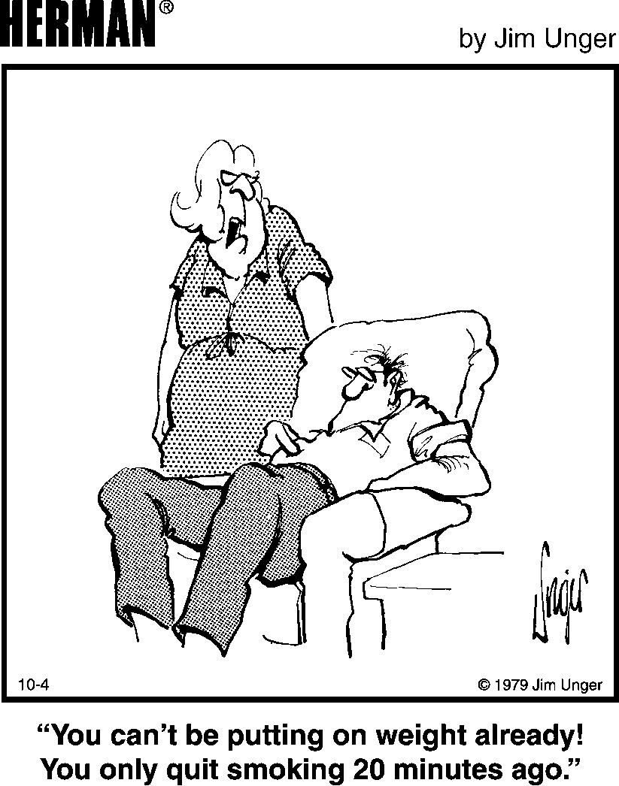
HERMAN ® is reprinted with permission from
LaughingStock Licensing Inc., Ottawa, Canada
All rights reserved.
Most smokers gain fewer than 10 pounds,
but there is a wide range.
Notes:
Postcessation weight gain is an important consequence of tobacco cessation that often is also a barrier to quitting. Most tobacco users will gain weight after quitting, and clinicians should neither deny the likelihood of weight gain nor minimize its significance (Fiore et al., 2008). For nearly all patients, the health risks associated with post-cessation weight gain are negligible compared to the risks of continued smoking.
Studies suggest that most quitters will gain fewer than 10 pounds, but a broad range of weight gains have been reported, with up to 10% of quitters gaining as much as 30 pounds (Fiore et al., 2008). For men and women, subgroups that are more likely to gain significant weight after quitting are African Americans, younger tobacco users (<55 years of age), and heavier tobacco users (those smoking more than 25 cigarettes per day) (Fiore et al., 2008).
The weight-suppressing effects of tobacco are well known. However, the mechanisms to explain why most successful quitters gain weight are not completely understood. Smokers have been found to have an approximately 10% higher metabolic rate compared with nonsmokers (Perkins, 1992). Higher caloric intakes have been documented after cessation (Hatsukami et al., 1993), and it has been speculated that the increased caloric intake might be caused either by an increase in appetite or by quitters eating more because the taste buds have become more receptive after cessation and foods taste better (Hamilton et al., 1992).
Fiore MC, Jaén CR, Baker TB, et al. (2008). Treating Tobacco Use and Dependence: 2008 Update. Clinical Practice Guideline. Rockville, MD: U.S. Department of Health and Human Services. Public Health Service.
Hamilton E, Whitney E, Sizer F. (1992). Nutrition: Concepts and Controversies, 6th ed. St. Paul: West Publishing.
Hatsukami D, LaBounty L, Hughes J, Laine D. (1993). Effects of tobacco abstinence on food intake among cigarette smokers. Health Psychol 12:499–502.
Perkins KA. (1992). Metabolic effects of cigarette smoking. J Appl Physiol 72:401–409.

Slide 34
STAGE 2: READY to QUIT
Discuss Key Issues (cont’d)
Concerns about Weight Gain
Discourage strict dieting while quitting
  Encourage healthful diet and meal planning
  Suggest increasing water intake or chewing sugarless gum
  Recommend selection of nonfood rewards
When fear of weight gain is a barrier to quitting
  Consider pharmacotherapy with evidence of delaying weight gain (bupropion SR or 4-mg nicotine gum or lozenge)
  Assist patient with weight maintenance or refer patient to specialist or program
Notes:
Many patients will be concerned about weight gain after quitting; these patients should be discouraged from strict dieting while quitting (Fiore et al., 2008). Patients should carefully plan and prepare meals to avoid binge eating, increase fruit and water intake to create a feeling of fullness, and chew sugarless gum or eat sugarless candies. Advise patients to select nonfood rewards.
For patients who are greatly concerned about weight gain, it may be most appropriate to recommend bupropion SR or nicotine gum or lozenge (4-mg strength), as these have been shown to delay weight gain after quitting (Fiore et al., 2008). Once the medications are terminated, however, the average patient will gain approximately the same amount of weight as those patients who did not use these medications. Patients also can be referred to a dietary specialist or weight maintenance program. In general, exercise programs have not been shown to reduce weight gain among quitters (Parsons et al., 2009).
♪ Note to instructor(s): Research studies have shown that patients who attempt to modify their diet at the same time as quitting smoking are less likely to succeed in smoking cessation than are patients who just try to quit smoking. We recommend that clinicians advise most of their patients to quit smoking first, then work on issues of weight gain. The average gain of less than 10 pounds is less detrimental to one’s health than is smoking, but it is not prudent for clinicians to overlook patients’ concerns about weight gain. If concern about weight gain is a key barrier to quitting, it should be addressed simultaneously with quitting.
Fiore MC, Jaén CR, Baker TB, et al. (2008). Treating Tobacco Use and Dependence: 2008 Update. Clinical Practice Guideline. Rockville, MD: U.S. Department of Health and Human Services. Public Health Service.
Parsons A, Shraim M, Inglis J, Aveyard P, Hajek P. (2009) Interventions for preventing weight gain after smoking cessation. Cochrane Database Syst Rev, CD006219.

Slide 35
STAGE 2: READY to QUIT
Discuss Key Issues (cont’d)
Concerns about Withdrawal Symptoms
Most pass within 2–4 weeks after quitting
Cravings can last longer, up to several months or years
  Often can be ameliorated with cognitive or behavioral coping strategies
Refer to Withdrawal Symptoms Information Sheet
  Symptom, cause, duration, relief
Most symptoms manifest within the first 1–2 days, peak within the first week, and subside within 2–4 weeks.
HANDOUT
Notes:
As described in the Pharmacology of Nicotine and Principles of Addiction module, cessation is associated with a wide range of withdrawal symptoms. In general, withdrawal symptoms manifest within the first 1–2 days, peak within the first week, and gradually subside over the next 2–4 weeks (Hughes, 2007). Strong cravings for tobacco may persist for months to years after cessation (Benowitz, 1992). These cravings typically are psychologically motivated, not physiologic, and can be ameliorated using cognitive or behavioral coping strategies. Sometimes a simple change of surroundings can help alleviate cravings, such as leaving the office to step outside for a breath of fresh air, or taking a quick walk up a flight or two of stairs to get some exercise.
When counseling a patient who is quitting, it is important to address concerns about withdrawal symptoms. The extent of withdrawal symptoms that a smoker experiences when abstinent from tobacco will be a function of his or her level of dependence.
♪ Note to instructor(s): At this time, direct students to pull out their one-page Withdrawal Symptoms Information Sheet (ancillary handout A2 WDR SX.pdf). This handout describes each symptom, when it occurs after cessation, and potential coping methods. The Withdrawal Symptoms Information Sheet can be used as a resource for distribution to patients.
Benowitz NL. (1992). Cigarette smoking and nicotine addiction. Med Clin N Am 76:415–437.
Hughes JR. (2007). Effects of abstinence from tobacco: valid symptoms and time course. Nicotine Tob Res 9:315–327.

Slide 36
STAGE 2: READY to QUIT
Facilitate Quitting Process
Discuss methods for quitting
  Discuss pros and cons of available methods
  Pharmacotherapy: a treatment, not a crutch!
  Importance of behavioral counseling
Set a quit date
Recommend Tobacco Use Log
  Helps patients to understand when and why they use tobacco
  Identifies activities or situations that trigger tobacco use
  Can be used to develop coping strategies to overcome the temptation to use tobacco
HANDOUT
Notes:
In facilitating the quitting process, clinicians should
Discuss the pros and cons of different methods for quitting. It is important to elicit the patient’s point of view—each patient will have his or her own perceptions of the different methods. Encourage use of pharmacotherapy in addition to behavioral counseling. Many patients will feel that pharmacotherapy is a “crutch”—these patients should be advised that tobacco use is a chronic condition that alters brain chemistry and that, when feasible and not contraindicated, pharmacotherapy should be used because it increases the chances of quitting. It should be viewed as a treatment, not a crutch.
Help the patient set a quit date. Ideally, this will be within the next two weeks (Fiore et al., 2008).
Recommend the Tobacco Use Log, if appropriate. This tool helps patients to identify moods, activities, or situations that trigger the desire to smoke or use other forms of tobacco. Triggers for tobacco use might include negative affect, being around other smokers, meal times, alcohol or coffee consumption, cravings for tobacco, stress, time pressures, or other situations such as celebrating with others. Triggers should be identified prior to quitting, while the patient is still smoking “normally.” Information gathered in the log can be used to develop coping strategies to overcome the temptation to use tobacco.
♪ Note to instructor(s): Have audience refer to the Tobacco Use Log handout. The Tobacco Use Log (ancillary handout A5 TOB USE LOG.pdf) is most appropriate for patients who are ready to quit, but it can be used with any patient who wants to learn more about his or her tobacco use behavior. This exercise provides important insight into the circumstances that underlie the need or desire for tobacco. Having a clear understanding of the behavior will help a person to be more effective when attempting to change it.
Fiore MC, Jaén CR, Baker TB, et al. (2008). Treating Tobacco Use and Dependence: 2008 Update. Clinical Practice Guideline. Rockville, MD: U.S. Department of Health and Human Services. Public Health Service.
Tobacco Use Log adapted from The Wrap Sheet and the Daily Cigarette Count (Wrap Sheet). In: The Washington State Pharmacists Association. (1997). “Smoking Cessation Training: Pharmacists Becoming Smoking Cessation Counselors,” pp. 3, 25.

Slide 37
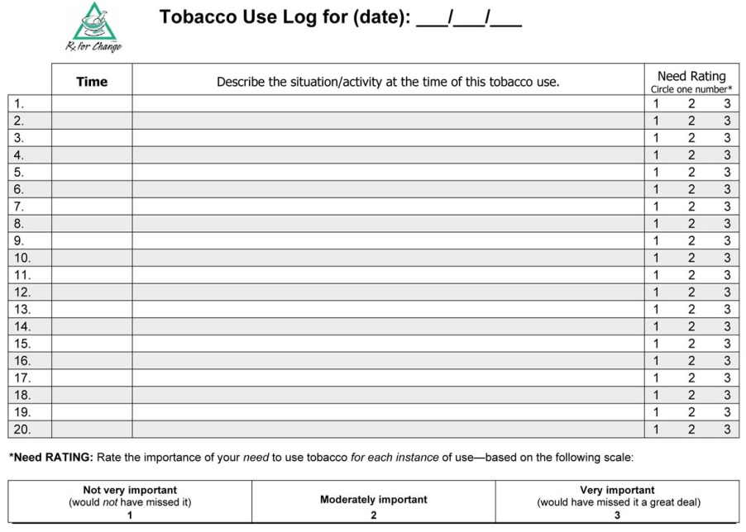
STAGE 2: READY to QUIT
Facilitate Quitting Process (cont’d)
Tobacco Use Log: Instructions for use
Continue regular tobacco use for 3 or more days
Each time any form of tobacco is used, log the following information:
  Time of day
  Activity or situation during use
  “Importance” rating (scale of 1–3)
Review log to identify situational triggers for tobacco use; develop patient-specific coping strategies
Notes:
Instructions for use:
The Tobacco Use Log is a documentation tool that is kept with the patient’s tobacco product(s). For example, the Tobacco Use Log could be folded and wrapped around the cigarette pack or can of snuff with a rubber band. The log should be readily available at the times when the patient uses the tobacco. Through careful documentation of tobacco use over a period of several days, patient-specific tobacco usage patterns become evident.
Instruct the patient to continue his or her regular tobacco use for a period of at least 3 days (including one non–work day). It is preferable to complete the Tobacco Use Log for 7 consecutive days, because usage patterns may fluctuate as a function of the day of the week (e.g., weekends vs. work days). The patient should not attempt to reduce tobacco use during this time. The intent is to document current tobacco use habits and patterns.
The following information should be noted in the Tobacco Use Log each time any form of tobacco is used:
Time of day
Brief description of the activity or situation while using the tobacco; other persons present at that time. Encourage the patient to think about the times and places where he or she uses tobacco, each time it is used. It is important for the patient to understand these cues so that effective coping strategies can be developed to overcome the temptation to use tobacco.
Rating of the patient’s perceived importance of using the tobacco, at that time, using the following scale:
1 = Very important (would have missed it a great deal)
2 = Moderately important
3 = Not very important (would not have missed it)
Log sheets should be reviewed prior to the quit attempt, to identify situations that trigger tobacco use and to develop coping strategies to prevent relapse. Cognitive and behavioral coping strategies are described in the slides that follow.

Slide 38
STAGE 2: READY to QUIT
Facilitate Quitting Process (cont’d)
Discuss coping strategies
  Cognitive coping strategies
    Focus on retraining the way a patient thinks
  Behavioral coping strategies
    Involve specific actions to reduce risk for relapse
HANDOUT
Notes:
The clinician and patient should discuss and develop effective cognitive and behavioral coping strategies for handling specific situations in which a person will be tempted to use tobacco.
Research shows that using both cognitive and behavioral strategies increases a patient’s likelihood of quitting (Prochaska & DiClemente, 1992). These strategies are described in the next few slides.
♪ Note to instructor(s): Have audience refer to Coping with Quitting: Cognitive and Behavioral Strategies (ancillary handout A6 COPING.pdf). This handout provides specific examples of coping strategies for various situations.
Prochaska JO, DiClemente CC. (1992). Stages of change in the modification of problem behaviors. In: Progress in Behavior Modification, edited by Hersen M, Eisler RM, Miller PM. Sycamore, IL: Sycamore, pp. 184–218.

Slide 39
STAGE 2: READY to QUIT
Facilitate Quitting Process (cont’d)
Cognitive Coping Strategies
  Review commitment to quit
  Distractive thinking
  Positive self-talk
  Relaxation through imagery
  Mental rehearsal and visualization
Notes:
Cognitive strategies focus on retraining the way a patient thinks. Many quitters panic because they are thinking about tobacco after they quit, and this leads to relapse. Thinking about cigarettes (or other forms of tobacco) is normal. The trick is not to dwell on the thought. As tobacco users move toward sustained abstinence, they learn to recognize that thinking about a cigarette doesn’t mean they need to have one.
Some examples of cognitive strategies include the following:
Review of one’s commitment to quitting can help, including reminding oneself that cravings and temptations are temporary and will pass. Sometimes it helps a patient to announce, either silently or out loud, “I want to be a nonsmoker, and the temptation will pass.” Or each morning, to look in the mirror and say, “I am proud that I made it through another day without tobacco!”
Deliberate, distractive thinking can help the patient move current thought processes to issues other than craving or temptation to use tobacco.
Positive self-talks, or “pep-talks,” involve saying things such as, “I can do this,” or reminding oneself of previous difficult situations in which tobacco use was avoided successfully.
Relaxation through imagery helps the patient to center the mind on positive, relaxing thoughts. This can help to ease the anxiety, stress, and negative moods that may trigger tobacco use.
Mental rehearsal and visualization involves envisioning situations that might arise and how best to handle them. This method is commonly used by athletes prior to a game. For example, a goalie might envision (or enact, during pregame warmups) how to block different types of shots or plays from opposing players. In the case of smoking, a person might envision what would happen if he or she were offered a cigarette by a friend—he or she would mentally craft and rehearse a response and perhaps even practice it by saying it out loud.

Slide 40
STAGE 2: READY to QUIT
Facilitate Quitting Process (cont’d)
Cognitive Coping Strategies: Examples
Thinking about cigarettes doesn’t mean you have to smoke one:
  “Just because you think about something doesn’t mean you have to do it!”
  Tell yourself, “It’s just a thought,” or “I am in control.”
  Say the word “STOP!” out loud, or visualize a stop sign.
When you have a craving, remind yourself:
  “The urge for tobacco will only go away if I don’t use it.”
As soon as you get up in the morning, look in the mirror and say to yourself:
  “I am proud that I made it through another day without tobacco.”
Notes:
This slide presents several examples of cognitive statements that can be used while quitting.

Slide 41
STAGE 2: READY to QUIT
Facilitate Quitting Process (cont’d)
Behavioral Coping Strategies
  Control your environment
    Tobacco-free home and workplace
    Remove cues to tobacco use; actively avoid trigger situations
    Modify behaviors that you associate with tobacco: when, what, where, how, with whom
  Substitutes for smoking
    Water, sugar-free chewing gum or hard candies (oral substitutes)
  Take a walk, diaphragmatic breathing, self-massage
  Actively work to reduce stress, obtain social support, and alleviate withdrawal symptoms
Notes:
Behavioral strategies involved specific actions for coping with the effects of quitting and reducing risk for relapse. The effectiveness of these strategies may be patient specific, meaning that one technique will work better for some patients than for others. To determine which strategies work best for a specific patient, a clinician must understand the patient’s reasons for tobacco use and routines or situations with which tobacco use is associated.
General approaches include enhanced control of the environment. Tobacco-free environments (e.g., home and workplace) can increase chances of success (e.g., Bauer et al., 2005; Chapman et al., 1999; Eriksen & Cerak, 2008)—nationally, the effects of transitioning all workplaces to smoke-free environments would yield an estimated 4.5% decrease in the overall prevalence of smoking (Fichtenberg & Glantz, 2002). Patients should be advised to remove cues for tobacco use, modify behaviors associated with tobacco use, and actively avoid specific situations in which tobacco use is likely to occur. Oral substitutes for tobacco use include drinking water; chewing sugar-free gum; or sucking on hard, sugar-free candies. Taking walks helps to change the tobacco user’s environment and also increases circulation and oxygenation while burning calories. Deep breathing can have a relaxing effect, and research suggests that self-massage might reduce cravings (Hernandez-Reif et al., 1999).
Withdrawal symptoms are inevitable, especially with patients who are heavy users of tobacco products. It is important that clinicians educate their patients so that they know what to expect, how to alleviate specific symptoms, and how long to expect the symptoms to last.
♪ Note to instructor(s): Specific behavioral strategies for common cues or causes of relapse (stress, alcohol, other tobacco users, oral gratification needs, automatic smoking routines, postcessation weight gain, cravings for tobacco) are presented in the Coping with Quitting: Cognitive and Behavioral Strategies handout.
Bauer JE, Hyland A, Li Q, Steger C, Cummings KM. (2005). A longitudinal assessment of the impact of smoke-free worksite policies on tobacco use. Am J Public Health 95:1024–1029.
Chapman S, Borland R, Scollo M, Bronson RC, Dominello A, Woodward S. (1999). The impact of smoke-free workplaces on declining cigarette consumption in Australia and the United States. Am J Public Health 89:1018–1023.
Ericksen MP, Cerak RL. The diffusion and impact of clean indoor air laws. (2008). Annu Rev Public Health 29:171–185.
Fichtenberg CM, Glantz SA. (2002). Effect of smoke-free workplaces on smoking behavior: systematic review. BMJ 325:188–191.
Hernandez-Reif M, Field T, Hart S. (1999). Smoking cravings are reduced by self-massage. Prev Med 28:28–32.

Slide 42
STAGE 2: READY to QUIT
Facilitate Quitting Process (cont’d)
Provide medication counseling
  Promote compliance
  Discuss proper use, with demonstration
Discuss concept of “slip” versus relapse
  “Let a slip slide.”
Offer to assist throughout quit attempt
  Follow-up contact #1: first week after quitting
  Follow-up contact #2: in the first month
  Additional follow-up contacts as needed
Congratulate the patient!
Notes:
It is imperative that clinicians counsel patients on their pharmacotherapy regimens (proper use, with demonstration as needed) and encourage patients to adhere to the prescribed regimen. Patients should be advised to take cessation medications as prescribed, not as needed. If a patient waits until he or she is in dire need of nicotine, it is too late. Nicotine replacement therapy products do not have the same rapid onset of action as tobacco formulations.
Prior to embarking on a quit attempt, the patient should be strongly advised not to smoke an occasional cigarette, or to have “just one drag” off of a friend’s cigarette. These are precursors for a full relapse. But, the patient should know the difference between a slip and a full relapse. A slip is a situation in which a person smokes one or just a few cigarettes. Although this can lead to a full relapse, it is not a complete failure, and it should be considered part of the learning process. If this occurs, encourage the patient to think through the scenario and determine the trigger(s) for smoking. Suggest coping strategies that will enable the patient to avoid smoking in similar situations.
The last of the 5 A’s is to arrange follow-up. At this point, the clinician should summarize treatment plans and offer to assist throughout the quit attempt. The most effective timing for follow-up contacts is not well understood (Fiore et al., 2008), and likely will vary by patient. In general, contact should occur the first week after quitting and a few weeks later (within the first month), with additional follow-up contacts as needed until the patient is stable in his or her new role as a nonuser of tobacco. At follow-up contact, it is important to reassess the patient’s commitment to quitting and his or her confidence in quitting. The patient’s response will, in part, be a reflection of his or her confidence in the treatment plan. As needed, offer resources and referrals (e.g., to other health care providers, tobacco quitlines).
Finally, congratulate the patient for making the important decision to quit.
Fiore MC, Jaén CR, Baker TB, et al. (2008). Treating Tobacco Use and Dependence: 2008 Update. Clinical Practice Guideline. Rockville, MD: U.S. Department of Health and Human Services. Public Health Service.

Slide 43
STAGE 2: READY to QUIT
A Demonstration
CASE SCENARIO:
Ms. Staal
You are a clinician providing care to Ms. Staal, a 44-year old woman in the emergency room with pulmonary distress.
VIDEO # V17a
Notes:
♪ Note to instructor(s): This video takes place in an emergency room setting, but similar strategies should be used, regardless of clinician type or setting. To access the video file, go to http://rxforchange.ucsf.edu. Under the “5 A’s Curriculum,” click “Video Segments” and locate video V17a in the table. Other videos are available for download from this webpage and might be more appropriate for your audience. Edit this slide as needed to incorporate other videos.
After showing the video, debrief with your audience. Note that this brief intervention required very little time (2 minutes).

Slide 44
ASSESSING
READINESS to QUIT (cont’d)
STAGE 3: Recent quitter
Actively trying to quit for good
  Patients have quit using tobacco sometime in the past 6 months and are taking steps to increase their success.
  Withdrawal symptoms occur.
  Patients are at risk for relapse.
GOAL: Remain tobacco-free for at least 6 months.
Notes:
Patients who quit (in the past 6 months) are considered recent quitters. These patients are taking steps to enhance the likelihood that they can successfully quit by using medications such as nicotine replacement therapy. They dispose of unused cigarettes and remove lighters and other smoking apparatus from their homes and cars. They alter their routines to avoid habituated smoking patterns.
These patients likely are experiencing withdrawal symptoms—some pleasant (such as revived taste buds) and some not so pleasant (such as cravings, irritability, and weight gain).
Recent quitters are at high risk for relapse. The goal is to help them remain tobacco-free.

Slide 45
STAGE 3: RECENT QUITTERS
Evaluate the Quit Attempt
Status of attempt
  Ask about social support
  Identify ongoing temptations and triggers for relapse
  (negative affect, smokers, eating, alcohol, cravings, stress)
  Encourage healthy behaviors to replace tobacco use
Slips and relapse
  Has the patient used tobacco at all—even a puff?
Medication adherence, plans for termination
  Is the regimen being followed?
  Are withdrawal symptoms being alleviated?
  How and when should pharmacotherapy be terminated?
Notes:
Recent quitters face many challenges in adopting their new behavior (not smoking). During the quit attempt, clinicians should carefully tailor interventions to match each patient’s needs. It is an opportunity to problem solve, or intervene, most creatively.
Here are the basic strategies for evaluating a patient’s quit attempt:
Inquire about available social support.
Identify temptations and triggers relapse. Key triggers are negative affect, being around other tobacco users, eating, drinking alcohol, cravings for tobacco, and stress. Suggest coping strategies as needed, to remove or modify cues in the environment that make a person want to use tobacco, such as removing ashtrays, not entering an office where smokers are congregating, and not drinking alcohol if it will increase the likelihood of tobacco use.
Encourage healthful behaviors to replace smoking (e.g., drinking water, exercise).
Determine whether the patient has had any slips or has relapsed.
Evaluate the treatment regimen. Is adherence with medications adequate? Are withdrawal symptoms being alleviated? How and when should pharmacotherapy be terminated?

Slide 46
STAGE 3: RECENT QUITTERS
Facilitate Quitting Process
Relapse Prevention
Congratulate success!
Encourage continued abstinence
  Discuss benefits of quitting, problems encountered, successes achieved, and potential barriers to continued abstinence
  Ask about strong or prolonged withdrawal symptoms (change dose, combine or extend use of medications)
  Promote smoke-free environments
Social support provided as part of treatment
  Schedule additional follow-up as needed
Notes:
Relapse prevention is an important component of tobacco cessation interventions and should be part of every encounter with patients who recently quit using tobacco. At a minimum, the quitter should be congratulated for his or her successes and should be strongly encouraged to remain tobacco-free.
Relapse prevention interventions should include a discussion of the patient’s perceived benefits of quitting, challenges during the process, successes achieved (specific situations in which the patient was tempted to use tobacco but resisted), and potential barriers to continued abstinence (e.g., depression, alcohol use, weight gain, stress, and other tobacco users who are not supportive of cessation). For patients who are feeling a sense of loss after quitting (some individuals feel as though they have lost a best friend), acknowledge their feelings and reassure them that the feelings will subside over time. Identify and recommend other activities that the particular patient views as rewarding.
For patients who are complying with their pharmacotherapy regimens but continue to have strong or prolonged withdrawal symptoms, consider adding, combining, or extending use of medications. For a recent quitter, it is important to attempt to reduce relapse risk by promoting tobacco-free environments (e.g., in the home and workplace).
Social support, delivered as part of treatment, is recommended and the clinician should schedule follow-up visits or calls as needed to prevent relapse. If necessary, refer the patient to a tobacco cessation support group in the community.
♪ Note to instructor(s): The 2008 update of the Clinical Practice Guideline does not recommend extra-treatment social support, because the literature does not show a strong effect of helping patients identify and utilize support outside of the treatment relationship (Fiore et al., 2008; p. 97).
Fiore MC, Jaén CR, Baker TB, et al. (2008). Treating Tobacco Use and Dependence: 2008 Update. Clinical Practice Guideline. Rockville, MD: U.S. Department of Health and Human Services. Public Health Service.

Slide 47
STAGE 3: RECENT QUITTER
A Demonstration
CASE SCENARIO:
Mr. Angelo Fleury
You are a clinician providing follow-up care to Mr. Angelo Fleury, who recently quit and is experiencing difficulty sleeping and coping with job-related stress.
VIDEO # V25b
Notes:
♪ Note to instructor(s): This video takes place in a patient examination room, but similar strategies should be used, regardless of clinician type or setting. To access the video file, go to http://rxforchange.ucsf.edu. Under the “5 A’s Curriculum,” click “Video Segments” and locate video V25b in the table. Other videos are available for download from this webpage and might be more appropriate for your audience. Edit this slide as needed to incorporate other videos.
After showing the video, debrief with your audience. Note that this intervention provided a substantial amount of counseling, addressing key issues, in only 4 minutes.

Slide 48
ASSESSING
READINESS to QUIT (cont’d)
STAGE 4: Former tobacco user
Tobacco-free for 6 months
  Patients remain vulnerable to relapse.
  Ongoing relapse prevention is needed.
GOAL: Remain tobacco-free for life.
Notes:
Patients who have been tobacco-free for 6 or more months can be classified as former tobacco users. Nevertheless, many remain vulnerable to relapse.
The strategies to be applied for former tobacco users are similar to, but less intensive than, those used for recent quitters. The goal for these patients is to remain tobacco-free for life.

Slide 49
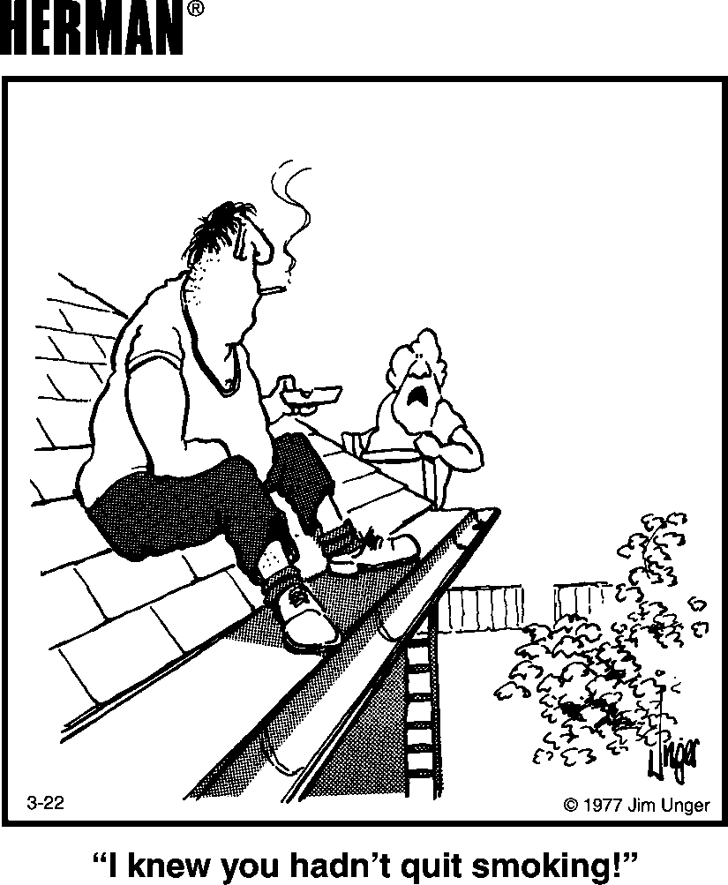
HERMAN ® is reprinted with permission from
LaughingStock Licensing Inc., Ottawa, Canada
All rights reserved.
Notes:
Quitting is difficult, and tobacco users typically make multiple serious quit attempts before they are able to quit for good. For this reason, clinicians should routinely screen for periodic tobacco use among former users and continue to demonstrate support and encouragement for the patient’s continued success.

Slide 50
STAGE 4:
FORMER TOBACCO USERS
Assess status of quit attempt
Slips and relapse
Medication compliance, plans for termination
    Has pharmacotherapy been terminated?
Continue to offer tips for relapse prevention
Encourage healthy behaviors
Congratulate continued success
Continue to assist throughout the quit attempt.
Notes:
As with recent quitters, clinicians must evaluate the status of the quit attempt. Has the patient had any strong temptations to use tobacco, or any occasional use of tobacco products (even a puff)? Patients might be particularly vulnerable to relapse during times of extreme stress. Also, it is important to ensure that patients are appropriately terminating or tapering off of pharmacotherapy products.
Relapse prevention strategies should be discussed as needed, and healthy behaviors should be encouraged—ones that the patient does not associate with tobacco use—such as exercise, hobbies (particularly ones that involve use of the hands), and going to movies with friends. To reduce weight gain, it is important for patients to maintain a healthy diet.
Finally, patients who have been off of tobacco for 6 or more months should be congratulated for their enormous success. Staying tobacco-free is a continuous process of learning how to cope with the change. Clinicians should acknowledge, reward, and reinforce the patient’s triumphs in the face of this challenge. Continue to assist throughout the quit attempt.
Remember: Behavioral change is a process, not a single step. It’s not uncommon for patients to experience at least one episode of relapse. This should not be regarded as a failure on the part of the patient or the provider, but rather one of the many possible steps within the process of establishing long-term change.

Slide 51
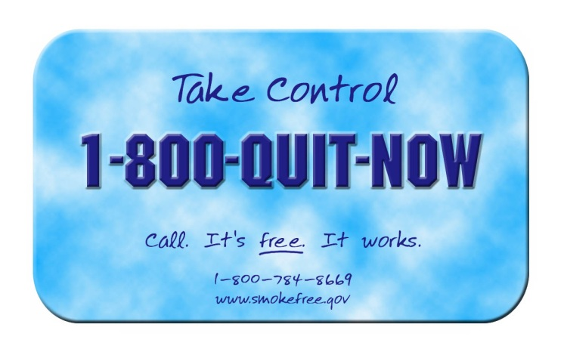
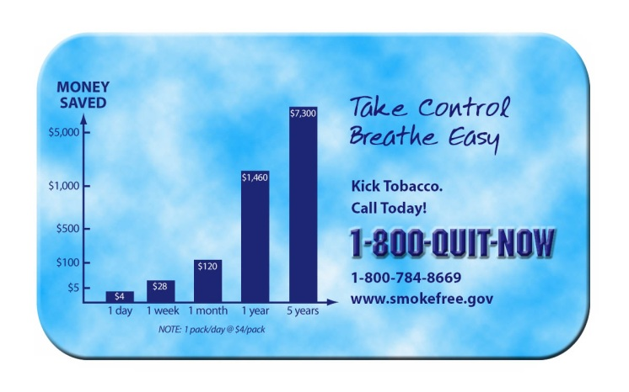
BRIEF COUNSELING:
ASK, ADVISE, REFER (cont’d)
Brief interventions have been shown to be effective
In the absence of time or expertise:
  Ask, advise, and refer to other resources, such as local group programs or the toll-free quitline
  1-800-QUIT-NOW
This brief intervention can be achieved in less than 1 minute.
Notes:
Brief interventions have been shown to be effective (Fiore et al., 2008). When time or logistics do not permit comprehensive tobacco cessation counseling during a patient visit, clinicians are encouraged to apply a truncated 5 A’s model, whereby they Ask about tobacco use, Advise tobacco users to quit, and Refer patients who are willing to quit to a telephone quitline or other community-based resource for tobacco cessation.
Fiore MC, Jaén CR, Baker TB, et al. (2008). Treating Tobacco Use and Dependence: 2008 Update. Clinical Practice Guideline. Rockville, MD: U.S. Department of Health and Human Services. Public Health Service.

Slide 52
WHAT ARE
“TOBACCO QUITLINES”?
Tobacco cessation counseling, provided at no cost via telephone to all Americans
Staffed by trained specialists
Up to 4–6 personalized sessions (varies by state)
Some state quitlines offer pharmacotherapy at no cost (or reduced cost)
Up to 30% success rate for patients who complete sessions
Most health-care providers, and most patients,
are not familiar with tobacco quitlines.
Notes:
What is a tobacco quitline? Tobacco quitlines are telephone services that provide tobacco cessation counseling at no cost to the caller. Quitlines have proliferated over the past decade, providing comprehensive interventions that can reach patients who might otherwise have limited access to medical treatment because of geographic location or lack of insurance or financial resources. In clinical trials, telephone counseling services for which at least some of the contacts are initiated by the quitline counselor have been shown to be effective in promoting abstinence (Fiore et al., 2008; Stead et al., 2007), and these positive results have been shown to translate into real-world effectiveness (Zhu et al., 2000). The addition of medication to quitline counseling significantly improves abstinence rates compared to medication alone (Fiore et al., 2008). In addition, preliminary evidence suggests that that quitlines also are effective for smokeless tobacco cessation (Severson et al., 2000). The telephone number for the toll-free tobacco quitline is 1-800-QUIT NOW. In some states, clinicians can submit a fax-referral form, on behalf of a patient, to the quitline. This form initiates a process whereby a quitline counselor then contacts the patient directly. Up to 30% success rates have been shown for patients who complete all follow-up sessions. However, most physicians, and most smokers, know almost nothing about them, so they are not being utilized by most smokers who want to quit. Even the busiest of clinicians can serve an important role by simply identifying tobacco users and referring them to a quitline for more comprehensive counseling.
Fiore MC, Jaén CR, Baker TB, et al. (2008). Treating Tobacco Use and Dependence: 2008 Update. Clinical Practice Guideline. Rockville, MD: U.S. Department of Health and Human Services. Public Health Service.
Severson HH,et al. (2000). A self-help cessation program for smokeless tobacco users: Comparison of two interventions. Nicotine Tob Res 2:363–370.
Stead LF, Perera R, Lancaster T. A systematic review of interventions for smokers who contact quitlines. Tob Control. 2007;16(Suppl 1):i3–8.
Zhu SH, et al. (2002). Evidence of real-world effectiveness of a telephone quitline for smokers. N Engl J Med 347:1087–1093.

Slide 53
METHODS for QUITTING
Nonpharmacologic
  Counseling and other non-drug approaches
Pharmacologic
  FDA-approved medications
Counseling and medications are both effective, but the combination of counseling and medication is more effective than either alone.
Fiore et al. (2008). Treating Tobacco Use and Dependence: 2008 Update.
Clinical Practice Guideline. Rockville, MD: USDHHS, PHS, May 2008.
Notes:
53
There are two basic methods for quitting:
Nonpharmacologic (counseling and other non-drug approaches)
Pharmacologic (FDA-approved medications)
Nonpharmacologic methods primarily involve counseling and behavioral therapies. This includes the provision of social support systems within the context of treatment, and problem solving and skills training. As discussed in the Assisting Patients with Quitting module, these methods should be used with all patients attempting to quit using tobacco. Pharmacologic methods approved by the U.S. Food and Drug Administration (FDA) for tobacco cessation include nicotine replacement therapy (NRT), sustained-release bupropion (Zyban) and varenicline (Chantix). Other pharmacologic methods for cessation that are not FDA approved for smoking cessation are also discussed in this module, as are complementary and alternative therapies.
Most tobacco users quit without assistance, and overall, around 95% of unaided quit attempts end in relapse (Fiore et al., 2008; p. 15). In general, combination therapy consisting of behavioral counseling with pharmacotherapy is more effective (40–70% improvement) than either method used alone (Fiore et al., 2008; pp. 102-103). This combined approach is similar to that used in the treatment of other chronic conditions. For example, a diabetic patient may administer insulin in combination with a prescribed diet and exercise regimen. A patient with asthma might use a corticosteroid inhaler in combination with various environmental control measures to prevent asthma exacerbations. Similarly, effective treatment of tobacco use and dependence involves a management plan consisting of behavioral counseling, support, and appropriate pharmacotherapy.
Fiore MC, Jaén CR, Baker TB, et al. (2008). Treating Tobacco Use and Dependence: 2008 Update. Clinical Practice Guideline. Rockville, MD: U.S. Department of Health and Human Services. Public Health Service.

Slide 54
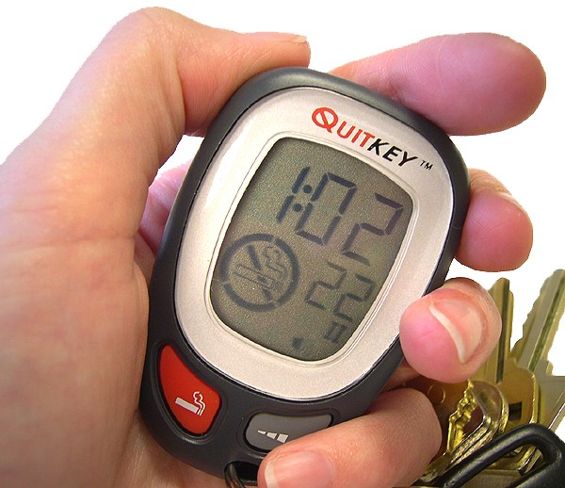
NONPHARMACOLOGIC METHODS
Cold turkey: Just do it!
Unassisted tapering (fading)
  Reduced frequency of use
  Lower nicotine cigarettes
  Special filters or holders
Assisted tapering
  QuitKey (PICS, Inc.)
    Computer developed taper based on patient’s smoking level
    Includes telephone counseling support
Notes:
54
Nonpharmacologic methods include the following:
Cold turkey: The “simplest” nonpharmacologic method, but the least successful (approximately 5% success; Fiore et al., 2008), is cold turkey—the smoker just quits abruptly, without the assistance of any clinical intervention or medication and without tapering off of nicotine.
Unassisted tapering: Tobacco users can taper off of tobacco products in a variety of ways. For example, they can self-regulate and reduce the number of cigarettes that they smoke, they can switch to cigarettes with a progressively lower nicotine content (“light” or “ultra-light” cigarettes), or they can purchase special filters or holders that decrease the nicotine inhalation concentration over time. However, many people who use this method smoke fewer cigarettes but still get the same amount of nicotine because they compensate for the low nicotine content by altering the way they smoke. For example, they may inhale more deeply, smoke each cigarette longer, or obstruct the vents on the filters. This method may be a reasonable approach for some smokers to “get ready to quit,” because it disrupts the behavior or habit. However, in general, tapering is not a very effective method of quitting.
Assisted tapering: Products such as the QuitKey (developed and marketed by PICS, Inc.; $59.95/unit) help patients to quit using tobacco gradually through a computer-assisted behavior modification program.
The hand-held QuitKey computer assists the smoker in decreasing the frequency of cigarette use over time. Based on data that patients enter during a 1-week baseline period when they smoke “normally,” the computer develops a patient-specific tapering curve appropriate to the patient’s level of smoking.
The scheduled gradual reduction concept for smoking cessation has been tested in research studies (Cinciripini et al., 1997). The QuitKey program, which was developed with funding from the National Institutes of Health, has been tested and proven to be effective in clinical trials (Jerome et al., 1992, 2000; Riley et al., 2002). The program results in a 19–24% abstinence rate 1 year after quitting.
♪ Note to instructor(s): For more information on the QuitKey, please consult the PICS, Inc. website, www.quitkey.com.
Cinciripini PM, Wetter DW, McClure JB. (1997). Scheduled reduced smoking: Effects on smoking abstinence and potential mechanisms of action. Addict Behav 22:759–767.
Fiore MC, Jaén CR, Baker TB, et al. (2008). Treating Tobacco Use and Dependence: 2008 Update. Clinical Practice Guideline. Rockville, MD: U.S. Department of Health and Human Services. Public Health Service.
Jerome A, Fiero PL, Behar A. (2000). Computerized scheduled gradual reduction for smokeless tobacco cessation: Development and preliminary evaluation of a self-help program. Computers in Human Behavior 16:493–505.
Jerome A, Perrone R, Kalfus G. (1992). Computer-assisted smoking treatment: A controlled evaluation and long-term follow-up. Journal of Advancement in Medicine 5:29–41.
Riley W, Jerome A, Behar A, Zack S. (2002). Feasibility of computerized scheduled gradual reduction for adolescent smoking cessation. Substance Use & Misuse 37:277–285.

Slide 55
NONPHARMACOLOGIC METHODS (cont’d)
Formal cessation programs
  Self-help programs
  Individual counseling
  Group programs
  Telephone counseling
    1-800-QUITNOW
    1-800-786-8669
  Web-based counseling
    www.smokefree.gov
    www.quitnet.com
    www.becomeanex.org
Acupuncture therapy
Hypnotherapy
Massage therapy
Notes:
55
Formal cessation programs: An abundance of formal smoking cessation programs are available. These range from self-help manuals to individual and group counseling programs. The National Quitline, launched in 2004 (1-800-QUITNOW), provides all Americans with toll-free telephone-based counseling. For individuals with Internet access, many Web-based programs offer private and convenient (“24/7/365” availability) cessation support. The effectiveness of these types of behavioral programs is enhanced further when pharmacologic agents also are used for cessation.
Alternative and complementary therapies: In recent years many patients have turned to various alternative and complementary therapies for cessation (Villano & White, 2004; Sood et al., 2006):
Acupuncture therapy (and related techniques including acupressure, laser therapy and electrostimulation) are believed to modulate neurotransmitter release thereby attenuating symptoms of nicotine withdrawal (Villano & White, 2004; White et al., 2006). A recent meta-analysis (White et al., 2006) concluded that there is no consistent evidence that acupuncture, acupressure, laser therapy, or electrostimulation are effective and the Clinical Practice Guideline (Fiore et al., 2008) does not recommend these approaches for smoking cessation.
Hypnotherapy also has been used for smoking cessation. Hypnotherapists implant subconscious suggestions to deter smoking. Evidence on its efficacy is conflicting, and currently the evidence is insufficient to support hypnosis as a treatment for smoking cessation (Abbott et al., 2000; Fiore et al., 2008).
Massage therapy is thought to reduce anxiety, decrease stress hormones, and improve mood. In one study, patients used either hand or ear self-massage during tobacco cravings for a period of 1 month. Patients reported improved moods and decreased anxiety, withdrawal symptoms, and number of cigarettes smoked per day (Hernandez-Reif et al., 1999). Massage therapy might be useful as an adjunct therapy to alleviate cravings and anxiety.
♪ Note to instructor(s): Members of your audience might have heard of an approach known as aversion therapy. In brief, this technique requires patients to smoke so much that they are nearly nicotine intoxicated, which makes them feel sick and (supposedly) makes them not want cigarettes any more. According to the U.S. Public Health Service Clinical Practice Guideline for treating tobacco use and dependence, aversive smoking interventions are not effective and have high incidence of adverse effects and are therefore not recommended (Fiore et al., 2008).
Abbot NC, Stead LF, White AR, et al. (2000). Hypnotherapy for smoking cessation. Cochrane Database Syst Rev 2:CD001008.
Fiore MC, Jaén CR, Baker TB, et al. (2008). Treating Tobacco Use and Dependence: 2008 Update. Clinical Practice Guideline. Rockville, MD: U.S. Department of Health and Human Services. Public Health Service.
Hernandez-Reif M, Field T, Hart S. (1999). Smoking cravings are reduced by self-massage. Prev Med 28:28–31.
Sood A, Ebbert JO, Sood R, Stevens SR. (2006). Complementary treatments for tobacco cessation: a survey. Nicotine Tob Res 8:767–771.
White AR, Rampes H, Campbell JL. (2006). Acupuncture and related interventions for smoking cessation. Cochrane Database Syst Rev 1:CD000009.
Villano LM, White AR. (2004). Alternative therapies for tobacco dependence. Med Clin N Am 88:1607–1621.

Slide 56
PHARMACOLOGIC METHODS:
FIRST-LINE THERAPIES
Three general classes of FDA-approved drugs for smoking cessation:
  Nicotine replacement therapy (NRT)
    Nicotine gum, patch, lozenge, nasal spray, inhaler
  Psychotropics
    Sustained-release bupropion
  Partial nicotinic receptor agonist
    Varenicline
Notes:
56
There are three general classes of FDA-approved drugs for cessation:
Nicotine replacement therapy (NRT) includes the nicotine gum, patch, lozenge, nasal spray, and inhaler. A nicotine sublingual tablet currently is available in Europe.
The only psychotropic agent currently approved by the FDA for smoking cessation is bupropion SR.
Varenicline, a partial nicotinic receptor agonist, was approved by the FDA in 2006 for smoking cessation.
According to the U.S. Public Health Service Clinical Practice Guideline for treating tobacco use and dependence, NRT, sustained-release bupropion and varenicline are considered first-line pharmacotherapies for smoking cessation (Fiore et al., 2008). Currently, no medications have an FDA indication for use in spit tobacco cessation.
♪ Note to instructor(s): The following pharmacotherapies have been studied but are not recommended by the U.S. Public Health Service Clinical Practice Guideline for treating tobacco use and dependence based on a lack of benefit relative to placebo therapy (David et al., 2006; Fiore et al., 2008; Hughes et al., 2007):
Anxiolytic agents (buspirone, diazepam)
Beta-blockers (propranolol)
Mecamylamine
Opioid antagonists (buprenorphine, naloxone, naltrexone)
Selective serotonin reuptake inhibitors (citalopram, fluoxetine, paroxetine, sertraline)
Silver acetate
David S, Lancaster T, Stead LF, Evins AE. (2006). Opioid antagonists for smoking cessation. Cochrane Database Syst Rev 4:CD003086.
Fiore MC, Jaén CR, Baker TB, et al. (2008). Treating Tobacco Use and Dependence: 2008 Update. Clinical Practice Guideline. Rockville, MD: U.S. Department of Health and Human Services. Public Health Service.
Hughes JR, Stead LF, Lancaster T. (2007). Antidepressants for smoking cessation. Cochrane Database Syst Rev 1:CD000031.

Slide 57
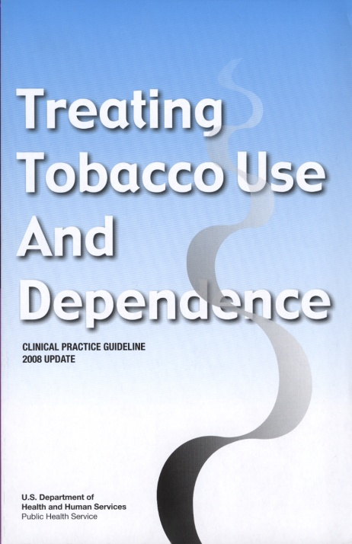
PHARMACOTHERAPY
“Clinicians should encourage all patients attempting to quit to use effective medications for tobacco dependence treatment, except where contraindicated or for specific populations* for which there is insufficient evidence of effectiveness.”
* Includes pregnant women, smokeless tobacco users, light smokers, and adolescents.
Medications significantly improve success rates.
Fiore et al. (2008). Treating Tobacco Use and Dependence: 2008 Update.
Clinical Practice Guideline. Rockville, MD: USDHHS, PHS, May 2008.
Notes:
57
The U.S. Public Health Service Clinical Practice Guideline for treating tobacco use and dependence states that “clinicians should encourage all patients attempting to quit to use effective medications for tobacco dependence treatment, except where contraindicated or for specific populations for which there is insufficient evidence of effectiveness” (Fiore et al., 2008, p. 106).
Use of pharmacotherapy requires special consideration in the following patient populations (Fiore et al., 2008):
Pregnant or breast-feeding women
Smokeless tobacco users
Patients smoking fewer than 10 cigarettes per day (light smokers)
Adolescents
Fiore MC, Jaén CR, Baker TB, et al. (2008). Treating Tobacco Use and Dependence: 2008 Update. Clinical Practice Guideline. Rockville, MD: U.S. Department of Health and Human Services. Public Health Service.

Slide 58
PHARMACOTHERAPY:
USE in PREGNANCY
The Clinical Practice Guideline makes no recommendation regarding use of medications in pregnant smokers
  Insufficient evidence of effectiveness
Category C: varenicline, bupropion SR
Category D: prescription formulations of NRT
“Because of the serious risks of smoking to the pregnant smoker and the fetus, whenever possible pregnant smokers should be offered person-to-person psychosocial interventions that exceed minimal advice to quit.” (p. 165)
Fiore et al. (2008). Treating Tobacco Use and Dependence: 2008 Update. Clinical Practice Guideline. Rockville, MD: USDHHS, PHS, May 2008.
Notes:
58
The Clinical Practice Guideline states that pregnant smokers should be encouraged to quit without medication based on insufficient evidence of effectiveness and hypothetical concerns with safety. Pregnant smokers should be offered person-to-person psychosocial interventions that exceed minimal advice to quit (Fiore et al., 2008).
The FDA has classified varenicline as a pregnancy category C drug, meaning either (a) animal studies have demonstrated that the drug exerts animal teratogenic or embryocidal effects, but there are no controlled studies in women, or (b) no studies are available in either animals or women. The manufacturer recommends that varenicline be used during pregnancy only if the potential benefit justifies the potential risk to the fetus (Pfizer, 2010).
The FDA has recently re-classified bupropion as a pregnancy category C drug. This change in labeling was based on an FDA reanalysis of pre-clinical animal data demonstrating an increase in the incidence of fetal malformations and skeletal variations among rabbits receiving dosages approximately two-fold higher than the maximum recommended human dose (on a mg/m² basis) of bupropion. The manufacturer recommends that bupropion be used during pregnancy only if clearly needed (GlaxoSmithKline, 2010).
♪ Note to instructor(s): The manufacturer of Zyban (GlaxoSmithKline) maintained a bupropion pregnancy registry from September 1, 1997 through March 31, 2008 and published and interim reports every 6 months. After more than a decade of surveillance, the registry has been closed based on evidence that excluded a major teratogenic effect in pregnancies with exposure to any formulation of bupropion (GlaxoSmithKline, 2008).
The FDA has classified prescription formulations of nicotine as a pregnancy category D drug, meaning there is evidence of risk to the human fetus. Accordingly, none of the NRT formulations have been FDA approved for use in pregnancy. Although NRT may pose a risk to the developing fetus, some researchers have argued this risk is considerably less than the risks of continued smoking (Benowitz & Dempsey, 2004). However, because it is assumed that NRT can cause fetal harm the Clinical Practice Guideline does not recommend its use during pregnancy (Fiore et al., 2008).
Benowitz NL, Dempsey DA. (2004). Pharmacotherapy for smoking cessation during pregnancy. Nicotine Tob Res 6(Suppl. 2):S189–S202.
Fiore MC, Jaén CR, Baker TB, et al. (2008). Treating Tobacco Use and Dependence: 2008 Update. Clinical Practice Guideline. Rockville, MD: U.S. Department of Health and Human Services. Public Health Service.
GlaxoSmithKline Inc. (2010, September). Zyban Package Insert. Research Triangle Park, NC.
GlaxoSmithKline. (2008, August). The bupropion pregnancy registry. Final report 1 September 1997 through 31 March 2008. Wilmington, NC. For Information on obtaining the report, see http://pregnancyregistry.gsk.com/bupropion.html
Pfizer, Inc. (2010, April). Chantix Package Insert. New York, NY.

Slide 59
PHARMACOTHERAPY:
OTHER SPECIAL POPULATIONS
Pharmacotherapy is not recommended for:
  Smokeless tobacco users
    No FDA indication for smokeless tobacco cessation
  Individuals smoking fewer than 10 cigarettes per day
  Adolescents
    Nonprescription sales (patch, gum, lozenge) are restricted to adults ≥18 years of age
    NRT use in minors requires a prescription
Recommended treatment is behavioral counseling.
Fiore et al. (2008). Treating Tobacco Use and Dependence: 2008 Update. Clinical Practice Guideline. Rockville, MD: USDHHS, PHS, May 2008.
Notes:
59
As noted previously, pharmacotherapy is not recommended for use in smokeless tobacco users, individuals smoking fewer than 10 cigarettes per day (light smokers), or adolescents because of insufficient evidence of effectiveness (Fiore et al., 2008). These populations tend to be excluded in randomized controlled trials, and therefore limited data are available.
Non-prescription NRT sales (nicotine patch, gum, lozenge) are restricted to adults ≥18 years of age, and use of NRT use in minors requires a prescription.
For each of these special populations, the recommended treatment is behavioral counseling (Fiore et al., 2008).
Fiore MC, Jaén CR, Baker TB, et al. (2008). Treating Tobacco Use and Dependence: 2008 Update. Clinical Practice Guideline. Rockville, MD: U.S. Department of Health and Human Services. Public Health Service.

Slide 60
NRT: RATIONALE for USE
Reduces physical withdrawal from nicotine
Eliminates the immediate, reinforcing effects of nicotine that is rapidly absorbed via tobacco smoke
Allows patient to focus on behavioral and psychological aspects of tobacco cessation
NRT products approximately doubles quit rates.
Notes:
60
The rationale for using NRT in tobacco cessation include the following:
NRT reduces physical withdrawal symptoms associated with nicotine cessation. NRT increases success by alleviating physical nicotine withdrawal symptoms, which are usually experienced following tobacco cessation. This makes patients more comfortable while they are quitting.
NRT eliminates the immediate, reinforcing effects of nicotine that is rapidly absorbed via tobacco smoke.
NRT allows the patient to focus on behavioral and psychological aspects of tobacco cessation. While NRT products are helping to alleviate withdrawal symptoms, the patient is able to focus on the behavioral and psychological changes necessary for successful tobacco cessation. NRT itself can be addicting, and although their addictive properties are negligible compared to tobacco products, some patients might have difficulty terminating NRT use.
NRT use significantly improves the success rates of smoking cessation. Meta-analyses of controlled trials of NRT have found that all products (gum, patch, lozenge, inhaler, and nasal spray) significantly improve abstinence rates when compared to placebo. Use of NRT approximately doubles long-term quit rates relative to placebo (Fiore et al., 2008; Stead et al., 2008).
Advantages of NRT include the following:
Patients are not exposed to the carcinogens and other toxic components found in tobacco and tobacco smoke.
NRT provides lower, slower, and less variable plasma nicotine concentrations than do cigarettes, which reduces the behaviorally reinforcing effect of smoking.
Fiore MC, Jaén CR, Baker TB, et al. (2008). Treating Tobacco Use and Dependence: 2008 Update. Clinical Practice Guideline. Rockville, MD: U.S. Department of Health and Human Services. Public Health Service.
Stead LF, Perera R, Bullen C, Mant D, Lancaster T. (2008). Nicotine replacement therapy for smoking cessation. Cochrane Database Syst Rev 1:CD000146.

Slide 61
NRT: PRODUCTS
Polacrilex gum
  Nicorette (OTC)
  Generic nicotine gum (OTC)
Lozenge
  Nicorette Lozenge (OTC)
  Nicorette Mini Lozenge (OTC)
  Generic nicotine lozenge (OTC)
Transdermal patch
  NicoDerm CQ (OTC)
  Generic nicotine patches (OTC, Rx)
Nasal spray
  Nicotrol NS (Rx)
Inhaler
  Nicotrol (Rx)
Patients should stop using all forms of tobacco
upon initiation of the NRT regimen.
Notes:
61
Currently available formulations of NRT include gum, lozenge, transdermal patch, nasal spray, and inhaler.
The nicotine gum, lozenge, and patch can be purchased without a prescription. The nicotine nasal spray and inhaler require a prescription.
To reduce the likelihood of nicotine-related adverse effects, patients should stop using all forms of tobacco when using these products. Symptoms of nicotine toxicity include headache, nausea and vomiting, abdominal pain, diarrhea, salivation, dizziness, blurred vision, weakness, cold sweat, mental confusion, weakness and in severe overdose, hypotension, seizures and respiratory depression (Taylor, 2006).
Taylor P. (2006). Agents acting at the neuromuscular junction and autonomic ganglia. In Brunton LL, Lazo JS, Parker KL (eds.), Goodman and Gilman's The Pharmacological Basis of Therapeutics, 11th ed. New York: McGraw-Hill.

Slide 62
PLASMA NICOTINE CONCENTRATIONS for NICOTINE-CONTAINING PRODUCTS
Cigarette
Moist snuff
0 10 20 30 40 50 60
Time (minutes)
Notes:
62
This graph depicts the plasma venous nicotine concentrations achieved with the various nicotine delivery systems. Peak plasma concentrations are higher and are achieved more rapidly when nicotine is delivered via cigarette smoke compared to the available NRT formulations.
Among the NRT formulations, the nasal spray has the most rapid absorption, followed by the gum, lozenge, and inhaler; absorption is slowest with the transdermal formulations. The concentration time curves in this slide depict levels achieved after administration of a single dose of nicotine following a period of overnight abstinence. The administration of nicotine varied across the studies as follows: the cigarette was smoked over 5 minutes, the moist snuff (2 grams Copenhagen) was placed between the check and gum for 30 minutes, the inhaler was used over 20 minutes (80 puffs), the gum was chewed over 30 minutes, the lozenge was held in the mouth for approximately 30 minutes, and the patch was applied to the skin for 1 hour. The data presented in the graph derive from multiple studies and are meant to illustrate the differences between nicotine absorption from tobacco and NRT (Choi et al., 2003; Fant et al., 1999; Schneider et al., 2001).
Because NRT formulations deliver nicotine more slowly and at lower levels (e.g., 30–75% of those achieved by smoking), these agents are far less likely to be associated with dependence when compared to tobacco products.
Choi JH, Dresler CM, Norton MR, Strahs KR. (2003). Pharmacokinetics of a nicotine polacrilex lozenge. Nicotine Tob Res 5:635–644.
Fant RV, Henningfield JE, Nelson RA, Pickworth WB. (1999). Pharmacokinetics and pharmacodynamics of moist snuff in humans. Tob Control 8:387–392.
Schneider NG, Olmstead RE, Franzon MA, Lunell E. (2001). The nicotine inhaler. Clinical pharmacokinetics and comparison with other nicotine treatments. Clin Pharmacokinet 40:661–684.

Slide 63
NRT: PRECAUTIONS
Patients with underlying cardiovascular disease
  Recent myocardial infarction (within past 2 weeks)
  Serious arrhythmias
  Serious or worsening angina
NRT products may be appropriate for these patients
if they are under medical supervision.
Notes:
63
Some general precautions to consider when recommending the use of NRT as a cessation aid:
Nicotine activates the sympathetic nervous system leading to an increase in heart rate, blood pressure, and myocardial contractility. Nicotine may also cause coronary artery vasoconstriction (Benowitz, 2003). These known hemodynamic effects of nicotine have led to concerns about the safety of NRT use in patients with established cardiovascular disease, particularly those with serious arrhythmias, serious or worsening angina, or those patients in the immediate post-myocardial infarction period (within past 2 weeks) (Fiore et al., 2008).
Soon after the nicotine patch was approved, anecdotal case reports appeared in the lay press linking NRT use (patch and gum) with adverse cardiovascular events (i.e., arrhythmias, myocardial infarction, stroke). Since then, several randomized, controlled trials have evaluated the safety of NRT in patients with cardiovascular disease including angiographically documented coronary artery stenosis, myocardial infarction, stable angina, and previous coronary artery bypass surgery or angioplasty (Joseph et al., 1996; Tzivoni et al., 1998; Working Group for the Study of Transdermal Nicotine in Patients with Coronary Artery Disease, 1994).
These trials found no significant increase in the incidence of cardiovascular events or mortality among patients receiving NRT when compared to placebo. However, because the trials specifically excluded patients with unstable angina, serious arrhythmias, and recent myocardial infarction, the Clinical Practice Guideline recommends that NRT be used with caution among patients in the immediate (within 2 weeks) post-myocardial infarction period, those with serious arrhythmias, and those with serious or worsening angina, owing to a lack of safety data in these high-risk populations (Fiore et al., 2008).
Although one methodologically weak, case-control study raised question regarding NRT use in intensive care settings (Lee & Afessa, 2007), NRT use in patients with cardiovascular disease has been the subject of numerous reviews, and it is widely believed by experts in the field that the risks of NRT in this patient population are small in relation to the risks of continued tobacco use (Benowitz, 2003; Benowitz & Gourlay, 1997; Joseph & Fu, 2003; McRobbie & Hajek, 2001; Meine et al., 2005; Stead et al., 2008). The 2008 updated Clinical Practice Guideline concludes that there is no evidence of increased cardiovascular risk with these medications (Fiore et al., 2008).
♪ Note to instructor(s): It is important to emphasize that in patients with NRT precautions, OTC/self-care is not appropriate.
Benowitz NL. (2003). Cigarette smoking and cardiovascular disease: Pathophysiology and implications for treatment. Prog Cardiovasc Dis 46:91–111.
Benowitz NL, Gourlay SG. (1997). Cardiovascular toxicity of nicotine: Implications for nicotine replacement therapy. J Am Coll Cardiol 29:1422–1431.
Fiore MC, Jaén CR, Baker TB, et al. (2008). Treating Tobacco Use and Dependence: 2008 Update. Clinical Practice Guideline. Rockville, MD: U.S. Department of Health and Human Services. Public Health Service.
Joseph AM, Fu SS. (2003). Safety issues in pharmacotherapy for smoking in patients with cardiovascular disease. Prog Cardiovasc Dis 45:429–441.
Joseph AM, Norman SM, Ferry LH, et al. (1996). The safety of transdermal nicotine as an aid to smoking cessation in patients with cardiac disease. N Engl J Med 335:1792–1798.
Lee AH, Afessa B. (2007). The association of nicotine replacement therapy with mortality in a medical intensive care unit. Crit Care Med 35:1517–1521.
McRobbie H, Hajek P. (2001). Nicotine replacement therapy in patients with cardiovascular disease: guidelines for health professionals. Addiction 96:1547–1551.
Meine TJ, Patel MR, Washam JB, Pappas PA, Jollis JG. (2005). Safety and effectiveness of transdermal nicotine patch in smokers admitted with acute coronary syndromes. Am J Cardiol 15:976–978.
Stead LF, Perera R, Bullen C, Mant D, Lancaster T. (2008). Nicotine replacement therapy for smoking cessation. Cochrane Database Syst Rev 1:CD000146.
Tzivoni D, Keren A, Meyler S, et al. (1998). Cardiovascular safety of transdermal nicotine patches in patients with coronary artery disease who try to quit smoking. Cardiovasc Drugs Ther 12:239–244.
Working Group for the Study of Transdermal Nicotine in Patients with Coronary Artery Disease. (1994). Nicotine replacement therapy for patients with coronary artery disease. Arch Intern Med 154:989–995.

Slide 64
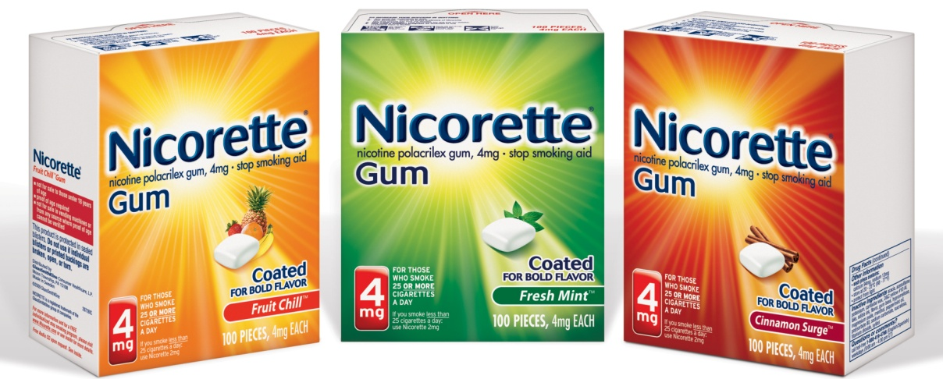
NICOTINE GUM
Nicorette (GlaxoSmithKline); generics
Resin complex
  Nicotine
  Polacrilin
Sugar-free chewing gum base
Contains buffering agents to enhance buccal absorption of nicotine
Available: 2 mg, 4 mg; original, cinnamon, fruit, mint (various), and orange flavors
Notes:
64
FDA approved: 1984
Switched to OTC status: 1996
Available strengths: 2 mg, 4 mg (for persons who smoke heavily)
Available flavors: Nicorette gum: original; mint (released 1998); FreshMint (coated formulation, released 2005); Fruit Chill (coated formulation, released 2006); Cinnamon Surge (coated formulation, released 2007); White Ice Mint (coated formulation, released 2008). Generic gum: original; mint; coated-mint, orange (previously available as Nicorette Orange; discontinued by GlaxoSmithKline 12/2005)
Description of Product
Nicotine polacrilex (polé-ah-kril-ex) is a resin complex of nicotine and polacrilin in a sugar-free chewing gum base. The original flavor gum has a distinct, tobacco-like, slightly peppery taste. Newer, softer to chew formulations, in a variety of flavors, have been released over the years to increase palatability. All gum formulations contain buffering agents (sodium carbonate and sodium bicarbonate) to increase salivary pH, thereby enhancing buccal absorption of nicotine.
Clinical Efficacy (Fiore et al., 2008)
In a meta-analysis of 13 trials, nicotine gum was found to significantly improve quit rates compared to placebo. The effectiveness and abstinence rates at 6-months post-quit date are shown in the table below. The 4-mg gum is more efficacious than the 2-mg gum as a cessation aid in highly dependent smokers (Fiore et al., 2008).
Fiore MC, Jaén CR, Baker TB, et al. (2008). Treating Tobacco Use and Dependence: 2008 Update. Clinical Practice Guideline. Rockville, MD: U.S. Department of Health and Human Services. Public Health Service.

Slide 65
NICOTINE GUM: DOSING
Dosage based on current smoking patterns:
If patient smokes | Recommended strength
≥25 cigarettes/day | 4 mg
<25 cigarettes/day | 2 mg
Notes:
65
The dosage of nicotine gum is based on the patient’s current level of smoking:
Patients who smoke 25 cigarettes a day or more should use the 4-mg strength.
Patients who smoke fewer than 25 cigarettes a day should use the 2-mg strength.
When the 2-mg gum is used properly, ~0.9 mg of nicotine is absorbed from each piece (Benowitz et al., 1987). In comparison, approximately 1 mg of nicotine is absorbed from each cigarette (Benowitz & Jacob, 1984). Nicotine plasma levels are lower (~8 mcg/L) and peak approximately 30 minutes after chewing a 2-mg piece of nicotine gum compared to smoking a single cigarette with peak nicotine levels of ~26 mcg/L, which are achieved within 10 minutes (Schneider et al., 1996).
Benowitz NL, Jacob P III. (1984). Daily intake of nicotine during cigarette smoking. Clin Pharmacol Ther 35:499–504.
Benowitz NL, Jacob P, Savanapridi C. (1987). Determinants of nicotine intake while chewing nicotine polacrilex gum. Clin Pharmacol Ther 41:467–473.
Schneider NG, Lunell E, Olmstead RE, Fagerström KO. (1996). Clinical pharmacokinetics of nasal nicotine delivery. A review and comparison to other nicotine systems. Clin Pharmacokinet 31:65–80.

Slide 66
NICOTINE GUM: DOSING (cont’d)
Recommended Usage Schedule for Nicotine Gum
Weeks 1–6 | Weeks 7–9 | Weeks 10–12
1 piece q 1–2 h | 1 piece q 2–4 h | 1 piece q 4–8 h
DO NOT USE MORE THAN 24 PIECES PER DAY.
Notes:
66
Patients using nicotine gum are more likely to quit successfully if they chew the gum on a fixed schedule rather than as needed (Fiore et al., 2008). This slide shows the manufacturers’ recommended dosing schedule. During the initial 6 weeks of therapy, patients should chew one piece of gum every 1–2 hours while awake. In general, this amounts to at least nine pieces of gum daily. Patients can use additional pieces (up to the daily maximum of 24 pieces per day) if cravings occur between the scheduled doses. Persons who smoke heavily generally need more pieces to reduce their cravings.
Patients will gradually increase the interval between doses using the following schedule:
Weeks 7–9: 1 piece every 2–4 hours
Weeks 10–12: 1 piece every 4–8 hours
♪ Note to instructor(s): The goal of using nicotine gum is to slowly reduce the dependence on nicotine. The manufacturers’ recommended dosing schedule is designed to reduce nicotine cravings gradually.
♪ Note to instructor(s): Participants might ask about the use of long-term nicotine gum therapy (e.g., >12 weeks of treatment). Data from the Lung Health Study found that ~40% and 15% of subjects were still using nicotine gum 1 and 5 years after quitting, respectively, with no serious adverse effects (Murray et al, 1996). The Clinical Practice Guideline encourages eventual discontinuation of all cessation pharmacotherapy but does state that continued use of medications is “clearly preferable to a return to smoking with respect to health consequences” (Fiore, et al., 2008).
Fiore MC, Jaén CR, Baker TB, et al. (2008). Treating Tobacco Use and Dependence: 2008 Update. Clinical Practice Guideline. Rockville, MD: U.S. Department of Health and Human Services. Public Health Service.
Murray RP, Bailey WC, Daniels K, et al. (1996). Safety of nicotine polacrilex gum used by 3,094 participants in the Lung Health Study. Chest 109:438–445.

Slide 67
NICOTINE GUM:
DIRECTIONS for USE
Chew each piece very slowly several times
Stop chewing at first sign of peppery taste or slight tingling in mouth (~15 chews, but varies)
“Park” gum between cheek and gum (to allow absorption of nicotine across buccal mucosa)
Resume slow chewing when taste or tingle fades
When taste or tingle returns, stop and park gum in different place in mouth
Repeat chew/park steps until most of the nicotine is gone (taste or tingle does not return; generally 30 minutes)
Notes:
67
Nicotine gum is not like ordinary chewing gum. It is a specially formulated nicotine delivery system that must be chewed properly for optimal results. When chewed like ordinary gum, nicotine will be released rapidly from the polacrilin resin, possibly leading to adverse effects including hiccups, heartburn, or gastric upset.
♪ Note to instructor(s): Instruct participants to open the nicotine gum sample and follow along with the directions for use. This is an optional exercise. Current tobacco users, former tobacco users, and women who are pregnant or breast-feeding should not participate in exercises with active drug formulations. Consult with your university or organization to gain approval for the hands-on component of the training. Although the nicotine exposure from a few chews of the gum is negligible with very brief exposure, always use placebo products when possible. Alternatively, distribute pieces of sugarless chewing gum for participants to use in practicing the chew-park method.
Nicotine gum: Directions for use
Chew each piece of gum very slowly several times.
Stop chewing at the first sign of peppery taste or slight tingling sensation in the mouth. (This usually happens after about 15 chews, but it varies.)
“Park” the gum between the cheek and gum to allow absorption of nicotine across the buccal mucosa (mouth lining).
When the taste or tingling dissipates (generally about 1–2 minutes), slowly resume chewing.
When the taste or tingling returns, stop chewing and park the gum in a different place in the mouth. Parking the gum in different areas of the mouth will decrease the incidence of mucosal irritation.
The chew/park steps should be repeated until most of the nicotine is gone. At this point, the taste or tingling does not return. On average, each piece of gum lasts 30 minutes.
♪ Note to instructor(s): The number of chews necessary for the taste or tingling sensation generally ranges from 15 to 30 chews.

Slide 68
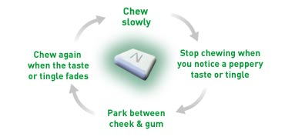
NICOTINE GUM:
CHEWING TECHNIQUE SUMMARY
Chew slowly
Stop chewing at first sign of peppery taste or tingling sensation
Chew again when peppery taste or tingle fades
Park between
cheek & gum
Notes:
68
The following is a review of proper chewing technique for nicotine gum:
Chew slowly.
Stop chewing at the first sign of a peppery taste or a slight tingling sensation.
Park the gum between the cheek and gum.
Chew again when the peppery taste or tingling sensation fades.
Repeat steps 1–4 until most of the nicotine is gone (taste or tingle won’t return; generally about 30 minutes).
The health care provider should stress the importance of proper gum chewing technique to increase the likelihood of success with this form of NRT.

Slide 69
NICOTINE GUM: ADDITIONAL PATIENT EDUCATION
To improve chances of quitting, use at least nine pieces of gum daily
The effectiveness of nicotine gum may be reduced by some foods and beverages:
    • Coffee • Juices
    • Wine • Soft drinks
Do NOT eat or drink for 15 minutes BEFORE or while using nicotine gum.
Notes:
69
To improve the chances of quitting, patients should use at least nine pieces of nicotine gum daily (one piece every 1–2 hours). Persons who smoke heavily genearlly need more pieces to reduce their cravings.
Emphasize that patients often do not use enough of the gum to derive benefit: They commonly chew too few pieces per day and/or shorten the length of treatment. For this reason, it may be preferable to recommend a fixed schedule of administration, tapering over 1–3 months (Fiore et al., 2008).
The effectiveness of nicotine gum may be reduced by some foods and drinks, such as coffee, juices, wine or soft drinks (Henningfield et al., 1990). Patients should be instructed not to eat or drink anything other than water for 15 minutes before or while using the nicotine gum.
To enhance buccal absorption, nicotine polacrilex is buffered to pH 8.5.
Acidic beverages might transiently reduce the pH of the saliva below that which is necessary for optimal buccal absorption of nicotine.
Fiore MC, Jaén CR, Baker TB, et al. (2008). Treating Tobacco Use and Dependence: 2008 Update. Clinical Practice Guideline. Rockville, MD: U.S. Department of Health and Human Services. Public Health Service.
Henningfield JE, Radzius A, Cooper TM, Clayton RR. (1990). Drinking coffee and carbonated beverages blocks absorption of nicotine from nicotine polacrilex gum. JAMA 264:1560–1564.

Slide 70
NICOTINE GUM:
ADD’L PATIENT EDUCATION (cont’d)
Chewing gum will not provide same rapid satisfaction that smoking provides
Chewing gum too rapidly can cause excessive release of nicotine, resulting in
  Lightheadedness
  Nausea and vomiting
  Irritation of throat and mouth
  Hiccups
  Indigestion
Notes:
70
Chewing the gum will not provide the same rapid satisfaction that smoking provides. Recall that buccal absorption of nicotine is far less rapid (peak nicotine concentrations are achieved within 30 minutes), compared to nicotine absorption from cigarette smoking (peak concentrations <10 minutes).
Patients should be warned that chewing the gum too rapidly can cause excessive release of nicotine and effects similar to those associated with smoking a cigarette too rapidly or those experienced by nonsmokers when they inhale from a cigarette for the first time:
Lightheadedness
Nausea and vomiting
Irritation of the throat and mouth
Hiccups
Indigestion

Slide 71
NICOTINE GUM:
ADD’L PATIENT EDUCATION (cont’d)
Side effects of nicotine gum include
  Mouth soreness
  Hiccups
  Dyspepsia
  Jaw muscle ache
Nicotine gum may stick to dental work
  Discontinue use if excessive sticking or damage to dental work occurs
Notes:
71
Side effects associated with nicotine gum include the following:
Mouth soreness
Hiccups
Dyspepsia
Jaw muscle ache
These side effects are more common during the first few days of therapy.
The consistency of nicotine gum (increased viscosity compared to ordinary chewing gum) may lead to increased adherence to dental work and may not be suitable for patients with the following:
Extensive restorations (fillings)
Bridges
Dentures
Caps or crowns
Braces
If excessive sticking or damage to dental work occurs, patients should discontinue use and consult a dentist.

Slide 72
NICOTINE GUM: SUMMARY
ADVANTAGES
  Might satisfy oral cravings.
  Might delay weight gain (4-mg strength).
  Patients can titrate therapy to manage withdrawal symptoms.
  A variety of flavors are available.
DISADVANTAGES
  Need for frequent dosing can compromise compliance.
  Might be problematic for patients with significant dental work.
  Patients must use proper chewing technique to minimize adverse effects.
  Gum chewing might not be socially acceptable.
Notes:
72
Advantages of nicotine gum include the following:
Might satisfy oral cravings.
Gum use (4-mg strength) might delay weight gain (Fiore et al., 2008).
Patients can titrate therapy to manage withdrawal symptoms.
A variety of flavors are available.
Disadvantages of the gum include the following:
Need for frequent dosing can compromise compliance.
Might be problematic for patients with significant dental work (e.g., gum might stick to dentures, braces, fillings, etc.)
Patients must use proper chewing technique to minimize adverse effects.
Gum chewing might not be socially acceptable.
Fiore MC, Jaén CR, Baker TB, et al. (2008). Treating Tobacco Use and Dependence: 2008 Update. Clinical Practice Guideline. Rockville, MD: U.S. Department of Health and Human Services. Public Health Service.

Slide 73
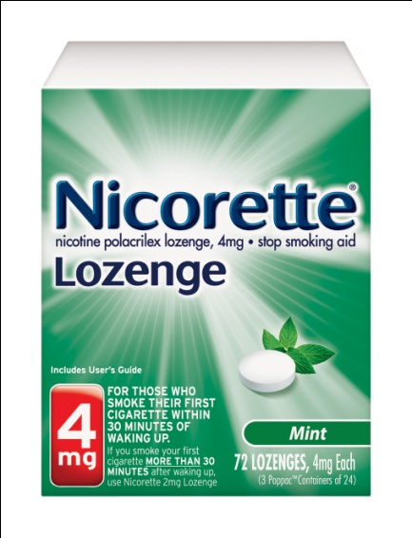
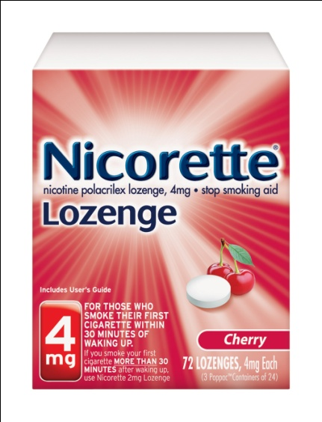
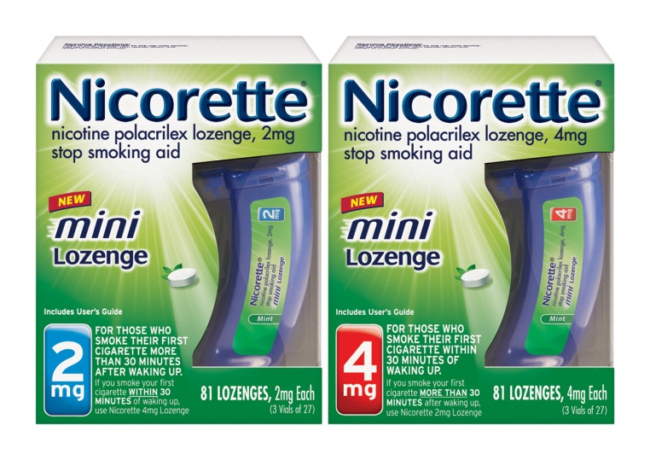
NICOTINE LOZENGE
Nicorette Lozenge and Nicorette Mini Lozenge (GlaxoSmithKline); generics
Nicotine polacrilex formulation
  Delivers ~25% more nicotine than equivalent gum dose
Sugar-free mint, cherry flavors
Contains buffering agents to enhance buccal absorption of nicotine
Available: 2 mg, 4 mg
Notes:
73
FDA approved for use without a prescription: 2002
Available strengths: 2 mg, 4 mg
Generic lozenge available: 2006; Nicorette Mini available: 2010
Available flavors:
Nicorette lozenge: mint; cherry. The “Commit” name is no longer used by GlaxoSmithKline (it was replaced with the Nicorette Lozenge), and the cappuccino flavor is no longer available.
Nicorette Mini lozenge: mint.
Generic lozenge: original; mint
Description of Product
Nicotine polacrilex (polé-ah-kril-ex) is a resin complex of nicotine and polacrilin in a sugar-free (contains aspartame) mint (various), cappuccino, or cherry flavored lozenge. The lozenge is meant to be consumed like hard candy or other medicinal lozenges (e.g., sucked and moved from side to side in the mouth until it dissolves). Because the nicotine lozenge dissolves completely, it delivers approximately 25% more nicotine than does an equivalent dose of nicotine gum (Choi et al., 2003). Like the nicotine gum, the lozenge also contains buffering agents (sodium carbonate and potassium bicarbonate) to increase salivary pH, thereby enhancing buccal absorption of the nicotine.
Clinical Efficacy (Fiore et al., 2008)
Data from a large randomized clinical trial suggest the nicotine lozenge improves quit rates significantly compared to placebo. The effectiveness at 6-months post-quit date are as follows:
The Nicorette Mini lozenge, released in Spring 2010, dissolves up to 3 times more rapidly than other nicotine lozenges, but does not work more rapidly in alleviating cravings. Marketing materials suggest that situational cravings can be alleviated in 5 minutes using the 4-mg lozenge (Nicorette Lozenge or Nicorette Mini Lozenge).
Choi JH, Dresler CM, Norton MR, Strahs KR. (2003). Pharmacokinetics of a nicotine polacrilex lozenge. Nicotine Tob Res 5:635–644.
Fiore MC, Jaén CR, Baker TB, et al. (2008). Treating Tobacco Use and Dependence: 2008 Update. Clinical Practice Guideline. Rockville, MD: U.S. Department of Health and Human Services. Public Health Service.

Slide 74
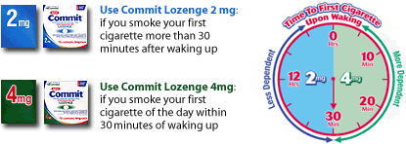
NICOTINE LOZENGE: DOSING
Dosage is based on the “time to first cigarette” (TTFC) as an indicator of nicotine dependence
Use the 2 mg lozenge:
If you smoke your first cigarette more than 30 minutes after waking
Use the 4 mg lozenge:
If you smoke your first cigarette of the day within 30 minutes of waking
Notes:
74
Unlike other forms of NRT, for which the number of cigarettes smoked per day is used as the basis for dosing, the recommended dosage of the nicotine lozenge is based on the time to first cigarette of the day (TTFC). Some experts believe that the best indicator of nicotine dependence is the need to smoke soon after waking (TTURC, 2007). Based on this method, individuals who smoke their first cigarette of the day within 30 minutes of waking are considered to be more highly dependent on nicotine than are those who smoke their first cigarette more than 30 minutes after waking. Because the nicotine lozenge has been studied in clinical trials using the TTFC as a dosage selector, the product is licensed for use in the following manner:
Patients who smoke their first cigarette of the day within 30 minutes of waking should use the
4-mg strength.
Patients who smoke their first cigarette of the day more than 30 minutes after waking should use the 2-mg strength.
Transdisciplinary Tobacco Use Research Center (TTURC) Tobacco Dependence Phenotype Workgroup. (2007). Time to first cigarette in the morning as an index of ability to quit smoking: implications for nicotine dependence. Nicotine Tob Res 9(Suppl 4):S555–70.

Slide 75
NICOTINE LOZENGE:
DOSING (cont’d)
Recommended Usage Schedule for the Nicotine Lozenge
Weeks 1–6 | Weeks 7–9 | Weeks 10–12
1 lozenge q 1–2 h | 1 lozenge q 2–4 h | 1 lozenge q 4–8 h
DO NOT USE MORE THAN 20 LOZENGES PER DAY.
Notes:
75
Patients using the nicotine lozenge are more likely to quit successfully if they use the lozenge on a fixed schedule rather than as needed. This slide shows the manufacturer’s recommended dosing schedule. During the initial 6 weeks of therapy, patients should suck on one lozenge every 1–2 hours (while awake). In general, this amounts to at least nine lozenges daily. Patients can use additional lozenges (up to 5 lozenges in 6 hours or a maximum of 20 lozenges per day) if cravings occur between the scheduled doses.
Patients should gradually increase the interval between doses using the following schedule:
Weeks 7–9: 1 lozenge every 2–4 hours
Weeks 10–12: 1 lozenge every 4–8 hours

Slide 76
NICOTINE LOZENGE:
DIRECTIONS for USE
Use according to recommended dosing schedule
Place in mouth and allow to dissolve slowly (nicotine release may cause warm, tingling sensation)
Do not chew or swallow lozenge.
Occasionally rotate to different areas of the mouth.
Standard lozenges will dissolve completely in about 20−30 minutes; Nicorette Mini lozenge will dissolve in 10 minutes.
Notes:
76
The nicotine lozenge is a specially formulated nicotine delivery system that must be used properly for optimal results. Although the nicotine lozenge is used like hard candy or other medicinal lozenges, if patients chew or swallow the lozenge or consume too many in a short period of time, they increase their likelihood experiencing adverse effects.
Nicotine lozenge: Directions for use
The lozenge should be used on a regular basis to reduce nicotine cravings and other withdrawal symptoms.
Allow the lozenge to dissolve slowly. When nicotine is released from the polacrilin resin, the patient may experience a warm, tingling sensation.
To reduce the risk of gastrointestinal side effects, the lozenge should not be chewed or swallowed.
The patient should occasionally rotate the lozenge to different areas of the mouth to minimize the potential for mucosal irritation.
On average, the standard lozenges will dissolve completely within 20–30 minutes. The Nicorette Mini lozenge dissolves in approximately 10 minutes.

Slide 77
NICOTINE LOZENGE: ADDITIONAL PATIENT EDUCATION
To improve chances of quitting, use at least nine lozenges daily during the first 6 weeks
The lozenge will not provide the same rapid satisfaction that smoking provides
The effectiveness of the nicotine lozenge may be reduced by some foods and beverages:
    • Coffee • Juices
    • Wine • Soft drinks
Do NOT eat or drink for 15 minutes BEFORE or while using the nicotine lozenge.
Notes:
77
To improve the chances of quitting, patients should use at least nine nicotine lozenges daily (one every 1–2 hours) during the first 6 weeks of treatment.
The nicotine lozenge will not provide the same rapid satisfaction that smoking provides. Peak nicotine concentrations achieved for the standard lozenge range from 30 to 60 minutes (Choi et al., 2003) and are significantly prolonged compared to cigarette smoking (peak concentrations <10 minutes). The Nicorette Mini lozenge dissolves more rapidly, but marketing materials suggest that situational cravings can be alleviated within 5 minutes and this is comparable to the standard lozenges.
The effectiveness of the nicotine lozenge may be reduced by some foods and beverages, such as coffee, juices, wine, or soft drinks. Patients should be instructed not to eat or drink for 15 minutes anything other than water before or while using the nicotine lozenge.
To enhance buccal absorption, nicotine polacrilex is buffered to an alkaline pH.
Acidic beverages might transiently reduce the pH of the saliva below that which is necessary for optimal buccal absorption of nicotine.
Choi JH, Dresler CM, Norton MR, Strahs KR. (2003). Pharmacokinetics of a nicotine polacrilex lozenge. Nicotine Tob Res 5:635–644.

Slide 78
NICOTINE LOZENGE:
ADD’L PATIENT EDUCATION (cont’d)
Side effects of the nicotine lozenge include
  Nausea
  Hiccups
  Cough
  Heartburn
  Headache
  Flatulence
  Insomnia
Notes:
78
Side effects associated with the nicotine lozenge include the following:
Nausea
Hiccups
Cough
Heartburn
Headache
Flatulence
Insomnia
Patients who use more than one lozenge at a time, continuously use one lozenge after another, or chew or swallow the lozenge are more likely to experience heartburn or indigestion.

Slide 79
NICOTINE LOZENGE: SUMMARY
ADVANTAGES
  Might satisfy oral cravings.
  Might delay weight gain (4-mg strength).
  Easy to use and conceal.
  Patients can titrate therapy to manage withdrawal symptoms.
  Several flavors are available.
DISADVANTAGES
  Need for frequent dosing can compromise compliance
  Gastrointestinal side effects (nausea, hiccups, and heartburn) may be bothersome.
Notes:
79
Advantages of nicotine lozenge include the following:
Might satisfy oral cravings.
Lozenge use (4-mg strength) might delay weight gain (Fiore et al., 2008).
Easy to use and conceal.
Patients can titrate therapy to manage withdrawal symptoms.
Several flavors are available.
Disadvantages of the gum include the following:
Need for frequent dosing can compromise compliance.
Gastrointestinal side effects (nausea, hiccups, and heartburn) may be bothersome.
Fiore MC, Jaén CR, Baker TB, et al. (2008). Treating Tobacco Use and Dependence: 2008 Update. Clinical Practice Guideline. Rockville, MD: U.S. Department of Health and Human Services. Public Health Service.

Slide 80
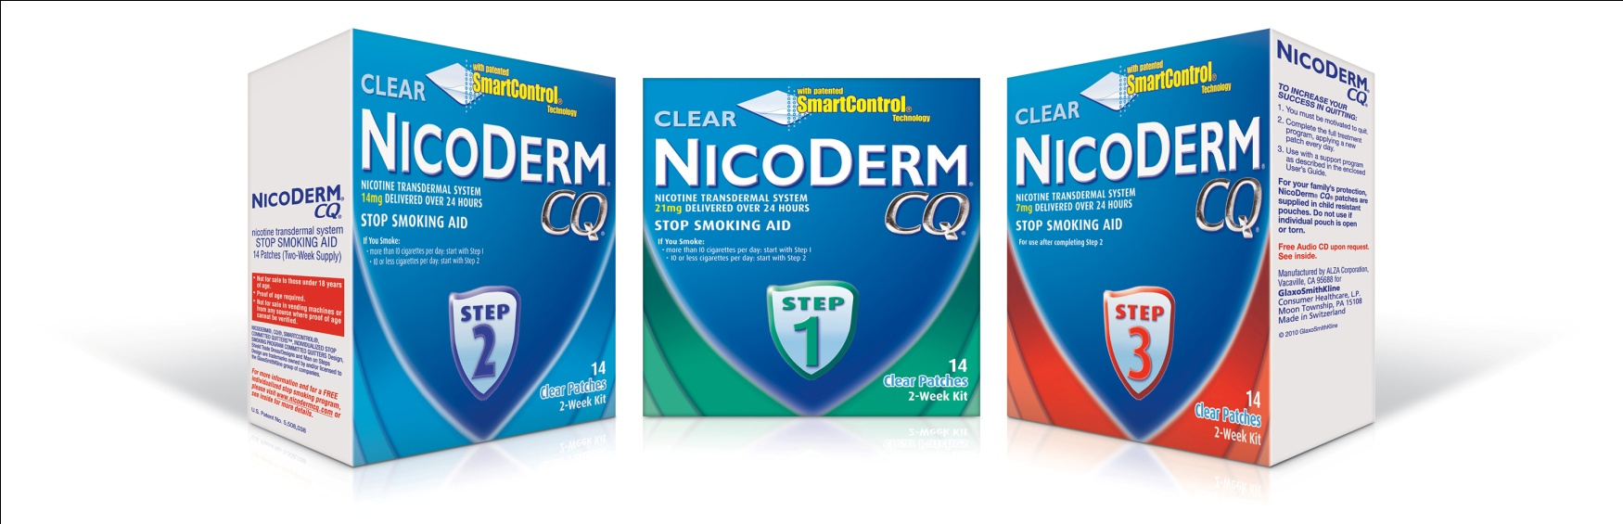
TRANSDERMAL NICOTINE PATCH
NicoDerm CQ (GlaxoSmithKline); generic
Nicotine is well absorbed across the skin
Delivery to systemic circulation avoids hepatic first-pass metabolism
Plasma nicotine levels are lower and fluctuate less than with smoking
Notes:
80
FDA approved: 1991
Available OTC: 1996
Description of Product
Transdermal nicotine delivery systems consist of an impermeable surface layer, a nicotine reservoir, an adhesive layer, and a removable protective liner. The technology for delivery of nicotine across the skin varies by manufacturer. NicoDerm uses a rate-controlling membrane. The generic patches (previously marketed as Habitrol) use drug-dispersion-type systems whereby release of nicotine is controlled by diffusion of the drug across an adhesive layer (Gore & Chien, 1998).
While the transdermal delivery technology varies by manufacturer, nicotine is well absorbed across the skin; 68–82% of the dose released from the patch reaches the systemic circulation. Plasma nicotine concentrations from the patch rise slowly over 1–4 hours and peak within 3–12 hours following application [Benowitz et al., 2009]. Blood levels of nicotine achieved with the transdermal patch are lower and fluctuate less than do those achieved with tobacco products or other NRT formulations.
Clinical Efficacy (Fiore et al., 2008)
In a meta-analysis of 25 trials, the transdermal nicotine patch was found to significantly improve quit rates compared to placebo. The effectiveness and abstinence rates at 6-months post-quit date are as follows:
Benowitz NL, Hukkanen J, Jacob P. (2009) Nicotine chemistry, metabolism, kinetics and biomarkers. Handb Exp Pharmacol: 29-60.
Fiore MC, Jaén CR, Baker TB, et al. (2008). Treating Tobacco Use and Dependence: 2008 Update. Clinical Practice Guideline. Rockville, MD: U.S. Department of Health and Human Services. Public Health Service.
Gore AV, Chien YW. (1998). The nicotine transdermal system. Clin Dermatol 16:599–615.

Slide 81
TRANSDERMAL NICOTINE PATCH:
PREPARATION COMPARISON
Product | NicoDerm CQ | Generic
Nicotine delivery | 24 hours | 24 hours
Availability | OTC | Rx/OTC
Patch strengths | 7 mg 14 mg 21 mg | 7 mg 14 mg 21 mg
Notes:
81
Products Available
NicoDerm CQ Patch^{OTC} (GlaxoSmithKline)
Switched to OTC status: August 1996
Availability: 7 mg, 14 mg, 21 mg (24-hour nicotine delivery system); also available in a clear formulation
Generic nicotine patch^{Rx,OTC} (formerly Habitrol Transdermal System)
Manufacturers:
OTC product (Novartis Consumer Health)
Rx product (Watson Pharmaceuticals)
Available OTC: November 1999
Availability: 7 mg, 14 mg, 21 mg (24-hour nicotine delivery system)
♪ Note to instructor(s): Novartis manufactures the OTC product but has sold the rights to a private- label company that is responsible for marketing and distributing the product for various retail pharmacies (e.g., Albertsons, CVS, Duane Reade, Kroger, Longs, Medicine Shoppe, Rite-Aid, Safeway, Walgreens, Wal-Mart). The product is labeled as Nicotine Transdermal System Step 1, Step 2, and Step 3.
♪ Note to instructor(s): Previously, Pfizer marketed the Nicotrol transdermal patch (5 mg, 10 mg, 15 mg; 16-hour nicotine delivery systems). This patch formulation was discontinued in 2005 and is no longer commercially available. Additionally, a fourth nicotine transdermal patch (11 mg, 22 mg; 24-hour nicotine delivery systems) utilizing a non-tapering 6-week regimen was available. The prescription product was originally marketed as Prostep (Lederle). In December 1998 the product was switched to OTC status and distributed to drug stores, grocery stores, and discount stores under a private label. This patch formulation was discontinued in 2003 and is no longer commercially available.

Slide 82
TRANSDERMAL NICOTINE PATCH: DOSING
Product | Light Smoker | Heavy Smoker
NicoDerm CQ | ≤10 cigarettes/day Step 2 (14 mg x 6 weeks) Step 3 (7 mg x 2 weeks) | >10 cigarettes/day Step 1 (21 mg x 6 weeks) Step 2 (14 mg x 2 weeks) Step 3 (7 mg x 2 weeks)
Generic (formerly Habitrol) | ≤10 cigarettes/day Step 2 (14 mg x 6 weeks) Step 3 (7 mg x 2 weeks) | >10 cigarettes/day Step 1 (21 mg x 4 weeks) Step 2 (14 mg x 2 weeks) Step 3 (7 mg x 2 weeks)
Notes:
82
The dosing schedules for the nicotine patches vary. In general, persons who smoke heavily require higher doses of nicotine. Although each of the currently-marketed formulations uses a tapering course of therapy, no evidence indicates that gradual weaning is more effective than abrupt discontinuation (Stead et al., 2008). Furthermore, 8 weeks of treatment appears to be as efficacious as longer durations (Stead et al., 2008). When patches applied for 16 hours (e.g., the previously-available Nicotrol patch) were compared to patches applied for 24 hours, no significant differences were found in quit rates (Stead et al., 2008). However, one study found that patients with strong morning cravings for cigarettes might have more success with a patch applied for 24 hours (Shiffman et al., 2000).
♪ Note to instructor(s): Some participants might ask about use of higher than recommended doses of transdermal nicotine for persons who smoke heavily. High-dose transdermal nicotine (44–63 mg/day) appears to be safe (Benowitz et al., 1998; Dale et al., 1995; Fredrickson et al., 1995; Hurt et al., 2003; Bars et al., 2006). However, trials evaluating higher doses of NRT have yielded conflicting results. Some studies suggest higher doses of NRT may be more effective in heavy smokers (Dale et al., 1995; Tonnesen et al., 1999; Bars et al., 2006), whereas others have demonstrated slight but not statistically significant improvements in cessation rates (Hughes et al., 1999; Jorenby et al., 1995) or no difference (Killen et al., 1999; Paoletti et al., 1996). When the results of six studies were pooled, the odds ratio for abstinence was 1.2 for high-dose NRT compared to conventional NRT (95% CI, 1.0–1.3), suggesting high-dose NRT therapy may be advantageous in some patients (Stead et al., 2008). This approach should be reserved for patients not able to quit using conventional doses of transdermal NRT.
♪ Note to instructor(s): The Clinical Practice Guideline does not recommend use of pharmacotherapy in patients smoking fewer than 10 cigarettes per day (light smokers), because of insufficient evidence of effectiveness (Fiore et al., 2008), yet the transdermal nicotine patch products gave FDA-approved labeling that includes dosing recommendations for patients smoking < 10 cigarettes per day.
Bars MP, Banauch GI, Appel D, Andreachi M, Mouren P et al. (2006). "Tobacco Free With FDNY": the New York City Fire Department World Trade Center Tobacco Cessation Study. Chest 129:979-987.
Benowitz NL, Zevin S, Jacob P, 3rd. (1998). Suppression of nicotine intake during ad libitum cigarette smoking by high-dose transdermal nicotine. J Pharmacol Exp Ther 287:958–962.
Dale LC, Hurt RD, Offord KP, Lawson GM. (1995). High-dose nicotine patch therapy; percentage of replacement and smoking cessation. JAMA 274:1353–1358.
Fredrickson PA, Hurt RD, Lee GM, et al. (1995). Safety and tolerability of high dose transdermal nicotine therapy for heavy smokers. Psychopharmacology 122:215–222.
Hughes JR, Lesmes GR, Hatsukami DK, et al. (1999). Are higher doses of nicotine replacement more effective for smoking cessation? Nicotine Tob Res 1:169–174.
Hurt RD, Krook JE, Croghan IT, et al. (2003). Nicotine patch therapy based on smoking rate followed by bupropion for prevention of relapse to smoking. J Clin Oncol 21:914–920.
Jorenby D, Smith SS, Fiore MC, et al. (1995). Varying nicotine patch dose and type of smoking cessation counseling. JAMA 274:1347–1352.
Killen JD, Fortmann SP, Davis L, Strausberg L, Varady A. (1999). Do heavy smokers benefit from higher dose nicotine patch therapy? Exp Clin Psychopharmacol 7:226–233.
Paoletti P, Fornai E, Maggiorelli F, Puntoni R, Viegi G, et al. (1996). Importance of baseline cotinine plasma values in smoking cessation: Results from a double-blind study with nicotine patch. Eur Respir J 9:643–651.
Shiffman S, Elash CA, Paton SM, et al. (2000). Comparative efficacy of 24-hour and 16-hour transdermal nicotine patches for relief of morning craving. Addiction 95:1185–1195.
Stead LF, Perera R, Bullen C, Mant D, Lancaster T. (2008). Nicotine replacement therapy for smoking cessation. Cochrane Database Syst Rev 1:CD000146.
Tonnesen P, Paoletti P, Gustavsson G, et al. (1999). Higher dosage nicotine patches increase one-year smoking cessation rates: Results from the European CEASE trial. Collaborative European Anti-Smoking Evaluation. European Respiratory Society. Eur Respir J 13:238–246.

Slide 83
TRANSDERMAL NICOTINE PATCH:
DIRECTIONS for USE
Choose an area of skin on the upper body or upper outer part of the arm
Make sure skin is clean, dry, hairless, and not irritated
Apply patch to different area each day
Do not use same area again for at least 1 week
Notes:
83
♪ Note to instructor(s): Instruct participants to remove the sample nicotine patch from the foil pouch and follow along with the directions for use. This is an optional exercise. Current tobacco users, former tobacco users, and women who are pregnant or breast-feeding should not participate in exercises with active drug formulations. Consult with your university or organization to gain approval for the hands-on component of the training. Although the nicotine exposure from this exercise is negligible, always use placebo products when possible. Alternatively, distribute samples of the nicotine patch for participants to handle but not apply.
♪ Note to instructor(s): Before distributing the patches during class, it is helpful to make a horizontal cut across the upper corner of the patch with scissors or clippers. This will allow the participants to quickly open the foil pouch during class. If this step is not performed before class, participants might be unable to open the child-resistant foil pouches.
Transdermal nicotine patch: Directions for use
Choose an area of skin on the upper body or the upper outer part of the arm.
To ensure that the patch will adhere well, make sure the skin is nonhairy, clean (not oily), dry, and free of creams, lotions, oils, or powder.
Do not apply the patch to skin that is inflamed, burned, broken out, or irritated in any way. These conditions may alter the amount of drug absorbed.
The patch should be applied to a different area each day.
To minimize the potential for local skin reactions, the same area should not be used again for at least 1 week.

Slide 84

TRANSDERMAL NICOTINE PATCH:
DIRECTIONS for USE (cont’d)
Remove patch from protective pouch
Peel off half of the backing from patch
Notes:
84
Transdermal nicotine patch: Directions for use (cont’d)
Remove the patch from the protective pouch (save pouch for later disposal of used patch).
Remove half of the protective liner from the patch. Try not to touch the exposed adhesive (i.e., the sticky side) because nicotine on hands can get into the eyes or nose and cause stinging or redness.

Slide 85
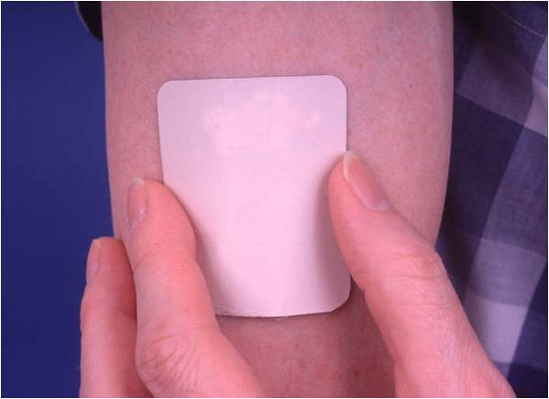
TRANSDERMAL NICOTINE PATCH:
DIRECTIONS for USE (cont’d)
Apply adhesive side of patch to skin
Peel off remaining protective covering
Press firmly with palm of hand for 10 seconds
Make sure patch sticks well to skin, especially around edges
Notes:
85
Transdermal nicotine patch: Directions for use (cont’d)
Immediately apply the sticky side of the patch to the skin.
Peel off the remaining half of the protective covering.
Press the patch firmly on the skin with the palm of the hand for 10 seconds.
Make sure the patch sticks well to the skin, especially around the edges. This is necessary to ensure a good seal.

Slide 86
TRANSDERMAL NICOTINE PATCH:
DIRECTIONS for USE (cont’d)
Wash hands: Nicotine on hands can get into eyes or nose and cause stinging or redness
Do not leave patch on skin for more than 24 hours—doing so may lead to skin irritation
Adhesive remaining on skin may be removed with rubbing alcohol or acetone
Dispose of used patch by folding it onto itself, completely covering adhesive area
Notes:
86
Transdermal nicotine patch: Directions for use (cont’d)
Wash hands after patch application, because nicotine on hands could get into the eyes or nose and cause stinging or redness.
After 24 hours, remove the old patch; the patch should not be left on the skin for more than 24 hours, because this may lead to skin irritation.
Any adhesive remaining on the skin may be removed with rubbing alcohol or acetone.
Dispose of a used patch by folding it onto itself, completely covering the adhesive area.

Slide 87
TRANSDERMAL NICOTINE PATCH:
ADDITIONAL PATIENT EDUCATION
Water will not harm the nicotine patch if it is applied correctly; patients may bathe, swim, shower, or exercise while wearing the patch
Do not cut patches to adjust dose
  Nicotine may evaporate from cut edges
  Patch may be less effective
Keep new and used patches out of the reach of children and pets
Remove patch before MRI procedures
Notes:
87
Water will not harm the nicotine patch if it is applied correctly. Patients may bathe, swim, shower, or exercise while wearing the patch.
Due to the high cost of nicotine patches, patients will often try to economize by cutting patches in half to save money. It is important to tell patients that they should not cut patches to adjust the dose. Nicotine in the patch may evaporate from the cut edges and the patch may be less effective.
Keep new and used patches out of the reach of children and pets.
Burns from nicotine patches worn during an MRI have been reported, and are likely caused by the metallic component in the backing of some patches. For this reason, the Institute for Same Medical Practices recommends that nicotine patches be removed prior to MRI procedures (Institute for Safe Medical Practices, 2004).
Institute for Safe Medical Practices. (2004, April 8). Burns in MRI patients wearing transdermal patches. Medication Safety Alert! 9(7). Retrieved October 9, 2008, from http://www.ismp.org/Newsletters/acutecare/articles/20040408.asp.

Slide 88
TRANSDERMAL NICOTINE PATCH:
ADD’L PATIENT EDUCATION (cont’d)
Side effects to expect in first hour:
  Mild itching
  Burning
  Tingling
Additional possible side effects:
  Vivid dreams or sleep disturbances
  Headache
Notes:
88
Shortly after applying the nicotine patch, patients may experience the following side effects:
Mild itching
Burning
Tingling
These effects are normal and should resolve within an hour.
Additional possible side effects include the following:
Vivid dreams or sleep disturbances. Patients should be advised to remove the patch at bedtime if this side effect becomes troublesome.
Headache

Slide 89
TRANSDERMAL NICOTINE PATCH:
ADD’L PATIENT EDUCATION (cont’d)
After patch removal, skin may appear red for 24 hours
  If skin stays red more than 4 days or if it swells or a rash appears, contact health care provider—do not apply new patch
Local skin reactions (redness, burning, itching)
  Usually caused by adhesive
  Up to 50% of patients experience this reaction
  Fewer than 5% of patients discontinue therapy
  Avoid use in patients with dermatologic conditions (e.g., psoriasis, eczema, atopic dermatitis)
Notes:
89
After removal, the skin under the patch may appear red for the next 24 hours.
If a skin rash develops after the use of a nicotine patch, or if the skin under the patch becomes swollen or very red, the patient should contact a health care professional. The patient should not apply a new patch.
Local skin reactions (redness, burning, itching)
These reactions are usually caused by irritation resulting from skin occlusion or from a reaction to the adhesives.
Up to 50% of patients experience local skin reactions.
Fewer than 5% of patients discontinue therapy:
Make certain patient is rotating patch application sites.
Consider different brand of patch. Each manufacturer uses different adhesives.
Consider treating skin reactions with OTC hydrocortisone cream (1%) or oral antihistamines.
Patients with dermatologic conditions (e.g., psoriasis, eczema, atopic dermatitis) are more likely to experience skin irritation and should not use the nicotine patch.

Slide 90
TRANSDERMAL NICOTINE PATCH: SUMMARY
ADVANTAGES
  Provides consistent nicotine levels.
  Easy to use and conceal.
  Once daily dosing associated with fewer compliance problems.
DISADVANTAGES
  Patients cannot titrate the dose to acutely manage withdrawal symptoms.
  Allergic reactions to the adhesive may occur.
  Patients with dermatologic conditions should not use the patch.
Notes:
90
Advantages of the nicotine patch include the following:
Provides consistent nicotine levels throughout the day.
Easy to use and conceal.
Once daily dosing associated with fewer compliance problems.
Disadvantages of the patch include the following:
Patients cannot titrate the dose to acutely manage withdrawal symptoms.
Allergic reactions to the adhesive may occur.
Patients with underlying dermatologic conditions (e.g., psoriasis, eczema, atopic dermatitis) should not use the patch because they are more likely to experience skin irritation.

Slide 91
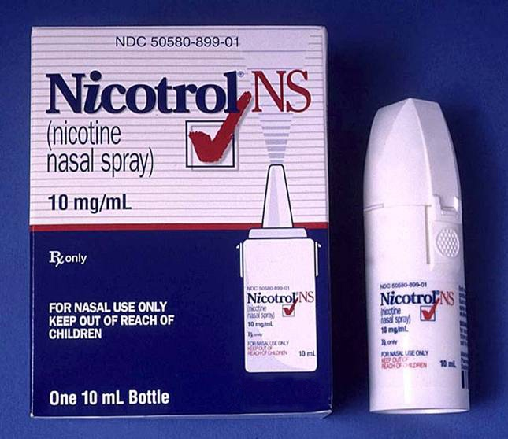
NICOTINE NASAL SPRAY
Nicotrol NS (Pfizer)
Aqueous solution of nicotine in a 10-ml spray bottle
Each metered dose actuation delivers
  50 mcL spray
  0.5 mg nicotine
~100 doses/bottle
Rapid absorption across nasal mucosa
Notes:
91
FDA approved: March 1996 (prescription only)
Description of Product
Nicotrol NS (nicotine nasal spray) is an aqueous solution of nicotine available in a metered-spray pump for administration to the nasal mucosa. Each actuation delivers a metered 50-µL spray containing 0.5 mg of nicotine. Each bottle contains approximately 100 doses (200 sprays) or about a 1-week supply (about 15 doses per day).
Nicotine is absorbed rapidly, and plasma nicotine concentrations attained via the nasal spray are comparable to (but lower than) those achieved by smoking. The nasal spray has a faster onset of action (t_{max} 11–13 minutes) compared to the gum, patch, or inhaler (Schneider et al., 1996).
Clinical Efficacy (Fiore, et al., 2008)
In a meta-analysis of four trials, the nicotine nasal spray was found to significantly improve quit rates compared to placebo. The effectiveness and abstinence rates at 6-months post-quit date are as follows:
Fiore MC, Jaén CR, Baker TB, et al. (2008). Treating Tobacco Use and Dependence: 2008 Update. Clinical Practice Guideline. Rockville, MD: U.S. Department of Health and Human Services. Public Health Service.
Schneider NG, Lunell E, Olmstead RE, Fagerström KO. (1996). Clinical pharmacokinetics of nasal nicotine delivery. A review and comparison to other nicotine systems. Clin Pharmacokinet 31:65–80.

Slide 92
NICOTINE NASAL SPRAY:
DOSING & ADMINISTRATION
One dose = 1 mg nicotine
  (2 sprays, one 0.5 mg spray in each nostril)
Start with 1–2 doses per hour
Increase prn to maximum dosage of 5 doses per hour or 40 mg (80 sprays; ~½ bottle) daily
For best results, patients should use at least 8 doses daily for the first 6–8 weeks
Termination:
  Gradual tapering over an additional 4–6 weeks
Notes:
92
Patients should be instructed to stop smoking completely while using the nicotine nasal spray.
One dose is 1 mg of nicotine—two sprays, one (0.5 mg spray) in each nostril. The recommended starting regimen is one or two doses per hour for 6–8 weeks. This may be increased up to a maximum recommended dose of 40 mg/day (80 sprays, about half a bottle).
For best results, patients should be encouraged to use at least the recommended minimum of 8 doses per day during the first 6–8 weeks of therapy. Less frequent administration may be less effective.
After 6–8 weeks, the dose should be decreased gradually over an additional 4–6 weeks.
♪ Note to instructor(s): No tapering strategy has been shown to be optimal in clinical studies. Many patients simply stopped using the spray at their last clinic visit. Strategies recommended by the manufacturer for discontinuing use include the following:
Use only half a dose (one spray) at a time.
Use the spray less frequently:
Skip a dose by not medicating every hour.
Keep a tally of daily usage, and try to meet a steadily reducing usage target.

Slide 93
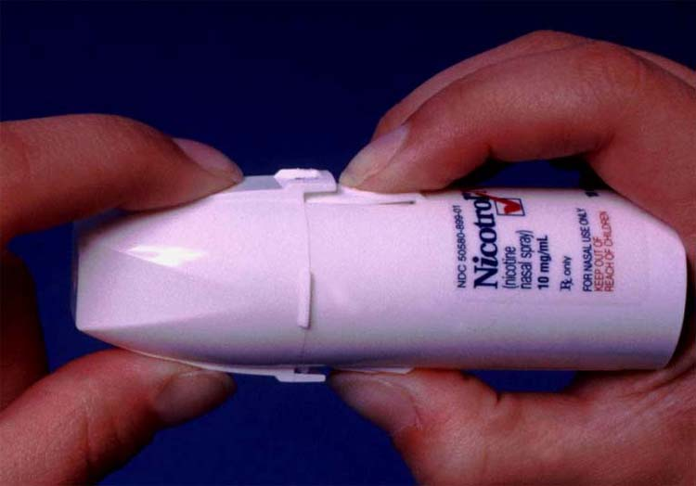
NICOTINE NASAL SPRAY: DIRECTIONS for USE
Press in circles on sides of bottle and pull to remove cap
Notes:
93
♪ Note to instructor(s): Demonstrate for participants, using nicotine nasal spray sample or placebo. Pass around sample for class to see and handle. Participants should NOT use this prescription product.
Nicotine nasal spray: Directions for use
Remove the cap. Using your thumb and index finger, press in on the circles on the sides of the bottle. Pull off the cap. Note: This child-resistant cap can be very difficult to remove. It is important to press firmly on the circles on the side of the bottle to unlock the cap.

Slide 94
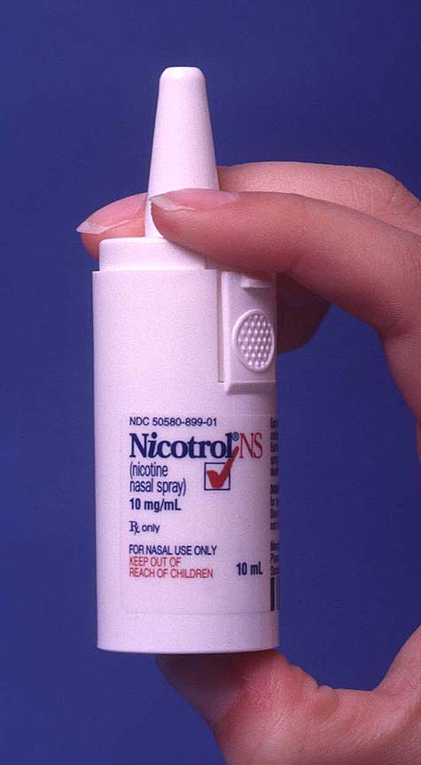
NICOTINE NASAL SPRAY: DIRECTIONS for USE (cont’d)
Prime the pump (before first use)
  Re-prime (1-2 sprays) if spray not used for 24 hours
Blow nose (if not clear)
Tilt head back slightly and insert tip of bottle into nostril as far as comfortable
Breathe through mouth, and spray once in each nostril
Do not sniff or inhale while spraying
Notes:
94
Nicotine nasal spray: Directions for use (cont’d)
Before using the nasal spray for the first time, the pump must be primed. This is done by actuating the device into a tissue:
Obtain a facial tissue or paper towel.
Hold the bottle and press firmly on the glass bottom of the unit with thumb.
Pump into the tissue until a fine spray is visible (about 6–8 times). The tissue should be discarded after use.
If the pump is not used for 24 hours, it should be primed into a tissue 1–2 times. To minimize drug wastage, avoid excessive priming.
Before using the spray, blow nose if it is not clear.
Tilt head back slightly and insert the tip of the bottle into the nostril as far as is comfortable.
Breathe through the mouth, and spray once in each nostril.
Do not sniff, swallow, or inhale through the nose while administering the medication because this increases the irritating effects of the spray.

Slide 95
NICOTINE NASAL SPRAY:
DIRECTIONS for USE (cont’d)
If nose runs, gently sniff to keep nasal spray in nose
Wait 2–3 minutes before blowing nose
Wait 5 minutes before driving or operating heavy machinery
  Spray may cause tearing, coughing, and sneezing
Avoid contact with skin, eyes, and mouth
  If contact occurs, rinse with water immediately
  Nicotine is absorbed through skin and mucous membranes
Notes:
95
Nicotine nasal spray: Directions for use (cont’d)
If nose runs, gently sniff to keep nasal spray in the nose.
Wait 2–3 minutes before blowing nose to allow the nicotine to be absorbed across the nasal mucosa.
Because of the potential for tearing, coughing, and sneezing, wait 5 minutes before driving or operating heavy machinery.
Place the cap back on the bottle after use and avoid contact with skin, eyes, and mouth. If contact occurs, rinse immediately with water, because nicotine is readily absorbed across the skin and mucous membranes.

Slide 96
NICOTINE NASAL SPRAY:
ADDITIONAL PATIENT EDUCATION
What to expect (first week):
  Hot peppery feeling in back of throat or nose
  Sneezing
  Coughing
  Watery eyes
  Runny nose
Side effects should lessen over a few days
  Regular use during the first week will help in development of tolerance to the irritant effects of the spray
If side effects do not decrease after a week, contact health care provider
Notes:
96
What to expect during first week:
Hot peppery feeling in the back of the throat or nose
Sneezing
Coughing
Watery eyes
Runny nose
These adverse effects should lessen over a few days. Regular use during the first week will help the patient adapt to the irritant effects of the spray. Some investigators have found that with regular use during the first week, tolerance to the irritant effects of the spray develops (Benowitz et al., 1997). However, the irritant effects of the spray should not be minimized because nasal or airway reactions are common (Fiore et al., 2008):
94% of patients report moderate-to-severe irritation in the first 2 days of therapy.
81% still report nasal irritation (mild to moderate) after 3 weeks.
If side effects do not lessen after a week, the patient should contact his or her health care provider.
Benowitz NL, Zevin S, Jacob P. (1997). Sources of variability in nicotine and cotinine levels with use of nicotine nasal spray, transdermal nicotine and cigarette smoking. Br J Clin Pharmacol 43;259–267.
Fiore MC, Jaén CR, Baker TB, et al. (2008). Treating Tobacco Use and Dependence: 2008 Update. Clinical Practice Guideline. Rockville, MD: U.S. Department of Health and Human Services. Public Health Service.

Slide 97
NICOTINE NASAL SPRAY:
SUMMARY
ADVANTAGES
  Patients can easily titrate therapy to rapidly manage withdrawal symptoms.
DISADVANTAGES
  Need for frequent dosing can compromise compliance.
  Nasal/throat irritation may be bothersome.
  Higher dependence potential.
  Patients with chronic nasal disorders or severe reactive airway disease should not use the spray.
Notes:
97
Advantages of the nicotine nasal spray include the following:
The dose can be easily titrated to rapidly manage withdrawal symptoms.
Disadvantages of the nasal spray include the following:
Need for frequent dosing can compromise compliance.
The initial nasal or throat irritation can be bothersome; it may take up to 3 weeks for the patient to tolerate therapy.
The nicotine nasal spray has a higher dependence potential relative to other NRT formulations but a lower dependence potential relative to tobacco products. About 13–20% of patients continue to use the nicotine nasal spray for longer periods than recommended (6–12 months) (Fiore et al., 2008; Hajeck et al., 2007), and 5% use the spray at higher doses than recommended (Fiore et al., 2008).
Patients with chronic nasal disorders (e.g., rhinitis, polyps, sinusitis) or patients with severe reactive airway disease should not use the nicotine nasal spray because of the irritant effects of the spray. Asthma exacerbation has been noted in some patients after administration of nicotine nasal spray.
Fiore MC, Jaén CR, Baker TB, et al. (2008). Treating Tobacco Use and Dependence: 2008 Update. Clinical Practice Guideline. Rockville, MD: U.S. Department of Health and Human Services. Public Health Service.
Hajek P, McRobbie H, Gillison F. (2007). Dependence potential of nicotine replacement treatments: effects of product type, patient characteristics, and cost to user. Prev Med 44:230–234.

Slide 98
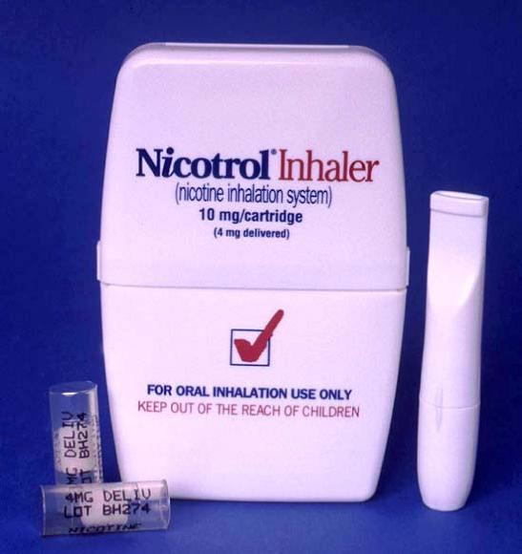
NICOTINE INHALER
Nicotrol Inhaler (Pfizer)
Nicotine inhalation system consists of:
  Mouthpiece
  Cartridge with porous plug containing 10 mg nicotine and 1 mg menthol
Delivers 4 mg nicotine vapor, absorbed across buccal mucosa
Notes:
98
FDA approved: May 1997 (prescription only)
Description of Product
The Nicotrol Inhaler (nicotine inhalation system) consists of a mouthpiece and a plastic cartridge delivering 4 mg of nicotine as an inhaled vapor from a porous plug containing 10 mg of nicotine and 1 mg of menthol (Pfizer, 2010). Menthol is added to decrease the irritant effects of nicotine (Schneider et al., 2001).
Given that the usual pack-a-day smoker repeats the hand-to-mouth motion up to 200 times per day or 73,000 times each year, it is not surprising that many smokers find they miss the physical manipulation of the cigarette and associated behaviors that go with smoking. The nicotine inhaler was designed to provide nicotine replacement in a manner similar to smoking while addressing the sensory and ritualistic factors important to many smokers (Schneider et al., 2001).
As a patient puffs on the inhaler mouthpiece, buccal nicotine vapor is released and delivers nicotine to the mouth and throat, where it is absorbed through the mucosa. Less than 5% of the nicotine in a dose reaches the lower respiratory tract. With an intensive inhalation regimen (80 puffs over 20 minutes), about 4 mg of nicotine is delivered and, of that, 2 mg is absorbed. Plasma nicotine levels are 50–70% lower than those achieved with cigarette smoking, and peak nicotine concentrations occur after 30 minutes, compared to 5 minutes after cigarette smoking (Schneider et al., 2001).
Clinical Efficacy (Fiore et al., 2008)
In a meta-analysis of six trials, the nicotine nasal spray was found to significantly improve quit rates compared to placebo. The effectiveness and abstinence rates at 6-months post-quit date are as follows:
Fiore MC, Jaén CR, Baker TB, et al. (2008). Treating Tobacco Use and Dependence: 2008 Update. Clinical Practice Guideline. Rockville, MD: U.S. Department of Health and Human Services. Public Health Service.
Pfizer Inc. (2010, January). Nicotrol Inhaler Package Insert. New York, NY.
Schneider NG, Olmstead RE, Franzon MA, Lunell E. (2001). The nicotine inhaler. Clinical pharmacokinetics and comparison with other nicotine treatments. Clin Pharmacokinet 40:661–684.

Slide 99
NICOTINE INHALER: DOSING
  Start with at least 6 cartridges/day during the first 3-6 weeks of treatment
    Increase prn to maximum of 16 cartridges/day
    In general, use 1 cartridge every 1-2 hours
  Recommended duration of therapy is 3 months
  Gradually reduce daily dosage over the following 6–12 weeks
Notes:
99
The initial dose for the inhaler should be individualized. Patients should titrate the dose to the level of nicotine that alleviates withdrawal symptoms. The best effects are achieved by frequent continuous puffing (20 minutes). In clinical trials, the average daily dose was more than 6 cartridges (range 3–18) for patients who successfully quit smoking.
Patients should start with at least 6 cartridges per day during the first 3–6 weeks of treatment and increase as needed to a maximum of 16 cartridges per day. In general, patients should use 1 cartridge every 1–2 hours during the initial 6 weeks of treatment.
The recommended duration of treatment is up to 3 months, after which patients may be weaned from the inhaler by gradual reduction of the daily dose over the following 6–12 weeks. The safety and efficacy of the continued use of nicotine inhaler for periods longer than 6 months have not been studied, and such use is not recommended.
Dosing recommendations are summarized below:
Duration Recommended cartridges/day
Initial treatment Up to 12 weeks 6–16
Gradual reduction 6–12 weeks No tapering strategy has been
(if needed) shown to be superior to any other in clinical studies.

Slide 100
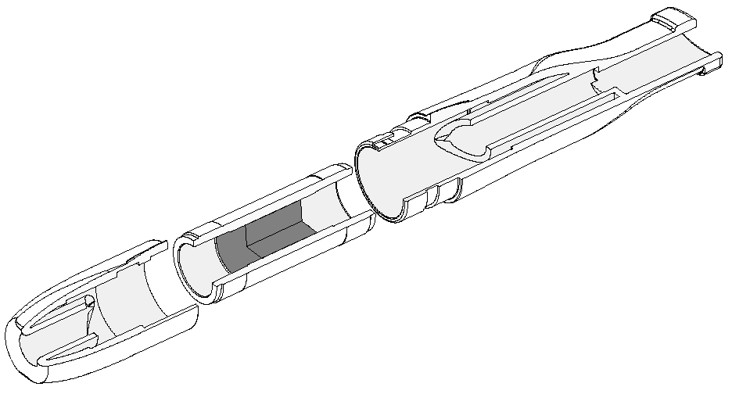
NICOTINE INHALER:
SCHEMATIC DIAGRAM
Air/nicotine mixture out
Sharp point that
breaks the seal
Aluminum laminate
sealing material
Sharp point that breaks the seal
Mouthpiece
Porous plug impregnated with nicotine
Nicotine cartridge
Air in
Reprinted with permission from Schneider et al. (2001). Clinical Pharmacokinetics 40:661–684. Adis International, Inc.
Notes:
100
This schematic diagram depicts the key components of the nicotine inhalation system. The nicotine inhaler consists of a two-piece plastic unit designed to deliver nicotine contained in individual cartridges. Each foil-sealed cartridge contains a porous plug impregnated with 10 mg of nicotine and 1 mg of menthol. Sharp spikes found on the interior of both mouthpiece components pierce the protective foil covering, allowing the release of nicotine vapor following inhalation.
Schneider NG, Olmstead RE, Franzon MA, Lunell E. (2001). The nicotine inhaler. Clinical pharmacokinetics and comparison with other nicotine treatments. Clin Pharmacokinet 40:661–684.

Slide 101
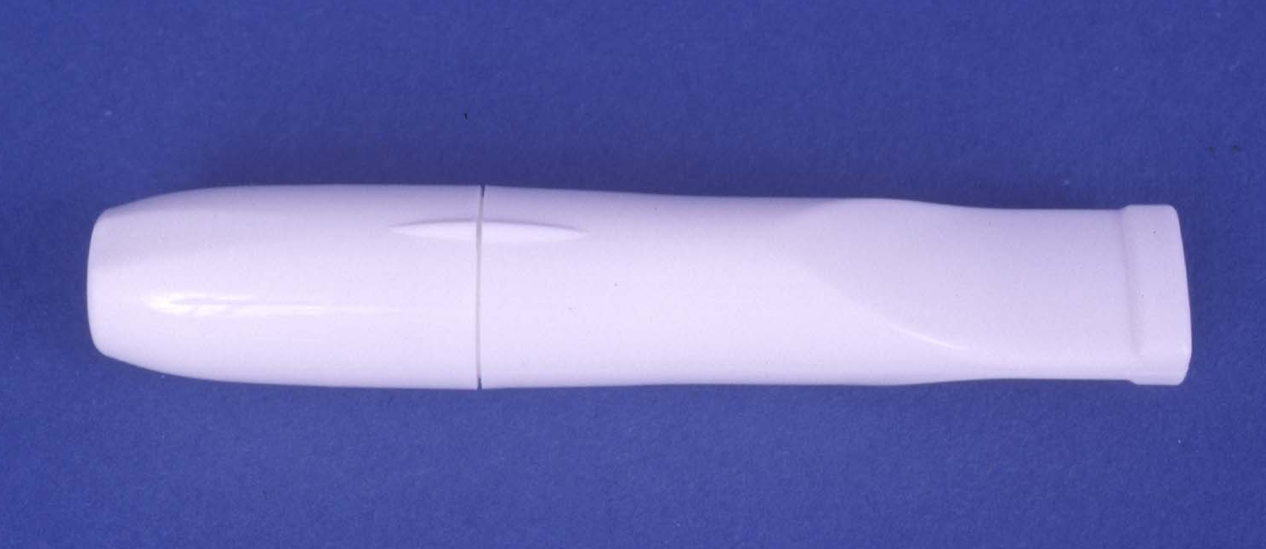
NICOTINE INHALER:
DIRECTIONS for USE
Align marks on the mouthpiece
Notes:
101
♪ Note to instructor(s): Demonstrate the use of inhaler with a placebo nicotine inhaler. Have each participant assemble and use a placebo inhaler unit.
♪ Note to instructor(s): The manufacturer has developed a short (1:39 min) video clip demonstrating proper use of the nicotine inhaler. The video clip can be accessed at the following link: http://www.nicotrol.com/nicotrol_demo.html
Nicotine inhaler: Directions for use
Align the marks on the mouthpiece.

Slide 102
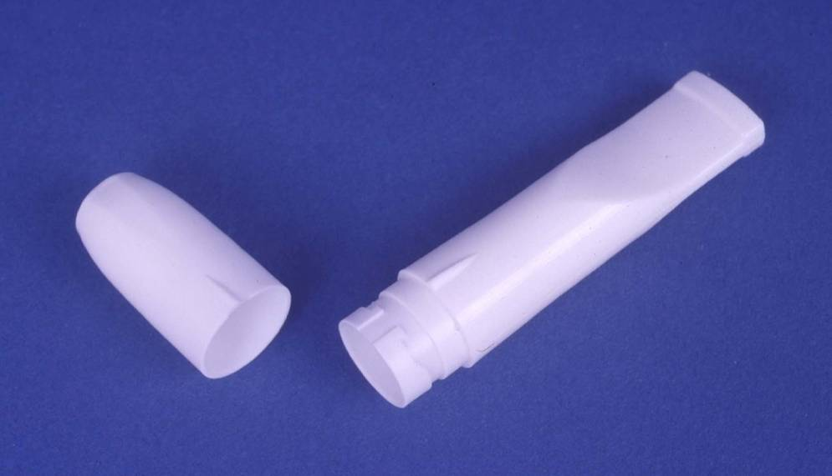
NICOTINE INHALER:
DIRECTIONS for USE (cont’d)
Pull and separate mouthpiece into two parts
Notes:
102
Nicotine inhaler: Directions for use (cont’d)
Pull and separate the mouthpiece into two parts.

Slide 103
NICOTINE INHALER:
DIRECTIONS for USE (cont’d)
Press nicotine cartridge firmly into bottom of mouthpiece until seal breaks
Notes:
103
Nicotine inhaler: Directions for use (cont’d)
Press the nicotine-containing cartridge firmly into the bottom of the mouthpiece until the seal breaks.

Slide 104
NICOTINE INHALER:
DIRECTIONS for USE (cont’d)
Put top on mouthpiece and align marks to close
Press down firmly to break top seal of cartridge
Twist top to misalign marks and secure unit
Notes:
104
Nicotine inhaler: Directions for use (cont’d)
Put the top on the mouthpiece and align the marks to close.
Press down firmly to break the top seal on the cartridge.
Twist the top piece to misalign the marks and secure the unit. The nicotine inhaler is now ready for use.

Slide 105
NICOTINE INHALER:
DIRECTIONS for USE (cont’d)
During inhalation, nicotine is vaporized and absorbed across oropharyngeal mucosa
Inhale into back of throat or puff in short breaths
Nicotine in cartridges is depleted after about 20 minutes of active puffing
  Cartridge does not have to be used all at once
  Open cartridge retains potency for 24 hours
Mouthpiece is reusable; clean regularly with mild detergent
Notes:
105
Nicotine inhaler: Directions for use (cont’d)
When inhaled or puffed through the mouthpiece, nicotine turns into a vapor that is absorbed across the oropharyngeal mucosa.
Inhale into the back of throat or puff in short breaths.
♪ Note to instructor(s): Patients should be instructed not to inhale into the lungs (like a cigarette) but to puff as if lighting a pipe. Deep inhalation into the lungs increases the delivery of nicotine and increases the incidence of adverse effects.
Nicotine in the cartridges is depleted after about 20 minutes of active puffing:
The 20-minute supply is not necessarily meant to be used at one time.
Patients can use the inhaler for just a few minutes, put it down, and then pick it up later and use it again for a total of 20 minutes of active puffing per cartridge (~ 80 puffs).
An open cartridge retains potency for 24 hours. Once opened, each cartridge, whether fully used or not, should be replaced after 24 hours.
The mouthpiece is reusable and should be cleaned regularly with a mild detergent and water.

Slide 106
NICOTINE INHALER:
ADDITIONAL PATIENT EDUCATION
Side effects associated with the nicotine inhaler include:
  Mild irritation of the mouth or throat
  Cough
  Headache
  Rhinitis
  Dyspepsia
Severity generally rated as mild, and frequency of symptoms declined with continued use
Notes:
106
When initiating treatment, local irritation of the mouth or throat (40%), cough (32%), headache (26%), rhinitis (23%) and dyspepsia (18%) may occur. The majority of patients rated cough and mouth and throat irritation symptoms as mild, decreasing with continued use (Fiore et al., 2008; Pfizer, 2008).
Other less common adverse effects include taste disturbances, nausea, diarrhea, and hiccups (Pfizer, 2005).
Fiore MC, Jaén CR, Baker TB, et al. (2008). Treating Tobacco Use and Dependence: 2008 Update. Clinical Practice Guideline. Rockville, MD: U.S. Department of Health and Human Services. Public Health Service.
Pfizer Inc. (2010, January). Nicotrol Inhaler Package Insert. New York, NY.

Slide 107
NICOTINE INHALER:
ADD’L PATIENT EDUCATION (cont’d)
The inhaler may not be as effective in very cold (<59°F) temperatures—delivery of nicotine vapor may be compromised
Use the inhaler longer and more often at first to help control cravings (best results are achieved with frequent continuous puffing over 20 minutes)
Effectiveness of the nicotine inhaler may be reduced by some foods and beverages
Do NOT eat or drink for 15 minutes BEFORE or while using the nicotine inhaler.
Notes:
107
Release of nicotine from the porous plug is dependent on the vapor pressure of nicotine, which is dependent on the air temperature passing through the plug. Under colder conditions (<59°F), less nicotine is delivered per puff. Conversely, under warmer conditions more nicotine is released per puff. However, nicotine plasma concentrations achieved using the inhaler in hot climates at maximal doses will not exceed levels normally achieved with smoking (Schneider et al., 2001).
Best results are achieved with frequent continuous puffing over 20 minutes. The inhaler should be used longer and more often at first to help control cigarette cravings. Less nicotine per puff is released from the inhaler compared to a cigarette.
The effectiveness of the nicotine inhaler may be reduced by some foods and beverages, such as coffee, juices, wine, or soft drinks. Therefore, patients should be instructed not to eat or drink anything other than water for 15 minutes before or while using the inhaler. Acidic beverages may transiently reduce the pH of the saliva below that necessary for optimal buccal absorption of nicotine.
Schneider NG, Olmstead RE, Franzon MA, Lunell E. (2001). The nicotine inhaler. Clinical pharmacokinetics and comparison with other nicotine treatments. Clin Pharmacokinet 40:661–684.

Slide 108
NICOTINE INHALER: SUMMARY
ADVANTAGES
  Patients can easily titrate therapy to manage withdrawal symptoms.
  The inhaler mimics the hand-to-mouth ritual of smoking.
DISADVANTAGES
  Need for frequent dosing can compromise compliance.
  Initial throat or mouth irritation can be bothersome.
  Cartridges should not be stored in very warm conditions or used in very cold conditions.
  Patients with underlying bronchospastic disease must use the inhaler with caution.
Notes:
108
Advantages of the nicotine inhaler include the following:
Patients can easily titrate therapy to manage withdrawal symptoms.
The inhaler mimics the hand-to-mouth ritual of smoking.
Disadvantages of the inhaler include the following:
Need for frequent dosing can compromise compliance.
Initial throat or mouth irritation (generally in first week) can be bothersome.
Cartridges should not be stored in conditions exceeding 77ºF or be used below 59ºF, because the delivery system may be compromised at temperatures outside this range.
Patients with underlying bronchospastic conditions should use the nicotine inhaler with caution. Other forms of NRT may be preferred for patients with severe bronchospastic airway disease (e.g., severe asthma or chronic obstructive pulmonary disease) because the nicotine vapor may be irritating and provoke bronchospasm.

Slide 109

BUPROPION SR
Zyban (GlaxoSmithKline); generic
Nonnicotine cessation aid
Sustained-release antidepressant
Oral formulation
Notes:
109
FDA approved for smoking cessation: May 1997 (prescription only), generic approved in 2004
Description of Product
Bupropion sustained-release (SR) tablets are an oral antidepressant medication used as a nonnicotine aid to smoking cessation (GlaxoSmithKline, 2010). The same chemical agent is marketed as Wellbutrin for use in treating depression.
Clinical Efficacy (Fiore et al., 2008)
In a meta-analysis of 24 trials, bupropion was found to significantly improve quit rates compared to placebo. The effectiveness and abstinence rates at 6-months post-quit date are as follows:
Fiore MC, Jaén CR, Baker TB, et al. (2008). Treating Tobacco Use and Dependence: 2008 Update. Clinical Practice Guideline. Rockville, MD: U.S. Department of Health and Human Services. Public Health Service.
GlaxoSmithKline Inc. (2010, September). Zyban Package Insert. Research Triangle Park, NC.

Slide 110
BUPROPION:
MECHANISM of ACTION
Atypical antidepressant thought to affect levels of various brain neurotransmitters
  Dopamine
  Norepinephrine
Clinical effects
  ↓ craving for cigarettes
  ↓ symptoms of nicotine withdrawal
Notes:
110
Bupropion is an atypical antidepressant thought to affect the levels of brain neurotransmitters (e.g., dopamine, norepinephrine). The purported mechanisms of action include blockade of neuronal re-uptake of dopamine and norepinephrine in the central nervous system and through antagonism of nicotinic acetylcholine receptors. The actions result in reduced craving for nicotine and symptoms of withdrawal (Fiore et al., 2008). Recall that the dopaminergic system is thought to play a role in self-reinforcing behavior (reward pathways) and dependence, whereas noradrenergic effects are thought to prevent the symptoms of nicotine withdrawal.
Fiore MC, Jaén CR, Baker TB, et al. (2008). Treating Tobacco Use and Dependence: 2008 Update. Clinical Practice Guideline. Rockville, MD: U.S. Department of Health and Human Services. Public Health Service.

Slide 111
BUPROPION:
PHARMACOKINETICS
Absorption
  Bioavailability: 5–20%
Metabolism
  Undergoes extensive hepatic metabolism (CYP2B6)
Elimination
  Urine (87%) and feces (10%)
Half-life
  Bupropion (21 hours); metabolites (20–37 hours)
Notes:
111
Absorption: Animal data suggest the absolute bioavailability of bupropion ranges from 5 to 20%.
Metabolism: Bupropion undergoes extensive hepatic metabolism to three active metabolites. One of the metabolites, hydroxybupropion, is formed by the cytochrome P450 isoenzyme CYP2B6.
Elimination: Bupropion and metabolites are eliminated in urine (87%) and feces (10%). Less than 1% of an oral dose of bupropion is excreted unchanged in urine.
Half-life: 21 hours (bupropion); 20–37 hours (metabolites). Steady-state plasma concentrations of bupropion and metabolites are reached within 5 and 8 days, respectively.
♪ Note to instructor(s): Because bupropion is extensively metabolized, drug interactions are possible, particularly with agents metabolized by the CYP2D6 isoenzyme including certain antidepressants (e.g., nortriptyline, imipramine, desipramine, paroxetine, fluoxetine, sertraline), antipsychotics (e.g., haloperidol, risperidone, thioridazine), beta-blockers (e.g., metoprolol), and Type 1C antiarrhythmics (e.g., propafenone, flecainide). Although bupropion is not metabolized by cytochrome CYP2D6, drug interactions are possible when bupropion is coadministered with drugs metabolized by this isoenzyme because bupropion and one of its metabolites (hydroxybupropion) are inhibitors of the CYP2D6 isoenzyme in vitro.
Drug Interactions
Levodopa (Dopar, Sinemet), amantadine (Symmetrel): Limited clinical data suggest a higher incidence of adverse experiences in patients receiving concurrent administration of bupropion with either levodopa or amantadine. Coadministration of bupropion to patients receiving levodopa should be undertaken with caution, using small initial doses and gradual dose increases.
Monoamine oxidase (MAO) inhibitors (isocarboxazid [Marplan]), phenelzine [Nardil], tranylcypromine [Parnate]): Animal data suggest the risk of acute bupropion toxicity is increased with coadministration. Do not administer bupropion within 14 days of discontinuing an MAO inhibitor.
Drugs that lower the seizure threshold: Concurrent administration of bupropion and agents (e.g., antipsychotics, antidepressants, theophylline, systemic steroids) that lower the seizure threshold should be undertaken only with extreme caution.
GlaxoSmithKline Inc. (2010, September). Zyban Package Insert. Research Triangle Park, NC.

Slide 112
BUPROPION:
CONTRAINDICATIONS
Patients with a seizure disorder
Patients taking
  Wellbutrin, Wellbutrin SR, Wellbutrin XL
  MAO inhibitors in preceding 14 days
Patients with a current or prior diagnosis of anorexia or bulimia nervosa
Patients undergoing abrupt discontinuation of alcohol or sedatives (including benzodiazepines)
Notes:
112
Bupropion is contraindicated in patients with seizure disorders. Although seizures were not reported in the Zyban smoking cessation clinical trials, the incidence of seizures with the sustained-release formulation (Wellbutrin) used in the treatment of depression was 0.1% (i.e., 1/1,000) in patients without a previous history of seizures. Patients taking any form of medication that lowers the seizure threshold should not be given bupropion without close medical monitoring.
Bupropion is contraindicated in patients with a current or prior diagnosis of anorexia or bulimia nervosa because of a higher incidence of seizures noted in patients treated for bulimia with the immediate-release formulation of bupropion.
Bupropion is the active ingredient in Wellbutrin, Wellbutrin SR, and Wellbutrin XL, which are used in the treatment of depression, and in Zyban, which is used for tobacco cessation. These medications should not be used in combination because the incidence of seizures is dose related.
The concurrent administration of bupropion and a monoamine oxidase (MAO) inhibitor is contraindicated. Studies in animals demonstrate that the acute toxicity of bupropion is enhanced by the MAO inhibitor phenelzine. At least 14 days should elapse between discontinuation of an MAO inhibitor and initiation of treatment with bupropion.
Bupropion is contraindicated in patients undergoing abrupt discontinuation of alcohol or sedatives, including benzodiazepines.
♪ Note to instructor(s): Because the use of bupropion is associated with a dose-dependent risk of seizures, clinicians should not prescribe doses over 300 mg/day for smoking cessation. The manufacturers report seizure incidence rates (from antidepressant trials with Wellbutrin) of approximately 0.1% (1/1,000) in patients treated with300 mg/day. For more information about seizure incidence in patients being treated with bupropion SR (Zyban) for smoking cessation, please see the “Bupropion: Adverse Effects” slide in this module.
Predisposing factors that may increase the risk of seizure with bupropion use include history of head trauma or prior seizure, central nervous system tumor, the presence of severe hepatic cirrhosis and concomitant medications that lower the seizure threshold. The risk of seizure may be minimized if the total daily dose does not exceed 300 mg (the maximum recommended dose for smoking cessation) and the recommended daily dose (300 mg) is administered in divided doses (150 mg twice daily). No single dose should exceed 150 mg to avoid high peak concentrations of bupropion or its metabolites.
GlaxoSmithKline Inc. (2010, September). Zyban Package Insert. Research Triangle Park, NC.

Slide 113

BUPROPION:
WARNINGS and PRECAUTIONS
Neuropsychiatric symptoms and suicide risk
  Changes in mood (depression and mania)
  Psychosis/hallucinations/paranoia/delusions
  Homicidal ideation/hostility
  Agitation/anxiety/panic
  Suicidal ideation or attempts
  Completed suicide
Patients should stop bupropion and contact a health care provider immediately if agitation, hostility, depressed mood or changes in
thinking or behavior (including suicidal ideation) are observed
Notes:
113
In July 2009, the FDA mandated that the prescribing information for all bupropion-containing products include a black-boxed warning highlighting the risk of serious neuropsychiatric events, including but not limited to depression, suicidal ideation, suicide attempt and completed suicide. These additional warnings were based on post-marketing adverse event surveillance reports received by the FDA (FDA, 2009). Clinicians should be aware that patients with serious psychiatric illness (e.g., depression, schizophrenia, bipolar disorder) did not participate in the pre-licensing studies of bupropion SR for smoking cessation (GlaxoSmithKline, 2010).
All patients being treated with bupropion should be observed for neuropsychiatric symptoms including changes in behavior, hostility, agitation, depressed mood, and suicide-related events, including ideation, behavior, and attempted suicide. Patients should be advised to stop taking bupropion and contact a healthcare provider immediately if agitation, hostility, depressed mood, or changes in thinking or behavior that are not typical for the patient are observed, or if the patient develops suicidal ideation or suicidal behavior. In many post-marketing cases, resolution of symptoms after discontinuation of bupropion was reported, although in some cases the symptoms persisted; therefore, ongoing monitoring and supportive care should be provided until symptoms resolve (GlaxoSmithKline, 2009).
Food and Drug Administration (2009, July). Information for healthcare professionals: varenicline (marketed as Chantix) and bupropion (marketed as Zyban, Wellbutrin, and generics). Available at:
http://www.fda.gov/Drugs/DrugSafety/PostmarketDrugSafetyInformationforPatientsandProviders/DrugSafetyInformationforHeathcareProfessionals/ucm169986.htm. Accessed June 17, 2011.
GlaxoSmithKline Inc. (2010, September). Zyban Package Insert. Research Triangle Park, NC.

Slide 114
BUPROPION:
WARNINGS and PRECAUTIONS (cont’d)
Bupropion should be used with caution in the following populations:
  Patients with a history of seizure
  Patients with a history of cranial trauma
  Patients taking medications that lower the seizure threshold (antipsychotics, antidepressants, theophylline, systemic steroids)
  Patients with severe hepatic cirrhosis
  Patients with depressive or psychiatric disorders
Notes:
114
Bupropion should be used with extreme caution in patients with a history of seizure or cranial trauma, or in patients taking medications that may lower the seizure threshold (e.g., antipsychotics, antidepressants, theophylline, systemic steroids) (GlaxoSmithKline, 2009).
Bupropion also should be used with extreme caution in patients with severe hepatic cirrhosis (GlaxoSmithKline, 2009). In these patients a reduced frequency of dosing is required, because peak bupropion levels are substantially increased and accumulation is likely to occur to a greater extent than usual in such patients. The dose should not exceed 150 mg every other day in these patients.
As with most antidepressant agents, bupropion has a black-box warning that specifies that the drug should be used with caution in patients with major depressive disorder (both adult and pediatric) as these patients might experience worsening of their depression and/or the emergence of suicidal ideation and behavior (suicidality) or unusual changes in behavior. These effects tend to be more prevalent in children, adolescents, and young adults (ages 18-24 years). Prior to initiating treatment with bupropion, patients with depressive symptoms should be adequately screened to determine whether they are at risk for bipolar disorder (GlaxoSmithKline, 2009). It is advisable to consult with a psychiatrist before initiating bupropion therapy in a patient with depressive or psychiatric disorders.
GlaxoSmithKline Inc. (2010, September). Zyban Package Insert. Research Triangle Park, NC.

Slide 115
BUPROPION SR: DOSING
Patients should begin therapy 1 to 2 weeks PRIOR
to their quit date to ensure that therapeutic plasma levels of the drug are achieved.
Initial treatment
  150 mg po q AM x 3 days
Then…
  150 mg po bid
  Duration, 7–12 weeks
Notes:
115
Treatment with bupropion SR should be initiated while the patient is still smoking, because approximately 1 week of treatment is required to achieve steady-state blood levels. Patients should set a target quit date that falls within the first 2 weeks of treatment, generally in the second week (GlaxoSmithKline, 2009).
The starting dose of bupropion SR is one 150-mg tablet each morning for the first 3 days. If the initial dose is tolerated adequately, the dosage should be increased on day 4 to the recommended, maximum dosage of 300 mg/day, given as two 150-mg doses taken at least 8 hours apart. Doses above 300 mg/day should not be used.
The duration of therapy is recommended to be 7–12 weeks; however, some patients may benefit from extended treatment. Whether to continue treatment with bupropion for periods longer than 12 weeks (3 months) for smoking cessation must be determined for individual patients (GlaxoSmithKline, 2009). In some patients, maintenance treatment up to 12 months may be appropriate (Hays et al., 2003).
♪ Note to instructor(s): For patients experiencing side effects with the 300 mg/day regimen, data suggest that 150 mg/day is better tolerated and exhibits comparable long-term efficacy (Swan, 2003). Similarly, Hurt and colleagues (1997) found no significant difference in long-term (>6 months) abstinence rates between subjects randomized to 150 mg/day or 300 mg/day.
GlaxoSmithKline Inc. (2010, September). Zyban Package Insert. Research Triangle Park, NC.
Hays JT, Hurt RD, Rigotti NA, et al. (2001). Sustained-release bupropion for pharmacologic relapse prevention after smoking cessation. a randomized, controlled trial. Ann Intern Med 135:423–433.
Hurt RD, Sachs DP, Glover ED, et al. (1997). A comparison of sustained-release bupropion and placebo for smoking cessation. N Engl J Med 337:1195–1202.
Swan GE, McAfee T, Curry SJ, et al. (2003). Effectiveness of bupropion sustained release for smoking cessation in a health care setting: a randomized trial. Arch Intern Med 163:2337–2344.

Slide 116
BUPROPION:
ADVERSE EFFECTS
Common side effects include the following:
  Insomnia (avoid bedtime dosing)
  Dry mouth
Less common but reported effects:
  Tremor
  Skin rash
Notes:
116
Common side effects include insomnia (31–45%) and dry mouth (10–11%). These side effects usually lessen with continued use. Patients should be advised to avoid taking bupropion at bedtime.
Side effects that are less common but are associated with discontinuation of treatment include nervous system disturbances (3.4%; primarily tremors) and skin disorders (2.4%; primarily rashes) (GlaxoSmithKline, 2007).
♪ Note to instructor(s): While seizures are an important potential adverse effect associated with bupropion therapy, clinicians should know that the reported frequency of seizures with bupropion SR in clinical trials for smoking cessation is <0.1% (7 seizures among 8,000 bupropion-treated patients) (Hughes et al, 2007). While seizures are relatively rare, bupropion should be used with extreme caution in patients with a history of seizure, cranial trauma, patients receiving medications known to lower the seizure threshold, and patients with underlying severe hepatic cirrhosis (GlaxoSmithKline, 2007). For more information about seizure incidence in patients being treated with bupropion (Wellbutrin) as an antidepressant, please see the previous “Bupropion: Contraindications” slide in this module.
GlaxoSmithKline Inc. (2010, September). Zyban Package Insert. Research Triangle Park, NC.
Hughes JR, Stead LF, Lancaster T. (2007). Antidepressants for smoking cessation. Cochrane Database Syst Rev 1:CD000031.

Slide 117
BUPROPION:
ADDITIONAL PATIENT EDUCATION
Dose tapering not necessary when discontinuing treatment
If no significant progress toward abstinence by seventh week, therapy is unlikely to be effective
  Discontinue treatment
  Reevaluate and restart at later date
Notes:
117
Dose tapering of bupropion SR is not required when discontinuing treatment.
If a patient has not made significant progress toward abstinence by the seventh week of therapy with bupropion SR, he or she is unlikely to quit during that attempt and treatment should be discontinued. Patients who are unsuccessful should be evaluated to determine why they relapsed, and a new quit attempt should be encouraged when conditions are more favorable.

Slide 118
BUPROPION SR: SUMMARY
ADVANTAGES
  Easy to use oral formulation.
  Twice daily dosing might reduce compliance problems.
  Might delay weight gain
  Bupropion might be beneficial for patients with depression.
DISADVANTAGES
  The seizure risk is increased.
  Several contraindications and precautions preclude use in some patients.
Notes:
118
Advantages of bupropion SR include the following:
Easy to use oral formulation.
Twice daily dosing might reduce compliance problems.
Might delay weight gain
Bupropion SR might be beneficial for use in patients with coexisting depression.
Disadvantages of bupropion SR include the following:
The seizure risk is increased.
Several contraindications and precautions preclude use in some patients.

Slide 119
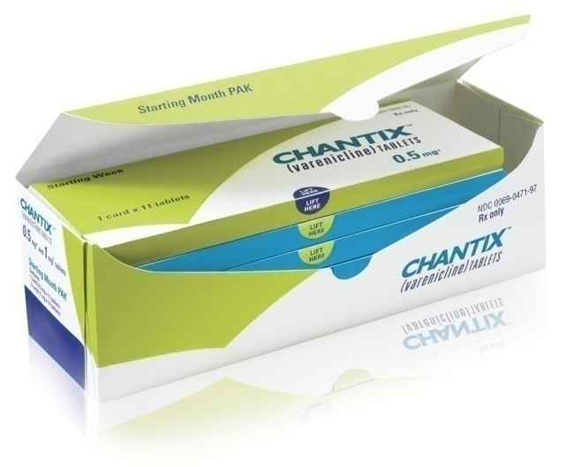
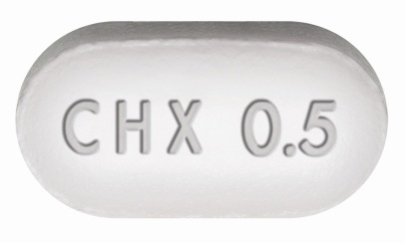
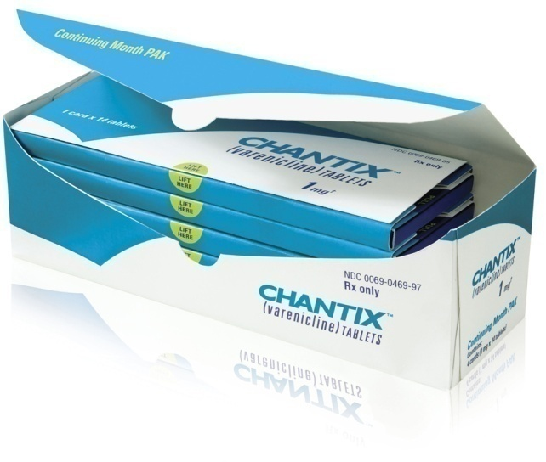
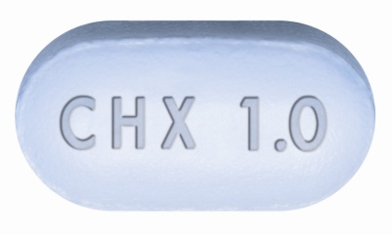
VARENICLINE
Chantix (Pfizer)
Nonnicotine cessation aid
Partial nicotinic receptor agonist
Oral formulation
Notes:
119
FDA approved for smoking cessation: May 11, 2006 (prescription only)
Description of Product (Pfizer, 2010)
Varenicline is a partial agonist selective for the α₄β₂ nicotinic acetylcholine receptor indicated for use as an aid to smoking cessation treatment.
Clinical Efficacy (Fiore et al., 2008)
In a meta-analysis of four trials, varenicline was found to significantly improve quit rates compared to placebo. The effectiveness and abstinence rates at 6-months post-quit date are as follows:
Fiore MC, Jaén CR, Baker TB, et al. (2008). Treating Tobacco Use and Dependence: 2008 Update. Clinical Practice Guideline. Rockville, MD: U.S. Department of Health and Human Services. Public Health Service.
Pfizer, Inc. (2010, April). Chantix Package Insert. New York, NY.

Slide 120
VARENICLINE:
MECHANISM of ACTION
Binds with high affinity and selectivity at α₄β₂ neuronal nicotinic acetylcholine receptors
  Stimulates low-level agonist activity
  Competitively inhibits binding of nicotine
Clinical effects
  ↓ symptoms of nicotine withdrawal
  Blocks dopaminergic stimulation responsible for reinforcement & reward associated with smoking
Notes:
120
Varenicline binds with high affinity and selectivity at α₄β₂ neuronal nicotinic acetylcholine receptors. The efficacy of varenicline in smoking cessation is believed to be the result of low-level agonist activity at the receptor site combined with competitive inhibition of nicotine binding. The partial agonist activity induces modest receptor stimulation that attenuates the symptoms of nicotine withdrawal. In addition, by blocking the ability of nicotine to activate α₄β₂ nicotinic acetylcholine receptors, varenicline inhibits the surges of dopamine release that are believed to be responsible for the reinforcement and reward associated with smoking (Coe, 2005; Foulds, 2006; Pfizer, 2008).
Coe JW, Brooks PR, Vetelino MG, et al. (2005). Varenicline: an alpha4beta2 nicotinic receptor partial agonist for smoking cessation. J Med Chem 48:3474–7.
Foulds J. (2006). The neurobiological basis for partial agonist treatment of nicotine dependence: varenicline. Int J Clin Pract 60:571–576.
Pfizer, Inc. (2010, April). Chantix Package Insert. New York, NY.

Slide 121
VARENICLINE:
PHARMACOKINETICS
Absorption
  Virtually complete after oral administration; not affected by food
Metabolism
  Undergoes minimal metabolism
Elimination
  Primarily renal through glomerular filtration and active tubular secretion; 92% excreted unchanged in urine
Half-life
  24 hours
Notes:
121
Absorption: absorption is virtually complete after oral administration, and oral bioavailability is unaffected by food or time-of-day dosing.
Metabolism: Varenicline undergoes minimal metabolism, with 92% excreted unchanged in the urine.
Elimination: Renal elimination of varenicline is primarily through glomerular filtration along with active tubular secretion possibly via the organic cation transporter, OCT2.
Half-life: ~24 hours; following administration of multiple oral doses of varenicline, steady-state conditions are reached within 4 days.
Pfizer, Inc. (2010, April). Chantix Package Insert. New York, NY.

Slide 122
VARENICLINE:
WARNINGS and PRECAUTIONS
Neuropsychiatric Symptoms and Suicidality
  Changes in mood (depression and mania)
  Psychosis/hallucinations/paranoia/delusions
  Homicidal ideation/hostility
  Agitation/anxiety/panic
  Suicidal ideation or attempts
  Completed suicide
Patients should stop varenicline and contact a health care provider immediately if agitation, hostility, depressed mood or changes in
thinking or behavior (including suicidal ideation) are observed
Notes:
122
In July 2009, the FDA mandated that the prescribing information for varenicline include a black-boxed warning highlighting the risk of serious neuropsychiatric events, including but not limited to depression, suicidal ideation, suicide attempt and completed suicide (FDA, 2010). These additional warnings were based on post-marketing adverse event surveillance reports received by the FDA which included changes in mood (including depression and mania), psychosis, hallucinations, paranoia, delusions, homicidal ideation, hostility, agitation, anxiety, and panic, as well as suicidal ideation, suicide attempt, and completed suicide. Some reported cases may have been complicated by the symptoms of nicotine withdrawal in patients who stopped smoking. However, some of these symptoms have occurred in patients taking varenicline who continued to smoke (Pfizer, 2010).
Clinicians should be aware that patients with serious psychiatric illness (e.g., depression, schizophrenia, bipolar disorder) did not participate in the pre-marketing studies of varenicline and the safety and efficacy of varenicline in such patients has not been established (Pfizer, 2010).
All patients being treated with varenicline should be observed for neuropsychiatric symptoms or worsening of pre-existing psychiatric illness including changes in behavior, hostility, agitation, depressed mood, and suicide-related events, including ideation, behavior, and attempted suicide. Patients should be advised to stop taking varenicline and contact a healthcare provider immediately if agitation, hostility, depressed mood, or changes in thinking or behavior that are not typical for the patient are observed, or if the patient develops suicidal ideation or suicidal behavior. In many postmarketing cases, resolution of symptoms after discontinuation of varenicline was reported, although in some cases the symptoms persisted; therefore, ongoing monitoring and supportive care should be provided until symptoms resolve (Pfizer, 2010).
Food and Drug Administration (2009, July). Information for healthcare professionals: varenicline (marketed as Chantix) and bupropion (marketed as Zyban, Wellbutrin, and generics). Available at: http://www.fda.gov/Drugs/DrugSafety/PostmarketDrugSafetyInformationforPatientsandProviders/DrugSafetyInformationforHeathcareProfessionals/ucm169986.htm. Accessed June 17, 2011.
Pfizer, Inc. (2010, April). Chantix Package Insert. New York, NY.

Slide 123
VARENICLINE:
WARNINGS and PRECAUTIONS (cont’d)
Cardiovascular adverse events in patients with existing cardiovascular disease
Hypersensitivity reactions
Serious skin reactions
Accidental injury
Nausea
Notes:
The following warnings and precautions are included in the varenicline prescribing information:
Cardiovascular Adverse Events in Patients with Existing Cardiovascular Disease
In June 2011, the FDA issued a drug safety communication notifying the public of a small, increased risk of cardiovascular events associated with varenicline use (1mg twice daily for 12 weeks) among patients with cardiovascular disease (FDA, 2011). This warning was issued subsequent to the review of a randomized placebo-controlled clinical trial of 700 smokers with stable, documented cardiovascular disease (other than, or in addition to, hypertension) (Rigotti et al., 2010). Overall, there was a low incidence of cardiovascular adverse events but certain events were reported more frequently among patients treated with varenicline (n=28) than among patients treated with placebo (n=17). These events include: angina pectoris, nonfatal myocardial infarction, need for coronary revascularization, and new diagnosis of peripheral vascular disease or admission for a procedure for the treatment of peripheral vascular disease. Per FDA recommendations, clinicians should be aware that smoking is an independent and major risk factor for cardiovascular disease, and smoking cessation is of particular importance in this patient population. The known benefits of varenicline should be weighed against its potential risks when deciding to use the medication in smokers with cardiovascular disease. Patients taking varenicline should contact their healthcare professional if they experience new or worsening symptoms of cardiovascular disease, such as shortness of breath or trouble breathing, new or worsening chest pain, or new or worse pain in legs when walking.
Angioedema and Hypersensitivity Reactions
Clinical signs included swelling of the face, mouth (tongue, lips, and gums), extremities, and neck (throat and larynx). There were infrequent reports of life-threatening angioedema requiring emergent medical attention due to respiratory compromise. Patients should be instructed to discontinue varenicline and immediately seek medical care if they experience these symptoms.
Serious Skin Reactions
Serious skin reactions, including Stevens-Johnson Syndrome and erythema multiforme have been reported. Patients should be instructed to stop taking varenicline and contact their healthcare provider immediately at the first appearance of a skin rash with mucosal lesions or any other signs of hypersensitivity.
Accidental Injury
There have been post-marketing reports of traffic accidents, near-miss incidents in traffic, or other accidental injuries in patients taking varenicline. In some cases, the patients reported somnolence, dizziness, loss of consciousness or difficulty concentrating that resulted in impairment, or concern about potential impairment, in driving or operating machinery. Patients should be advised to use caution driving or operating machinery or engaging in other potentially hazardous activities until they know how varenicline may affect them.
Nausea
Nausea is the most common adverse reaction, experience by up to 30% of patients. Dose reduction might be helpful.
Food and Drug Administration (2011, June). FDA Drug Safety Communication: Chantix (varenicline) may increase the risk of certain cardiovascular adverse events in patients with cardiovascular disease. Available at: http://www.fda.gov/Drugs/DrugSafety/ucm259161.htm. Accessed June 17, 2011.
Pfizer, Inc. (2010, April). Chantix Package Insert. New York, NY.
Rigotti NA, Pipe AL, Benowitz NL, Arteaga C, Garza D, Tonstad S. (2010). Efficacy and safety of varenicline for smoking cessation in patients with cardiovascular disease: a randomized trial. Circulation 121:221–229.

Slide 124


VARENICLINE: DOSING
Patients should begin therapy 1 week PRIOR to their
quit date. The dose is gradually increased to minimize treatment-related nausea and insomnia.
Treatment Day | Dose
Day 1 to day 3 | 0.5 mg qd
Day 4 to day 7 | 0.5 mg bid
Day 8 to end of treatment* | 1 mg bid
Initial dose titration
* Up to 12 weeks
Notes:
124
Treatment with varenicline should be initiated one week BEFORE the patient stops smoking. This dosing regimen allows for gradual titration of the dose to minimize treatment-related nausea and insomnia. The recommended dose of varenicline is 1mg bid (taken as one 1mg tablet in the morning and one 1mg tablet in the evening) following a 1-week titration as follows:
Treatment Day Dose
Days 1–3 0.5 mg qd
Days 4–7 0.5 mg bid
Weeks 2–12 1 mg bid
The manufacturer recommends that the dosage may be lowered temporarily or permanently for patients experiencing intolerable treatment-associated adverse effects. Patients should be treated with varenicline for 12 weeks. For patients who have successfully quit smoking at the end of 12 weeks, an additional course of 12 weeks may be appropriate to increase the likelihood of long-term abstinence.
♪ Note to instructor(s): Per the manufacturer’s prescribing information, the recommended dosage of varenicline for children, elderly patients, and individuals with impaired renal or hepatic function is as follows:
Use in children
Safety and effectiveness in pediatric patients have not been established; therefore, varenicline is not recommended for use in patients under 18 years of age.
Dosing in elderly patients and patients with impaired hepatic function
No dosage adjustment is necessary for patients with hepatic impairment. Because elderly patients are more likely to have decreased renal function, care should be taken in dose selection, and it may be useful to monitor renal function.
Patients with impaired renal function
No dosage adjustment is necessary for patients with mild to moderate renal impairment. For patients with severe renal impairment (estimated creatinine clearance <30 mL/min), the recommended starting dose is 0.5 mg once daily. Patients may then titrate as needed to a maximum dose of 0.5 mg twice a day. For patients with end-stage renal disease undergoing hemodialysis, a maximum dose of 0.5 mg once daily may be administered if tolerated well.
Pfizer, Inc. (2010, April). Chantix Package Insert. New York, NY.

Slide 125
VARENICLINE:
ADVERSE EFFECTS
Common (≥5% and 2-fold higher than placebo)
  Nausea
  Sleep disturbances (insomnia, abnormal dreams)
  Constipation
  Flatulence
  Vomiting
Notes:
125
Common side effects (≥5% and twice the rate observed in placebo-treated patients) include:
Nausea (30%)
Sleep disturbance (insomnia 18%; abnormal dreams 13%)
Constipation (8%)
Flatulence (6%)
Vomiting (5%)
♪ Note to instructor(s): Per the manufacturer’s prescribing information, nausea was the most common adverse event associated with varenicline treatment. Nausea was generally described as mild or moderate and often transient; however, for some subjects, it was persistent over several months. The incidence of nausea was dose-dependent. Initial dose titration was beneficial in reducing the occurrence of nausea. Approximately 3% of subjects receiving varenicline 1 mg bid discontinued treatment prematurely because of nausea. For patients with intolerable nausea, dose reduction should be considered.
Pfizer, Inc. (2010, April). Chantix Package Insert. New York, NY.

Slide 126
VARENICLINE:
ADDITIONAL PATIENT EDUCATION
Doses should be taken after eating, with a full glass of water
Nausea and insomnia are usually temporary side effects
  If symptoms persist, notify your health care provider
May experience vivid, unusual or strange dreams during treatment
Use caution driving or operating machinery until effects of quitting smoking with varenicline are known
Notes:
126
Doses should be taken after eating, with a full glass of water.
Nausea and insomnia are side effects that are usually temporary. However, if these symptoms persist, notify your provider so dosage reduction can be considered.
Patients should be informed that they may experience vivid, unusual or strange dreams during treatment with varenicline.
Patients should be advised to use caution driving or operating machinery until they know how quitting smoking with varenicline may affect them.
Pfizer, Inc. (2010, April). Chantix Package Insert. New York, NY.

Slide 127
VARENICLINE:
ADDITIONAL PATIENT EDUCATION (cont’d)
Stop taking varenicline and contact a health-care provider immediately if agitation, depressed mood, suicidal thoughts or changes in behavior are noted
Stop taking varenicline at the first sign of rash with mucosal lesions and contact a health-care provider immediately
Discontinue varenicline and seek immediate medical care if swelling of the face, mouth (lip, gum, tongue) and neck are noted
Notes:
127
If patients develop agitation, hostility, depressed mood, or changes in behavior or thinking that are not typical for them, or if patients develop suicidal ideation or behavior, they should be urged to discontinue varenicline and report these symptoms to their healthcare provider immediately.
Patients should be advised to stop taking varenicline at the first sign of rash with mucosal lesions or skin reaction and contact a health care provider immediately because serious skin reactions, such as Stevens Johnson Syndrome and Erythema Multiforme have been reported.
Patients should be instructed to discontinue varenicline and immediately seek medical care if they experience swelling of the face, mouth (lip, gum, tongue) and neck (larynx and pharynx) as these symptoms can lead to life threatening respiratory compromise.
Pfizer, Inc. (2010, April). Chantix Package Insert. New York, NY.

Slide 128
VARENICLINE: SUMMARY
ADVANTAGES
  Easy to use oral formulation.
  Twice daily dosing might reduce compliance problems.
  Offers a new mechanism of action for persons who have failed other agents.
DISADVANTAGES
  May induce nausea in up to one third of patients.
  Post-marketing surveillance data indicate potential for neuropsychiatric symptoms.
Notes:
128
Advantages of varenicline include the following:
Easy to use oral formulation.
Twice daily dosing might reduce compliance problems.
Varenicline offers a new mechanism of action for persons who previously failed using other medications.
Disadvantages of varenicline include the following:
The drug may induce nausea in up to one third of patients.
Post-marketing surveillance data indicate the potential for neuropsychiatric symptoms.

Slide 129
PHARMACOLOGIC METHODS: SECOND-LINE THERAPIES
Clonidine (Catapres transdermal or oral)
Nortriptyline (Pamelor oral)
Notes:
129
Second-line medications are efficacious for treating tobacco dependence but should not be used initially because (a) they are not FDA approved for tobacco cessation and (b) they have a greater incidence of adverse effects. For these reasons, clonidine and nortriptyline should be reserved for patients unable to use first-line medications (Fiore et al., 2008).
Clonidine (Catapres) is a centrally acting α₂-adrenergic agonist that reduces sympathetic outflow from the central nervous system. It is approved for use as an antihypertensive agent but is also effective in reducing the autonomic symptoms of both opioid and alcohol withdrawal. Studies of clonidine for smoking cessation have been inconsistent, but a recent meta-analysis of three trials concluded that clonidine was an effective agent for tobacco cessation. The estimated odds ratio for success with clonidine was 2.1 (95% CI, 1.2–3.7) relative to placebo (Fiore et al., 2008).
Side effects: The most commonly reported adverse effects include dry mouth, drowsiness, dizziness, sedation, and constipation. Given its antihypertensive properties, clonidine can be expected to lower blood pressure in most patients. Monitoring of blood pressure may be necessary.
Precautions and contraindications: Patients should be tapered off of clonidine (over 2–4 days), because abrupt termination might lead to rebound hypertension. It must be used with caution in patients who have reduced ventricular function, slow heart rate, or AV node conduction problems. FDA pregnancy class C drug.
Dosage regimen: Dosages for tobacco cessation have ranged from 0.15 to 0.75 mg/day orally and from 0.1 to 0.3 mg/day per day transdermally. The Clinical Practice Guideline recommends a starting dose of 0.1 mg orally twice daily or 0.1 mg/day transdermally, increasing by 0.10 mg/day per week as tolerated. The duration of therapy has varied across clinical trials, from 3 to 10 weeks. Available only by prescription.
Nortriptyline (Aventyl, Pamelor) is a tricyclic antidepressant with demonstrated efficacy for smoking cessation in four studies. The estimated odds ratio of quitting was 1.8 (95%, CI, 1.3–2.6) relative to placebo (Fiore et al., 2008).
Side effects: The primary side effects are sedation, dry mouth, blurred vision, urinary retention, lightheadedness, and tremor.
Precautions and contraindications: It must be used with caution in patients with underlying cardiovascular conditions due to the risk of arrhythmias and postural hypotension. FDA pregnancy class D drug.
Dosage regimen: The regimens studied for smoking cessation have typically started at a dose of 25 mg at bedtime, increasing gradually to a target dose of 75–100 mg/day for 6–10 weeks; most trials gradually tapered the dosage over an additional 1–2 weeks. Because the half-life of the drug is prolonged (up to 54 hours), therapy is initiated prior to the quit date to allow nortriptyline to reach therapeutic steady-state concentrations. In clinical trials, nortriptyline has been initiated 10–28 days before the quit date. Available only by prescription.
Fiore MC, Jaén CR, Baker TB, et al. (2008). Treating Tobacco Use and Dependence: 2008 Update. Clinical Practice Guideline. Rockville, MD: U.S. Department of Health and Human Services. Public Health Service.

Slide 130

HERBAL DRUGS for SMOKING CESSATION
Lobeline
  Derived from leaves of Indian tobacco plant (Lobelia inflata)
  Partial nicotinic agonist
  No scientifically rigorous trials with long-term follow-up
  No evidence to support use for smoking cessation
Illustration courtesy of Missouri Botanical Garden ©1995-2005. http://www.illustratedgarden.org/
Notes:
130
Although a variety of herbal and homeopathic products are available to aid cessation, data are lacking to support their safety and efficacy. Many herbal preparations for smoking cessation contain lobeline (Lobelia inflata), an herbal alkaloid with partial nicotinic agonist properties. Nonprescription, lobeline-containing products were banned by the FDA in 1993 due to a lack of efficacy. Although lobeline remains available as a dietary supplement, a meta-analysis found no evidence to support the role of lobeline as an aid for smoking cessation (Stead & Hughes, 1997). Studies of lobeline were largely uncontrolled and short-term (<6 months), and they used outcome measures such as the percentage reduction in the number of cigarettes smoked, rather than complete abstinence (Stead & Hughes, 1997). Likewise, nicobrevin (an herbal product not available in the United States containing quinine, menthyl valerate, camphor and eucalyptus oil) has not been proven effective for tobacco cessation (Stead & Lancaster, 2006).
♪ Note to instructor(s): Herbal smoking cessation medications containing lobeline include CigArrest, Smoke Away, and NicoRx.
Stead LF, Hughes JR. (1997). Lobeline for smoking cessation. Cochrane Database Syst Rev 3:CD000124.
Stead LF, Lancaster T. (2006). Nicobrevin for smoking cessation. Stead LF, Lancaster T. Cochrane Database Syst Rev 2:CD005990.

Slide 131
LONG-TERM (≥6 month) QUIT RATES for AVAILABLE CESSATION MEDICATIONS
23.9
20.2
18.0
19.0
15.8
16.1
17.1
Percent quit
11.3
11.8
11.2
10.3
9.9
8.1
9.1
Data adapted from Cahill et al. (2008). Cochrane Database Syst Rev; Stead et al. (2008).
Cochrane Database Syst Rev; Hughes et al. (2007). Cochrane Database Syst Rev
Notes:
131
This bar chart summarizes the long-term (≥6-month) quit rates observed with the different NRT products, bupropion SR and varenicline (Cahill et al., 2008; Stead et al., 2008; Hughes et al., 2007). These data derive from 145 different randomized-controlled trials; therefore, it is inappropriate to compare the active medications with respect to clinical efficacy. What this chart does illustrate, however, is that the quit rates from each of the methods is approximately twice that of its corresponding placebo control treatment arm.
Each of the pharmacotherapy options depicted in the chart is considered effective. When patients ask for assistance with their quit attempt, any product can be recommended, if not contraindicated. However, when assisting patients in choosing a product, clinicians should consider additional factors. The number of cigarettes smoked per day (or time to first cigarette, for the nicotine lozenge), level of dependence, advantages and disadvantages of each product, methods used for prior quit attempts and reasons for relapse, and the patient’s own product preference need to be considered. Behavioral counseling should be used in conjunction with all pharmacologic therapies.
Cahill K, Stead LF, Lancaster T. Nicotine receptor partial agonists for smoking cessation. (2008). Cochrane Database Syst Rev 3:CD006103.
Hughes JR, Stead LF, Lancaster. (2007). Antidepressants for smoking cessation. Cochrane Database Syst Rev 4:CD000031.
Stead LF, Perera R, Bullen C, Mant D, Lancaster T. (2008). Nicotine replacement therapy for smoking cessation. Cochrane Database Syst Rev 1:CD000146.

Slide 132
COMBINATION PHARMACOTHERAPY
Regimens with enough evidence to be ‘recommended’ first-line
Combination NRT
  Long-acting formulation (patch)
    Produces relatively constant levels of nicotine
  PLUS
  Short-acting formulation (gum, inhaler, nasal spray)
    Allows for acute dose titration as needed for nicotine withdrawal symptoms
Bupropion SR + Nicotine Patch
Notes:
132
While the use of first- and second-line medications approximately double the likelihood that a patient will successfully quit smoking, data from clinical trials suggest that only 19–33% of patients remain abstinent six months after quitting (Fiore et al, 2008). Given these low success rates, clinicians and researchers have explored modified approaches to standard therapies, including the use of combination therapy. Data from randomized, controlled trials suggest that certain combinations of first-line cessation medications are efficacious in promoting long-term abstinence . As such, the 2008 Clinical Practice Guideline considers the regimens indicated on the slide to be appropriate first-line therapy in patients attempting to quit smoking (Fiore et al., 2008).
Plasma levels of nicotine achieved with standard doses of NRT are generally much lower than those attained with regular smoking. As such, conventionally dosed NRT may deliver sub-therapeutic nicotine levels for some individuals, and in particular, for moderate-to-heavy smokers. Indeed, based on data from eight clinical trials, the 2008 Clinical Practice Guideline recommends that clinicians consider the use of combination pharmacotherapy as a first-line treatment approach for patients during a quit attempt (Fiore et al., 2008). Dual NRT regimens, which typically consist of a long-acting agent (e.g., nicotine patch) in combination with a short-acting formulation (i.e., gum, lozenge, inhaler, or nasal spray) are being increasingly used as initial therapy. The long-acting formulation, which delivers nicotine at relatively constant level, is used to prevent the onset of severe withdrawal symptoms while the short-acting formulation, which delivers nicotine at a more rapid rate, is used as needed to control withdrawal symptoms that may occur during potential relapse situations (e.g., after meals, during times of stress, when around other smokers).
Controlled trials suggest that the nicotine patch in combination with short-acting NRT formulations (i.e., gum, nasal spray, or inhaler) significantly increase quit rates relative to placebo (Fiore et al., 2008; Stead et al., 2008). Similar results have been observed in trials using combination therapy with sustained-release bupropion and the nicotine patch. More recent data suggest that aggressive combination regimens including triple agent NRT (e.g., inhaler, patch, and nasal spray) with or without sustained-release bupropion [Bars et al., 2006] and triple-combination therapy (e.g., patch, inhaler and sustained-release bupropion) [Steinberg et al., 2009] are a safe and effective treatment approach.
Clinicians should be aware that while the combination of the nicotine patch and sustained-release bupropion has been approved by FDA, the concurrent use of multiple NRT products is not FDA-approved for tobacco cessation. Furthermore, the optimal combinations, dosages, and duration of dual NRTs are currently unknown. Data concerning the safety and efficacy of varenicline-based combination regimens are conflicting. Data provided by the manufacturer suggest a higher incidence of adverse effects (nausea headache, vomiting, dizziness) among patients receiving varenicline and the nicotine patch compared to varenicline monotherapy (Pfizer, 2009). In contrast, preliminary data from Ebbert and colleagues suggest that varenicline in combination with sustained sustained-release bupropion or NRT is a potentially safe and effective treatment approach (Ebbert et al., 2009). Data from randomized, controlled trials of are needed before varenicline combination therapy can be routinely recommended as a therapeutic approach for smoking cessation.
Bars MP, Banauch GI, Appel D, et al. (2006). Tobacco Free with FDNY: The New York City Fire Department World Trade Center Tobacco Cessation Study. Chest 129: 979-987.
Ebbert JO, Burke MV, Hays JT, et al. (2009). Combination treatment with varenicline and nicotine replacement therapy. Nicotine Tob Res 11: 572-576.
Ebbert JO, Croghan IT, Sood A. et al. (2009). Varenicline and bupropion sustained-release combination therapy for smoking cessation. Nicotine Tob Res 11: 234-239.
Fiore MC, Jaén CR, Baker TB, et al. (2008). Treating Tobacco Use and Dependence: 2008 Update. Clinical Practice Guideline. Rockville, MD: U.S. Department of Health and Human Services. Public Health Service.
Pfizer, Inc. (2010, April). Chantix Package Insert. New York, NY.
Stead LF, Perera R, Bullen C, Mant D, Lancaster T. (2008). Nicotine replacement therapy for smoking cessation. Cochrane Database Syst Rev 1:CD000146.
Steinberg MB, Greenhaus S, Schmelzer AC, et al. (2009) Triple-combination pharmacotherapy for medically ill smokers: a randomized trial. Ann Intern Med 150: 447-454.

Slide 133
COMPLIANCE IS KEY to QUITTING
Promote compliance with prescribed regimens.
Use according to dosing schedule, NOT as needed.
Consider telling the patient:
  “When you use a cessation product it is important to read all the directions thoroughly before using the product. The products work best in alleviating withdrawal symptoms when used correctly, and according to the recommended dosing schedule.”
Notes:
133
Comprehensive counseling not only provides patients with information and social support for their quit attempts, but it also could improve the poor compliance rates commonly observed with treatment regimens for cessation (Hajek et al., 1999; Pierce & Gilpin, 2002; Schneider et al., 2003; Shiffman et al., 2008).
When counseling quitters for pharmacotherapy, particularly with short-acting forms of NRT, it is important to emphasize the need to use the products correctly and to adhere to the recommended dosing schedule. Patients who use more lozenges, for example, have been shown to be more likely to achieve abstinence (Shiffman et al., 2002).
Hajek P, West R, Foulds J, Nilsson F, Burrows S, Meadow A. (1999). Randomized comparative trial of nicotine polacrilex, a transdermal patch, nasal spray, and an inhaler. Arch Intern Med 159:2033–2038.
Pierce JP, Gilpin EA. (2002). Impact of over-the-counter sales on effectiveness of pharmaceutical aids for smoking cessation. JAMA 288:1260–1264.
Schneider MP, van Melle G, Uldry C, Huynh-Ba M, Fallab Stubi CL, Iorillo D, et al. (2003). Electronic monitoring of long-term use of the nicotine nasal spray and predictors of success in a smoking cessation program. Nicotine Tob Res 5:719–727.
Shiffman S, Dresler CM, Hajek P, Gilburt SJA, Targett DA, Strahs KR. (2002). Efficacy of a nicotine lozenge for smoking cessation. Arch Intern Med 162;1267–1276.
Shiffman S, Ferguson SG, Rohay J, Gitchell JG. (2008). Perceived safety and efficacy of nicotine replacement therapies among US smokers and ex-smokers: relationship with use and compliance. Addiction 103:1371–1378.

Slide 134
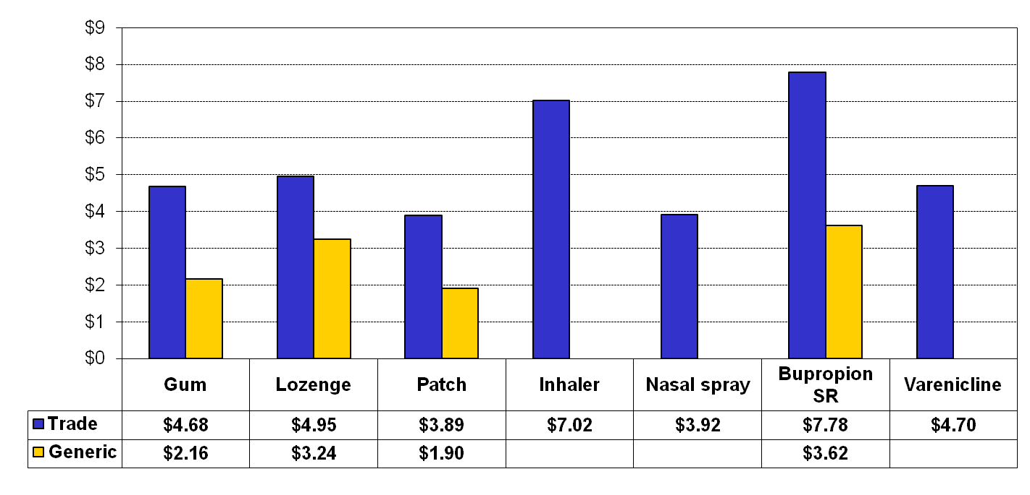
COMPARATIVE DAILY COSTS of PHARMACOTHERAPY
Average $/pack of cigarettes, $5.51
$/day
Notes:
134
This slide presents the approximate daily costs of treatment for the various pharmacotherapies for cessation. These are estimates* based on the recommended initial dosing for each agent. Costs can vary considerably depending on the patient’s level of smoking, degree of nicotine dependence, product selection (trade versus generic), and need for additional doses of short-acting NRT (gum, lozenge, nasal spray, or oral inhaler).
As a comparison, the cost for one pack of cigarettes (national average, approximately $5.51) is shown (Campaign for Tobacco-Free Kids, 2010). In general, the daily cost of pharmacotherapy approximates the cost of one pack of cigarettes. For more exact estimates, refer to the Pharmacologic Product Guide.
*Cost calculated using the most expensive average wholesale price (AWP) for each trade name agent and the least expensive AWP for each generic product (Medi-Span, 2009).
Campaign for Tobacco-Free Kids. (2010). “State Cigarette Excise Tax Rates & Rankings.” Retrieved June 17, 2010, from http://www.tobaccofreekids.org/research/factsheets/pdf/0097.pdf
Medi-Span Electronic Drug File. (2009, September). Indianapolis, IN: Wolters Kluwer Health.

Slide 135
The RESPONSIBILITY of
HEALTH PROFESSIONALS
It is inconsistent
to provide health care and
—at the same time—
remain silent (or inactive)
about a major health risk.
TOBACCO CESSATION
is an important component of THERAPY.
Notes:
As a final note, it is important to emphasize that it is inconsistent, and perhaps unethical, to provide health care and—at the same time—remain silent (or inactive) about a major health risk. Addressing tobacco use is an essential component of clinical care. Promoting tobacco cessation is, in itself, an important component of therapy—it has immediate payoff in terms of both health improvements and cost savings (Lightwood & Glantz, 1997).
The primary goal of the Rx for Change: Clinician-Assisted Tobacco Cessation program is to provide current and future health professionals with the knowledge and skills necessary to make an impact on the incidence of tobacco-related disease in the U.S. and abroad. Clinicians can make a difference (Fiore et al., 2008).
Fiore MC, Jaén CR, Baker TB, et al. (2008). Treating Tobacco Use and Dependence: 2008 Update. Clinical Practice Guideline. Rockville, MD: U.S. Department of Health and Human Services. Public Health Service.
Lightwood JM, Glantz SA. (1997). Short-term economic and health benefits of smoking cessation: Myocardial infarction and stroke. Circulation 96:1089–1096.

Slide 136
Address tobacco use with all patients.
At a minimum, make a commitment to incorporate brief tobacco interventions as part of routine patient care.
Ask, Advise, and Refer.
MAKE a COMMITMENT…
Notes:
In summary, then, it is recommended that all clinicians, at a minimum, make a commitment to incorporate brief tobacco interventions as part of their routine care with all patients. You can successfully intervene in five minutes in the context of a regular interaction with a patient. Should even that prove to be impractical, clinicians should ask patients about tobacco use, advise patients to quit, and refer patients to other resources for additional assistance.

Slide 137
DR. GRO HARLEM BRUNTLAND,
FORMER DIRECTOR-GENERAL of the WHO:
“If we do not act decisively, a hundred years from now our grandchildren and their children will look back and seriously question how people claiming to be committed to public health and social justice allowed the tobacco epidemic to unfold unchecked.”
USDHHS. (2001). Women and Smoking: A Report of the Surgeon General. Washington, DC: PHS.
Notes:
This quote, from Dr. Gro Harlem Bruntland, former Director-General of the World Health Organization, is the closing remark in the 2001 Surgeon General’s report on women and smoking (USDHHS, 2001). It appropriately emphasizes the urgency of the need for clinicians and other health professionals to take a more active role in countering tobacco use. According to Dr. Margaret Chan, Director-General of the World Health Organization, “Reversing this entirely preventable epidemic must now rank as a top priority for public health and for political leaders in every country of the world” (WHO, 2008).
U.S. Department of Health and Human Services (USDHHS). (2001). Women and Smoking: A Report of the Surgeon General. Washington, DC: Public Health Service.
World Health Organization (WHO). (2008). Report on the Global Tobacco Epidemic, 2008. The MPOWER package. Geneva, World Health Organization.

